Slide 1
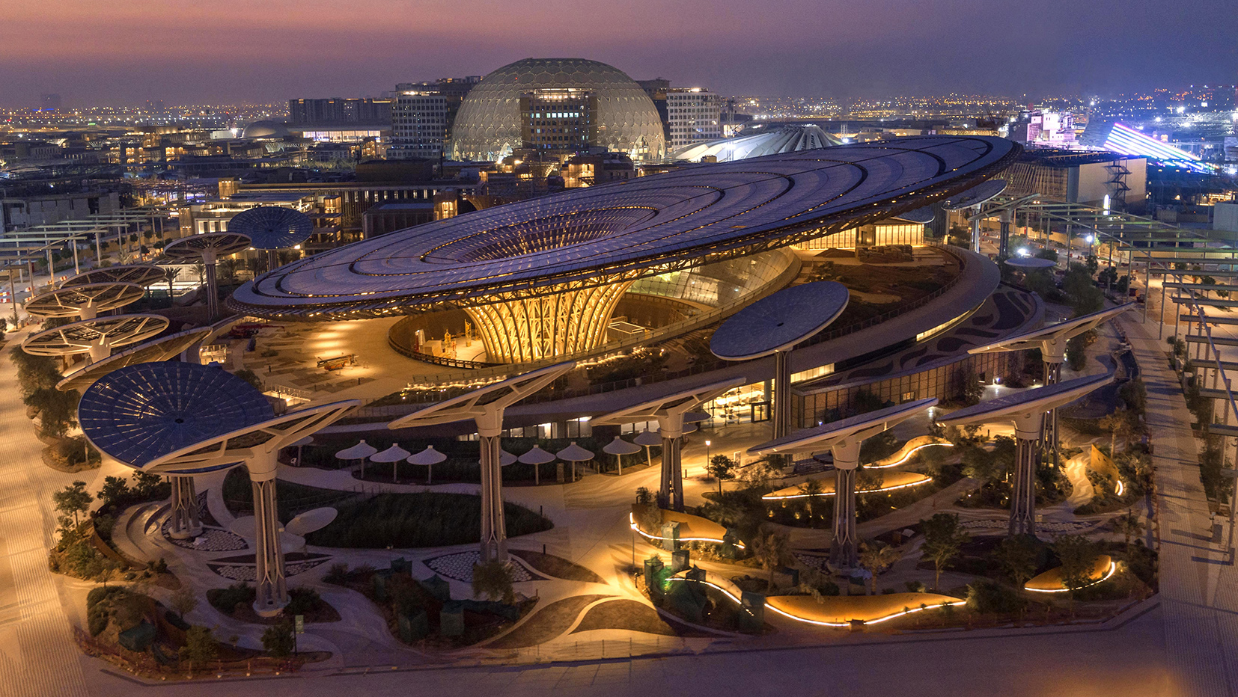

JOIN THE MAKING OF A NEW WORLD
EXPO 2020 DUBAI
1 OCTOBER 2021 – 31 MARCH 2022
ITINERARIES – EXPO JOURNEYS

Slide 2
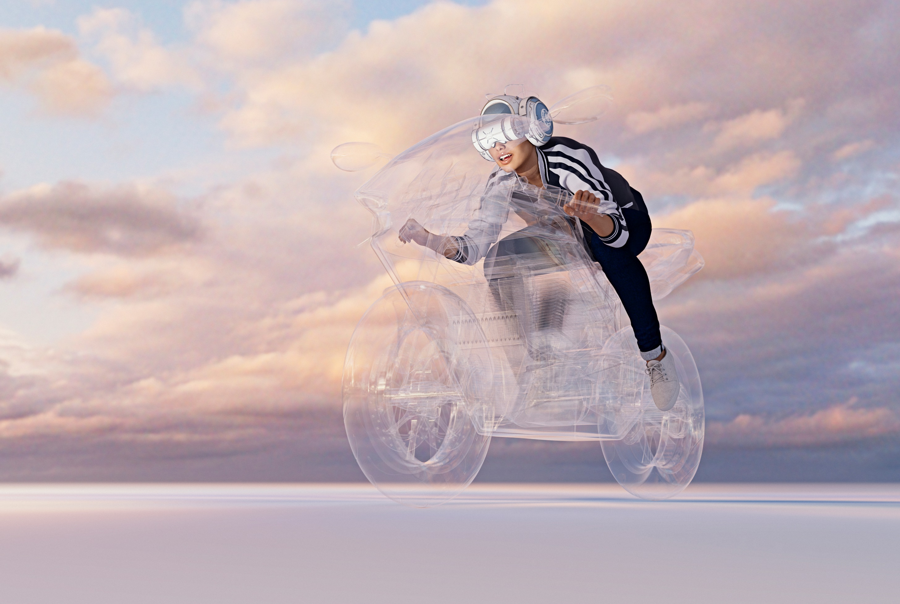


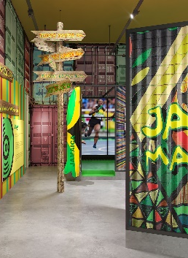



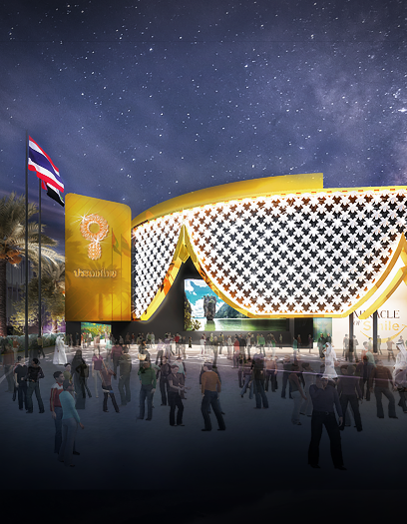
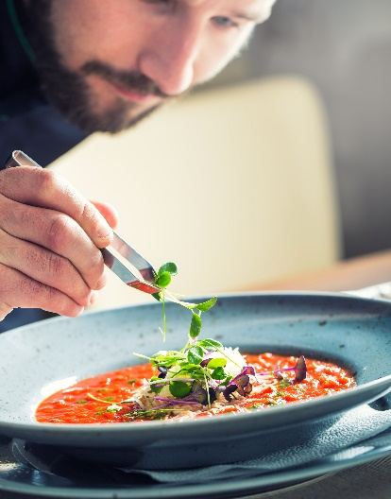
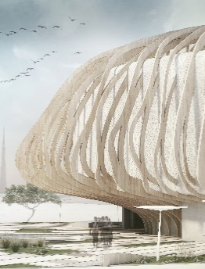

EXPLORE WATER RELATED ISSUES IN TAJIKISTAN
MAKE IT MOVE! USING MOBILITY TO CHANGE THE WORLD
1
The Tajikistan Pavilion explores how water-related issues are linked inextricably with social, economic and environmental development, and will play a significant role in sustainable development, from health and nutrition to gender equity and economics
5
Today, through its drive to become the world's 4th global logistics hub and so help provide goods, services and access to opportunities to almost 1 billion people, Jamaica is ready to continue moving the world forward. Visit the pavilion to find out why.
EXPO
FMCG & RETAIL
JOURNEY
TAJIKISTAN
SUSTAINABILTY
JAMAICA
MOBILITY
DISCOVER THE FUTURE OF FLOW FOR LOGISTICS AT DP WORLD
VISIT AFRICA’ UNDISPUTED ONE-STOP LOGISTICS HUB
2
6
See Cargospeed, the ultra-fast transportation system for palletized cargo powered by hyperloop technology alongside Boxbay, an automated high-rise stacking system for containers which is set to transform storage and management at ports worldwide.
Learn more about the 'Pearl of Africa’
The Uganda pavilion comes to life as a journey of Uganda’s development to becoming an advanced economy, a journey that links different times, eras and places
1-DAY ITINERARY
DP WORLD
MOBILITY
UGANDA
OPPORTUNITY
WALK THROUGH THE HARDWOKING AVENUE
ENTER A WORLD OF CHARMING HIGH TECH IN THAILAND
3
Unlock investment opportunities in Nigeria in Food manufacturing, textile, garments as well as the leather industry. Understand how the Adire textile has inspired fashion designers. Learn how the country is an anchor between agricultural products, processed food supply and food security.
7
Experience Thai warm hospitality, innovation and flora. Covered on the outside by a curtain of 500-plus woven artificial flowers, the nation will present its capabilities in digital innovation and technology in transportation, logistics, digital connectivity and personal mobility.
DO NOT MISS
GLOBAL BEST PRACTICES
The Global Best Practice Programme – Small Steps Big Leaps: Solutions for Sustainable Impact – is Expo’s platform for showcasing simple yet impactful interventions that localise the UN SDGs. These will be projects that provide tangible solutions to the world’s most pressing challenges
NIGERIA
OPPORTUNITY
THAILAND
MOBILITY
HAVE A ROTATING LUNCH AT THE SIGNATURE STARS FOOD HALL
PAY TRIBUTE TO A PRECIOUS RESIN
4
8
Learn about Oman’s gift to the world-the notorious frankincense tree. Discover how it has benefited Oman spanning everything from medicine to food to cosmetics. Find out how it has contributed to advancements in transportation, knowledge, and manufacturing
This exciting venue features an array of mouthwatering lunch options. Choose from a rotating ‘Resident’ Chef restaurant or ‘Food on the Move’ concept and enjoy a signature menu.
PUBLIC REALM
MOBILITY
OMAN
OPPORTUNITY
VERSION: MAR 2021
*This itinerary is for illustrative purposes and can be adapted to your needs and requirements. Contents may change.
Notes:
Manufacturing
Oman
Poland

Slide 3
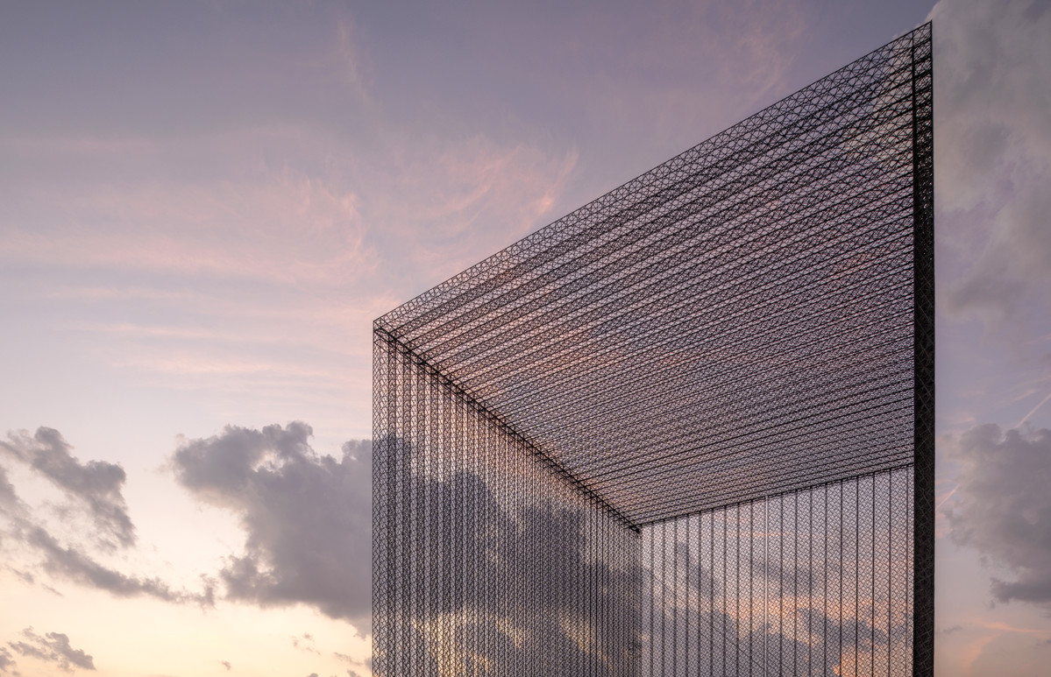

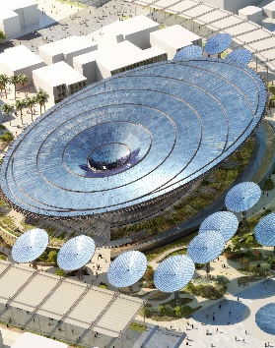
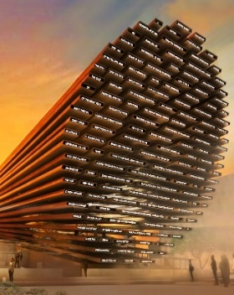
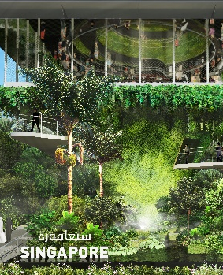
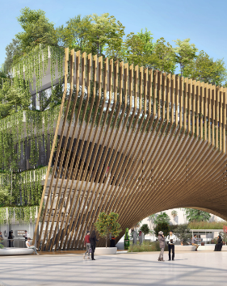
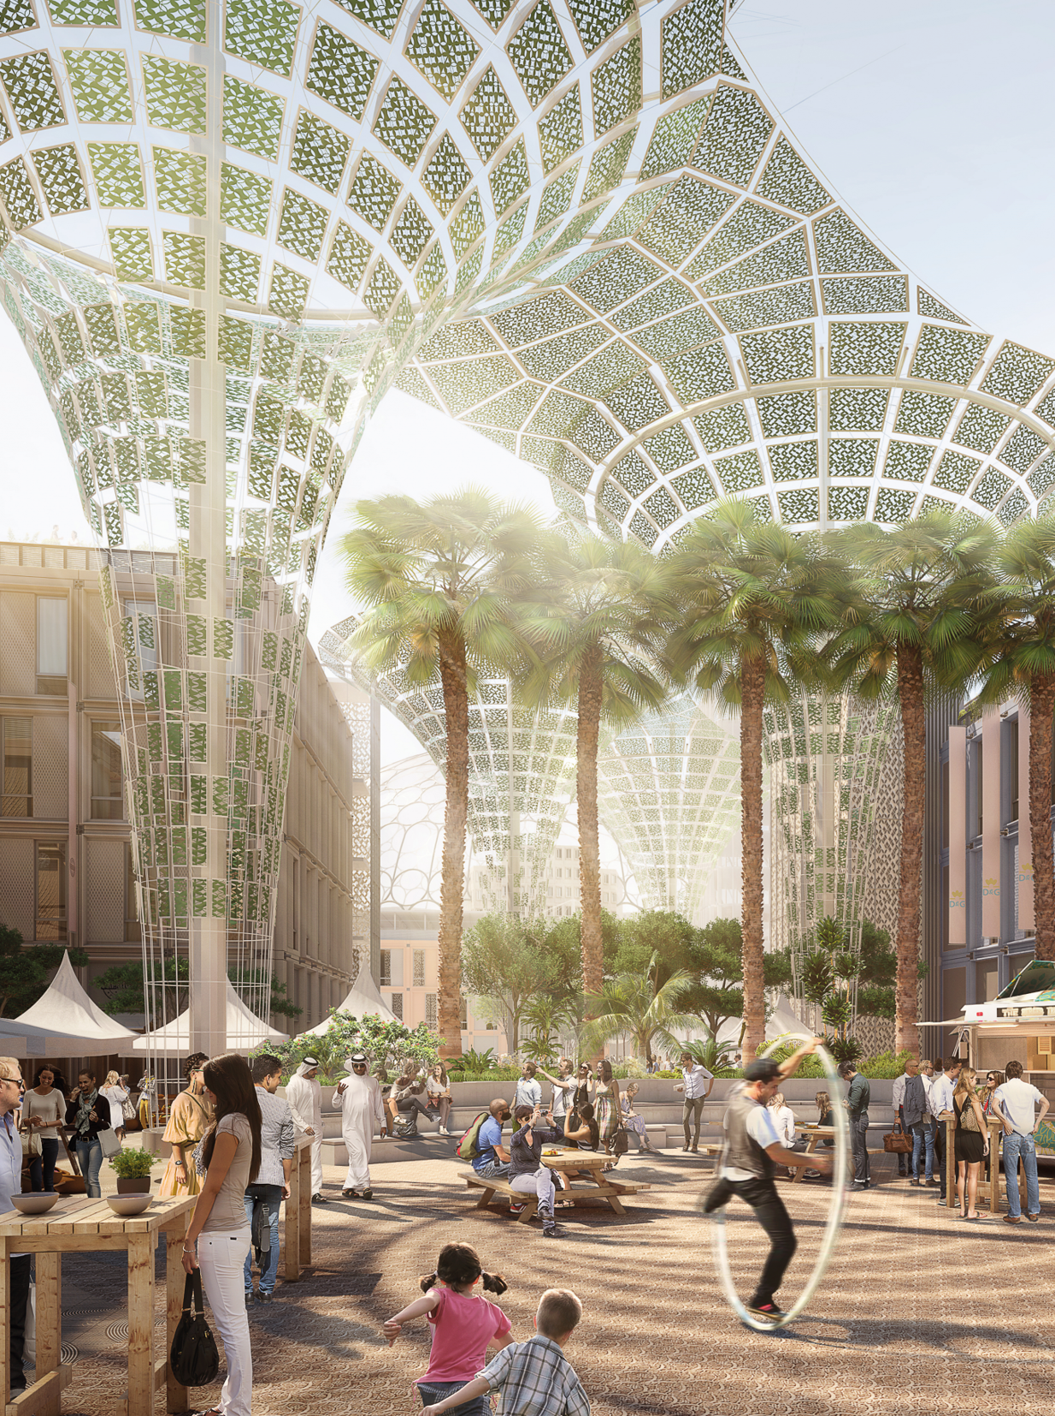
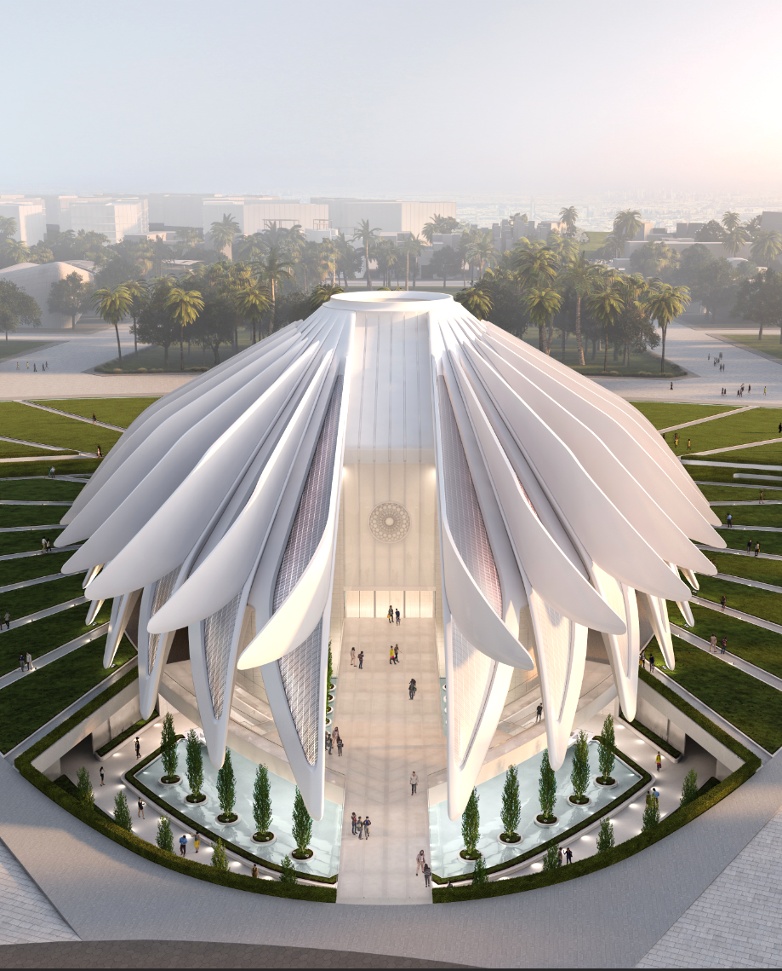
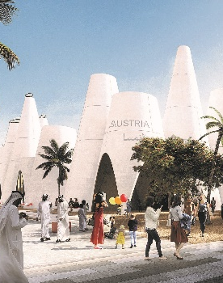
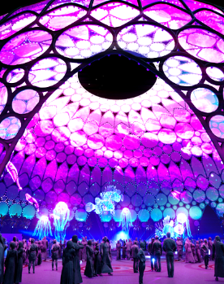

EXPLORE THE ARCHITECTURE
OF A SELF-SUSTAINING PAVILION
EXPERIENCE THE AI INSPIRED PAVILION OF THE UK
1
5
Designed by UK-based Grimshaw Architects, the pavilion will meet LEED Platinum green building standards – the highest available accreditation for sustainable architecture. Creating its own electricity and water, this pavilion features state-of-the-art innovations in sustainability.
Learn the techniques behind a cone-shaped, cross-laminated timber on a concrete structure, made up of small pieces of solar powered video screens. Explore leading British expertise in sectors including artificial intelligence, machine learning and space.
EXPO
CONSTRUCTION & REAL ESTATE
JOURNEY
SUSTAINABILITY PAVILION
SUSTAINABILITY
UNITED KINGDOM
OPPORTUNITY DISTRICT
DISCOVER URBAN INNOVATION AT THE SINGAPORE PAVILION
LEARN ABOUT THE FUTURE OF DESIGN AT THE BELGIUM PAVILION
2
6
Showcasing Singapore's urban innovations, the net-zero energy pavilion designed by WOHA explores our journey towards livability and resilience. Expect an experiential journey through nature at the ground garden, garden cones and a hanging garden.
Designed by Assar Architects and Vincent Callebaut Architectures, the pavilion produces more energy than it consumes through natural light and ventilation, renewable energies and the smart use of water.
1-DAY ITINERARY
MORE PAVILIONS TO DISCOVER
SINGAPORE
SUSTAINABILITY
BELGIUM
MOBILITY
ITALY PAVILION
Inspired by ships and sailors to manifest the concept of circular architecture, the circular economy and digital architecture.
EXPLORE ART & DESIGN THROUGHOUT THE EXPO SITE
VISIT THE ICONIC FALCON-SHAPED PAVILLION OF THE UAE
3
7
Enjoy a walk through the Expo site, a showcase of breakthrough designS and a celebration of the cultural and architectural traditions of the region. Admire the site’s signage based on traditional UAE weaving and see a series of sculpted benches, designed in the shapes of Arabic script.
The pavilion will be one of Expo 2020 Dubai's iconic architectures. Conceptualised by Santiago Calatrava, the architect behind the Opera House in Valencia, the UAE pavilion has been designed to represent a falcon taking flight.
CZECH REPUBLIC PAVILION
The S.A.W.E.R system extract water vapour from the air to create an oasis in the desert.
PUBLIC REALM
EXPO SITE
UNITED ARAB EMIRATES
NEAR AL WASL DOME
VISIT A 9,000-YEAR-OLD SOIL ARCHITECTURE OF AUSTRIA
WATCH A SHOW AT AL WASL DOME – THE HEART OF EXPO 2020
4
8
Austria is a nation innovative ideas. This is reflected in its decision to use a 9,000-year-old soil to build its pavilion, which comprises 47 truncated cones. The structure will be ventilated through its innovative use of the cones, and will house exhibitions, workshops and installations.
Designed by Adrian Smith + Gordon Gill Architecture, the trellis design evokes the Expo 2020 logo. Discover the innovative technology used to piece together the trellis and the mechanism behind enveloping it in the material that makes it one of the world's largest 360-degree projection canvases.
BRAZIL PAVILION
A striking water feature with a tensile structure that references the country’s rivers and mangroves.
AUSTRIA
OPPORTUNITY
AL WASL DOME
AL WASL PLAZA
VERSION: MAR 2021
*This itinerary is for illustrative purposes and can be adapted to your needs and requirements. Contents may change.

Slide 4
EXPLORE THE ARCHITECTURE
OF A SELF-SUSTAINING PAVILION
EXPERIENCE THE AI INSPIRED PAVILION OF THE UK
1
Designed by UK-based Grimshaw Architects, the pavilion will meet LEED Platinum green building standards – the highest available accreditation for sustainable architecture. Creating its own electricity and water, this pavilion features state-of-the-art innovations in sustainability.
5
Learn the techniques behind a cone-shaped, cross-laminated timber on a concrete structure, made up of small pieces of solar powered video screens. Explore leading British expertise in sectors including artificial intelligence, machine learning and space.
EXPO ARCHITECTURE & DESIGN JOURNEY
SUSTAINABILITY PAVILION
SUSTAINABILITY
UNITED KINGDOM
OPPORTUNITY DISTRICT
DISCOVER URBAN INNOVATION AT THE SINGAPORE PAVILION
LEARN ABOUT THE FUTURE OF DESIGN AT THE BELGIUM PAVILION
2
Showcasing Singapore's urban innovations, the net-zero energy pavilion designed by WOHA explores our journey towards livability and resilience. Expect an experiential journey through nature at the ground garden, garden cones and a hanging garden.
6
Designed by Assar Architects and Vincent Callebaut Architectures, the pavilion produces more energy than it consumes through natural light and ventilation, renewable energies and the smart use of water.
1-DAY ITINERARY
MORE PAVILIONS TO DISCOVER
SINGAPORE
SUSTAINABILITY
BELGIUM
MOBILITY
ITALY PAVILION
Inspired by ships and sailors to manifest the concept of circular architecture, the circular economy and digital architecture.
EXPLORE ART & DESIGN THROUGHOUT THE EXPO SITE
VISIST THE ICONIC FALCON-SHAPED PAVILLION OF THE UAE
3
Enjoy a walk through the Expo site, a showcase of breakthrough designS and a celebration of the cultural and architectural traditions of the region. Admire the site’s signage based on traditional UAE weaving and see a series of sculpted benches, designed in the shapes of Arabic script.
7
The pavilion will be one of Expo 2020 Dubai's iconic architectures. Conceptualised by Santiago Calatrava, the architect behind the Opera House in Valencia, the UAE pavilion has been designed to represent a falcon taking flight.
CZECH REPUBLIC PAVILION
The S.A.W.E.R system extract water vapour from the air to create an oasis in the desert.
PUBLIC REALM
EXPO SITE
UNITED ARAB EMIRATES
NEAR AL WASL DOME
VISIT A 9,000-YEAR-OLD SOIL ARCHITECTURE OF AUSTRIA
WATCH A SHOW AT AL WASL DOME – THE HEART OF EXPO 2020
4
8
Designed by Adrian Smith + Gordon Gill Architecture, the trellis design evokes the Expo 2020 logo. Discover the innovative technology used to piece together the trellis and the mechanism behind enveloping it in the material that makes it one of the world's largest 360-degree projection canvases.
Austria is a nation innovative ideas. This is reflected in its decision to use a 9,000-year-old soil to build its pavilion, which comprises 47 truncated cones. The structure will be ventilated through its innovative use of the cones, and will house exhibitions, workshops and installations.
BRAZIL PAVILION
A striking water feature with a tensile structure that references the country’s rivers and mangroves.
AUSTRIA
OPPORTUNITY
AL WASL DOME
AL WASL PLAZA
VERSION: MAR 2021
*This itinerary is for illustrative purposes and can be adapted to your needs and requirements. Contents may change.

Slide 5

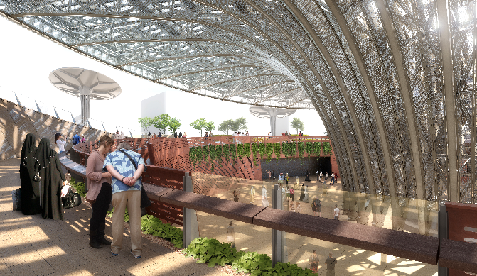

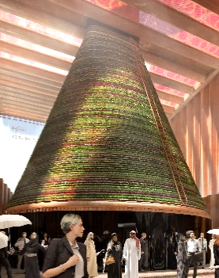
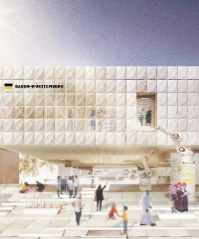

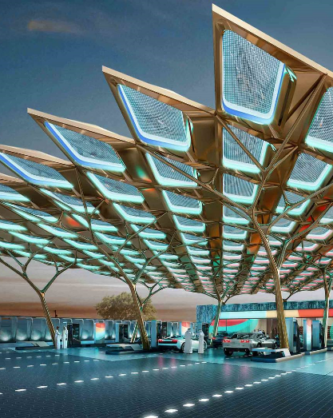


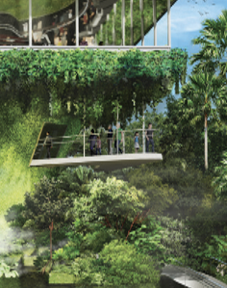

EXPERIENCE A SELF-SUSTAINING PAVILION OF THE FUTURE
WITNESS A KENYAN GREEN ENERGY REVOLUTION
1
Enter an immersive world of sustainability where forest roots communicate with each other and meet a giant consumption machine. The net-zero pavilion features solar-energy and atmospheric-water-harvesting 'trees', which rotate to face the sun.
5
Discover Kenya’s initiatives to revolutionize the energy sector through its quest to rely solely on 100% green energy. The pavilion introduces the largest energy power plants of Africa and its cutting-edge innovative techniques.
EXPO
RENEWABLES
JOURNEY
SUSTAINABILITY PAVILION
SUSTAINABILITY
KENYA
OPPORTUNITY
NATURE-INSPIRED PAVILION WILL UNITE ENERGY,WATER AND FOOD
COOL DOWN AT AN ARTIFICIALLY CREATED BLANKET OF MIST
2
Brimming with sustainable solutions, the building will harvest water, energy and food through innovations such as a cone-shaped vertical farm. With a naturally controlled climate, the structure is built using locally sourced materials that will be recycled after Expo.
6
Experience the “Innovation Cloud” an artificially created blanket of mist. Part of an energy concept based on a largely regenerative energy supply from Baden-Wurttemberg, which is supported by hybrid PVT panels.
1-DAY ITINERARY
RELEVANT EXPO BEST PRACTICE PROGRAMMES
NETHERLANDS
SUSTAINABILITY
BADEN-WURTTEMBURG
OPPORTUNITY
EDIBLE GARDEN CITY
Feeding communities with sustainable fresh food by building urban farms on rooftops conserving energy and natural resources.
TRY A TRULY UNIQUE LUNCH WITH MASTERCHEF EXPO
MEET THE AI SERVICE STATION OF THE FUTURE
3
Treat yourself to a unique lunch experience with global smash hit MasterChef, the TV Experience, bringing its unique dining concept to Expo 2020. Experience amazing dishes created by visiting MasterChef champions from around the world.
7
Learn about solar power and artificial intelligence that help drive ENOC’s service station of the future. Observe how wind turbines and waste water recycling assist in creating alternative energy. See how data analytics and sensors can cut queueing times
GREEN HYDROGEN POWERED VEHICLES
Green hydrogen used as a carbon-free energy source to power fuel-cell vehicles used within the Expo 2020 site.
LUNCH
PUBLIC REALM
ENOC
NET-ZERO ENERGY PAVILION
WATCH A SPECTACULAR
360-DEGREE PROJECTION SHOW
4
Showcasing Singapore’s urban innovations, the net-zero energy pavilion explores our collective journey towards liveability and resilience. The uniqueness of the Singapore pavilion is that its neither a box nor a building - its green, its soft, its alive and its refreshing. Underlining the idea of Singapore's pavilion as an oasis in the desert.
8
End your journey at the iconic Al Wasl Dome, an architectural marvel connecting the three thematic districts and watch a once-in-a-lifetime show. Watch epic tales on the canvas of a unique dome, the world’s largest 360-degree projection screen.
PLASTIC WASTE DEPOSIT AND TRACKING SYSTEM
A digital solution to incentivise the collection of plastic waste and to track it through supply chain.
SINGAPORE
SUSTAINABILITY
AL WASL SHOW
AL WASL PLAZA
VERSION: MAR 2021
*This itinerary is for illustrative purposes and can be adapted to your needs and requirements. Contents may change.

Slide 6
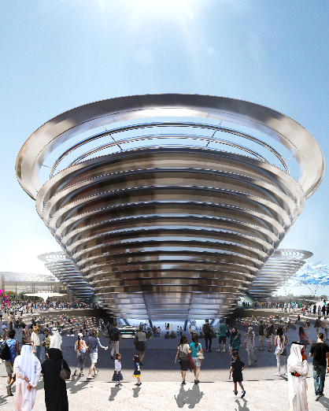
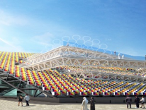

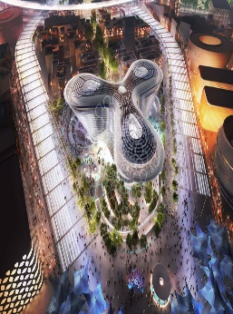
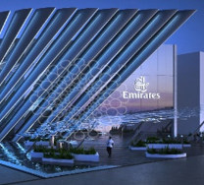

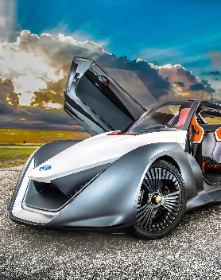

TRAVEL THROUGH TIME AT THE MOBILITY PAVILION
SEE THE ENDLESS BOUNDARIES OF MOBILITY
1
5
Ride on the world’s largest passenger lift
Learn about the history of mobility by meeting nine-metre-tall historical giants
Discover how AI is changing the way we live, learn and play
Pass by the Republic of Korea Pavilion to experience the “Future Mobility” exhibition
Experience a virtual environment that will have you marvel at the endless boundaries of mobility.Witness a kinetic installation that interacts with its audience and surroundings
EXPO
TRANSPORTATION
JOURNEY
MOBILITY PAVILION
MOBILITY
KOREA
MOBILITY
DISCOVER THE POWER OF DATA MOVEMENT AT DP WORLD
SEE CUTTING EDGE MOBILITY DEVICES IN ACTION
2
Experience cutting edge real-time movement of cargo across the world in the DP World Pavilion
Learn about the transformative powers of data through an immersive 270-degree experience
6
Swing by the partly underground partly open air 330-meter track surrounding the Mobility Pavilion. Discover new forms of transport and maybe even try it for yourself. Witness innovations that enhance people’s lives such as solar powered tricycles in Africa
1-DAY ITINERARY
RELEVANT EXPO BEST PRACTICE PROGRAMMES
DP WORLD
MOBILITY
MOBILITY
UNICEF DRONES PROGRAMME
Creating humanitarian drone corridors in developing countries to deliver vital medical supplies.
EXPLORE THE FUTURE OF AIR TRAVEL
MEET THE AI SERVICE STATION OF THE FUTURE
3
7
Land at the Emirates Pavilion and experience the Future of Commercial Aviation in UAE’s Centennial Year 2071. Engage with future technologies and innovations in air travel
Learn about solar power and AI that help drive ENOC’s service station of the future. Observe how wind turbines and waste water recycling assist in creating alternative energy. See how data analytics and sensors can cut queueing times
BIG BOX FOR THE CALAIS JUNGLE REFUGEE CAMP
A lightweight, briefcase-sized device that transforms any form of internet connectivity into Wi-Fi.
ENOC
EMIRATES
MOBILITY
ENOC
EXPLORE THE FUTURE OF INTELLIGENT MOBILITY CARS
ENTER A WORLD OF CHARMING HIGH TECH IN THAILAND
4
8
Discover Nissan’s flagship electric vehicle and next generation cars featuring advanced state-of-the-art technologies. Nissan LEAF, the car that has been sold in the thousands, is set to lead the way to mobility in the future with more than its impact on zero emissions.
Experience Thai hospitality and innovation and flora.The nation will present its capabilities in digital innovation and technology in transportation, logistics, digital connectivity and personal mobility.
PLUS SCHOOL PROGRAMME
An online software calculating healthy, cost-effective school meals while optimising the positive impact on economies.
SUSTAINABILITY
THAILAND
MOBILITY
NISSAN
MOBILITY
VERSION: APR 2021
*This itinerary is for illustrative purposes and can be adapted to your needs and requirements. Contents may change.

Slide 7

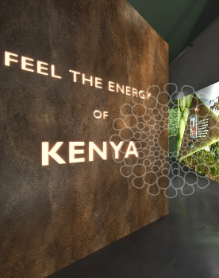
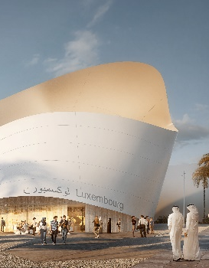
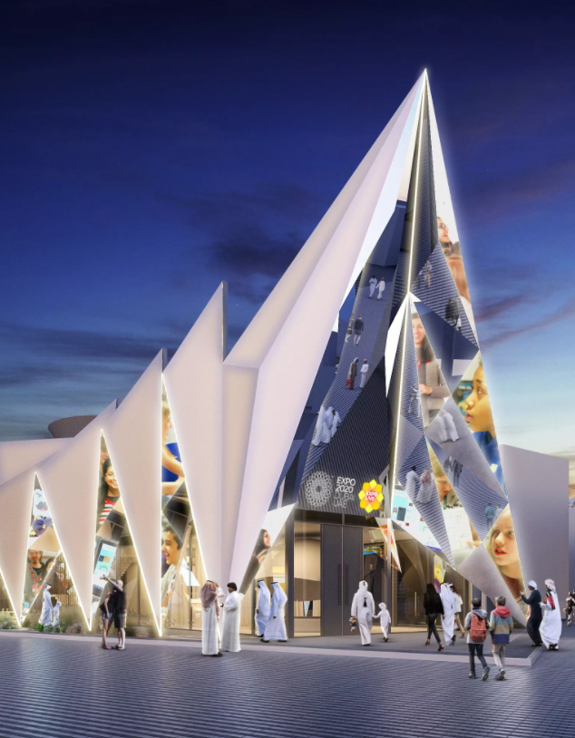
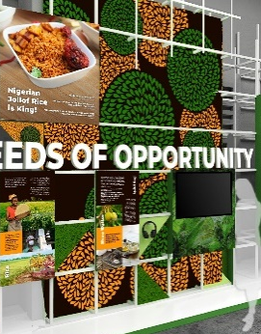

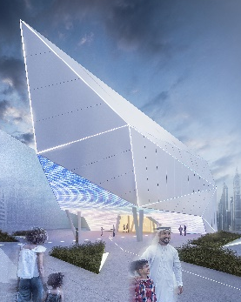
EXPLORE MORE ON FINTECH AT THE
KENYA PAVILION
TRAVEL THROUGH TIME AT THE MOBILITY PAVILION
1
showcasing Kenya's raw power in technological innovation across Agritech, Edutech and Fintech FinTech
discuss how mobile money has impacted the agricultural value chain (M-Pesa)
5
Ride on the world’s largest passenger lift. Learn about the history of mobility by meeting nine-metre-tall historical giants. Discover how AI is changing the way we live, learn and play
EXPO
FINTECH
JOURNEY
KENYA
OPPORTUNITY
MOBILITY PAVILION
MOBILITY
EXPLORE MORE ABOUT THE CIRCULAR ECONOMY
ATTEND TRADE TALKS AND FORUMS AT THE MALAYSIAN PAVILION
2
Tackling the 4th industrial revolution, and the circular economy at at Luxemburg pavilion.
Learn more on creating a society where wealth is based on diversity and transactions between people, companies, and sectors.
6
1-DAY ITINERARY
Organization's and government bodies will participate in 26 curated weekly thematic trade and business programmes
Discover sustainable industries in key sectors to Malaysia’s economy.
DO NOT MISS
LUXEMBURG
OPPORTUNITY
Malaysia
SUSTAINABILITY
EMIRATES NBD “BRANCH OF THE FUTURE”
Emirates NBD, brings a unique opportunity to showcase their innovations in smart technology, digital banking and global best practice through their site-wide presence and their Bank of the Future.”
CONNECT WITH INTERNATIONAL BUSINESSES
EXPLORE OPPORTUNTIES TO INVEST IN NIGERIA
3
Expo Live showcases global innovators in the Expo Live Pavilion, connecting them to an international network of participating nations, and global businesses
Discover financial products that will enable students to continue their education remotely.
7
The e abundance of opportunities available in Nigeria. Experience the creative and technology sectors propelling the youth and future of Nigeria
EMIRATES
MOBILITY
NIGERIA
OPPERTUNITY
STOP AT THE MULT-I DAY BLOCKCHAIN SUMMIT
BlockExpo and World Blockchain Summit 2020 will captivate technologists, futurists and savvy investors at the Dubai Exhibition Centre (DEC)
WATCH AL WASL SHOW ON A 360-DEGREE CANVAS
EXPLORING THE METAVERSE OF REALITIES AT THE SERBIA PAVILION
4
8
Watch a live musical “The Ship of Human Endeavor” at the iconic Al Wasl
Imagined by director Shekhar Kapur with Music by A.R. Rahman
Take a voyage in search of human connection to each other, the natural world and the cosmos
Todays most innovative companies are presenting their achievements in the fields of VR, AI and Blockchain. One-2-one virtual business meetings with visitors showing Serbia’s opportunities and more
ALWASL
SERBIA
MOBILITY
VERSION: APR 2021
*This itinerary is for illustrative purposes and can be adapted to your needs and requirements. Contents may change.

Slide 8


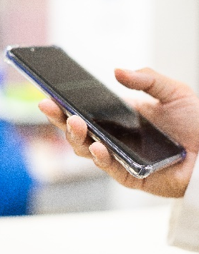


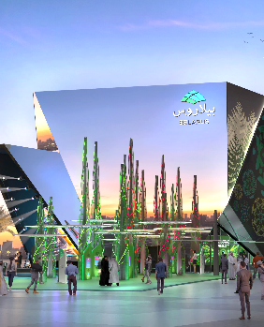


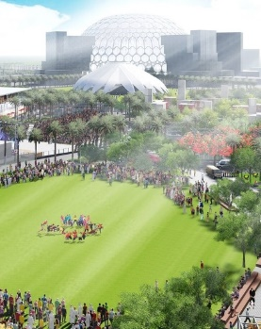


EXPLORE ORIENTAL WISDOM IN HEALING AND WELLNESS
LEARN ABOUT THE BEST PRACTICE PROGRAMME IN HEALTHCARE
1
Gather ancestral knowledge of plant-based medicine used in contemporary medicine. Discover the traditional Hammam, an ancient cultural wellness space, using indigenous natural resources such as volcanic clay, black soap and argan oil for healing and wellness.
5
Discover innovative solutions for critical global health challenges. See how we can fight neglected tropical diseases using mobile phones, or how we can deliver vital medical supplies in a matter of minutes to remote communities through humanitarian drone corridors.
EXPO
HEALTH & WELLNESS JOURNEY
MOROCCO
OPPORTUNITY
OPPORTUNITY PAVILION
OPPORTUNITY
EXPERIENCE THE STORY OF WATER AT SABEEL FOUNTAINS
DISCOVER YLANG YLANG – THE ESSENCE OF HEALTH
2
As you walk towards the next pavilion, stop and have a sip of water at one of the Sabeel drinking water fountains. They tell the story of water as a priceless, shared resource. Discover how humanity should respect and relate to water as one of its most precious resources.
6
Learn all about the healing power and production cycle of Ylang Ylang in the Comoros Pavilion. The plant that transforms into the final Chanel No 5 perfumes in stores all over the world. Immerse yourself in a story of new beginnings, of promise and natural potential.
1-DAY ITINERARY
RELEVANT EXPO LIVE PROGRAMME
DISTRICT EXPERIENCE
OPPORTUNITY
COMOROS
SUSTAINABILITY
DISCOVER 4D PRINT OF
LIVE CELLS IN BELARUS
WATCH A STUNNING 360-DEGREE PROJECTION SHOW
ARGENTINA PAVILION
Smart insoles that monitor foot amputations caused by diabetes.
3
7
Explore how humanity can learn from the natural world in the Belarus Pavilion. Discover a 4D printer, which can reproduce live cells as part of a range of innovative new technologies across a number of sectors. These include healthcare, agriculture and artificial intelligence.
Proceed to the iconic Al Wasl Dome, an architectural marvel connecting the three thematic districts and enjoy a once-in-a-lifetime show. Watch spectacular tales on the huge canvas of the unique dome, making it the world’s largest 360-degree projection screen.
INDIA PAVILION
Clean Birth Kit distribution to healthcare workers in rural areas to tackle childbirth death and newborn care.
BELARUS
OPPORTUNITY
AL WASL SHOW
AL WASL PLAZA
RIDE A BIKE OR ATTEND A YOGA CLASS IN JUBILEE PARK
NOURISH YOURSELF WITH SUPERFOODS IN PERU
4
8
Make your way to the Jubilee Park, a beautifully landscaped area with water features that evoke a green oasis. Attend a yoga class or ride a bike after having a meal at one of the many F&B facilities. Avail some souvenirs such as a unique camel soap bar with antibacterial properties.
Try the best experiential gastronomy in the world, based on Peruvian superfoods that are changing humanity's future. Enjoy a sensory experience through one of the cradles of mankind and one of the most biodiverse countries in the world.
LATVIA PAVILION
Interactive face motion games for effective therapy in children with speech impediments and facial disabilities.
PARK AREA
OPPORTUNITY
PERU
MOBILITY
VERSION: MAR 2021
*This itinerary is for illustrative purposes and can be adapted to your needs and requirements. Contents may change.

Slide 9


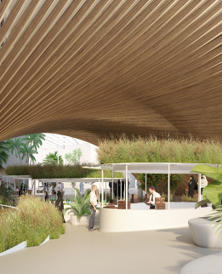


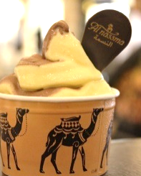
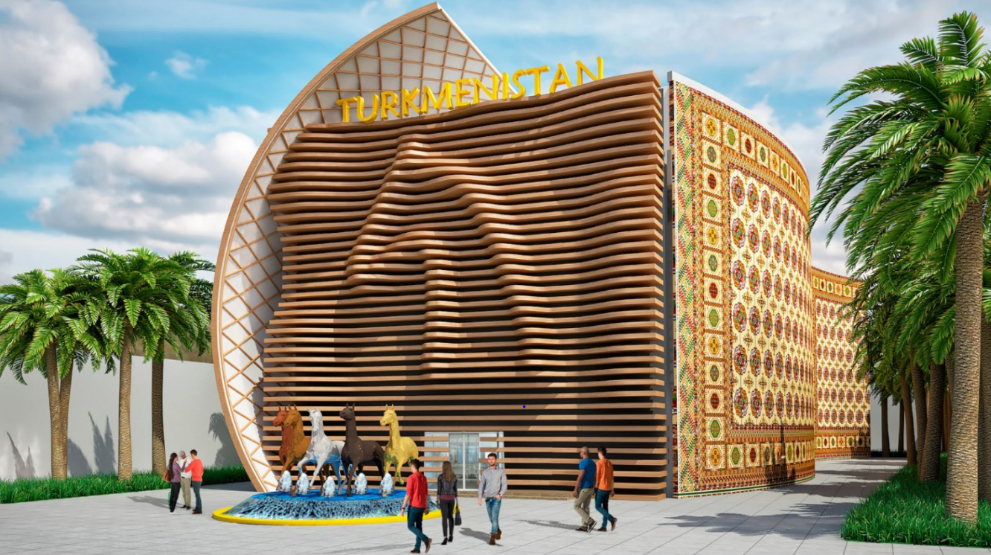
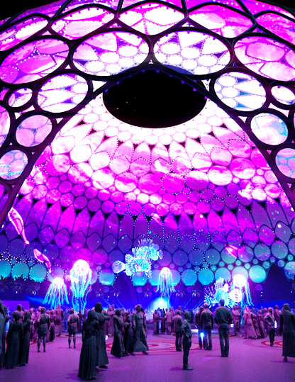





TRY THE BEST EXPERIMENTIAL GASTRONOMY IN PERU
SEE HOW BELGIUM FEEDS THE FUTURE
1
The experiential gastronomy, based on Peruvian superfoods, promises to change humanity's future. Enjoy a sensory experience through one of the cradles of mankind and most biodiverse countries in the world and watch a real-time construction of the last Incan bridge.
5
Discover the latest technologies of Belgium while sampling Flemish specialties. Belgium draws on renewable resources to feed its energy needs, smart tech to feed its plants and the nation’s world-famous fries, known as ‘frietjes’, to feed its visitors.
PERU
MOBILITY
BELGIUM
MOBILITY
EXPO FOR FOODIES
ENJOY LIVELY ENTERTAINMENT AT THE PUBLIC REALM
TRY CAMEL ICE CREAM AT ‘CAMELICIOUS’
2
Whilst walking towards your next destination, watch jugglers and pop-up theatres and listen to live performances of musical talents from all over the world. Unwind in one of the many shaded seating areas, enjoy a sip of water from the drinking fountains.
6
Soak in the lively spirit of Expo when walking through the Arab-style vistas featuring lush greenery. Try something undeniably UAE: camel milk. Camelicious Majlis Café will offer their signature ice-creams, coffees and milkshakes– all made from nutrient-rich camel milk.
1-DAY ITINERARY
HIGHLIGHTS
PUBLIC REALM
MOBILITY
PUBLIC REALM
MOBILITY
QUALITY, GUARANTEED
All food vendors at Expo sign the Food Ethos commitment to sustainability and wellness.
EVER TRIED TURKMEN CUISINE?
WATCH AL WASL SHOW ON A 360-DEGREE CANVAS
3
This pavilion features traditional ‘Akhal-Teke horses’, native to the nation. Learn about the nation’s agricultural connections with digital crop moving and growing, responding to touch. Sample traditional Turkmen cuisine such as Plov, Manty, Kefir or Shashlyk.
7
Head towards the iconic Al Wasl Dome, an architectural marvel connecting the three thematic districts for a once-in-a-lifetime show.
Watch spectacular tales on the huge canvas of the unique dome, making it the world’s largest 360-degree projection screen.
UNIQUE EXPERIENCES
Experiences that cater to your tastes while also stimulating your mind.
TURKMENISTAN
MOBIILITY
AL WASL SHOW
AL WASL PLAZA
ENJOY LUNCH WITH MASTERCHEF EXPO
EXPERIENCE THE FUTURE OF FOOD FOR DINNER
4
8
Go on a fully immersive, experiential journey with Expo’s ‘Future of Food’ concept combining technology, entertainment, lasers and fog with delectable dishes. Explore ideas such as genetic modification and try aerogel meringues or soups glowing in the dark.
Discover a new meaning to the term “TV dinners” with global smash hit MasterChef, bringing its unique dining concept to Expo 2020. Experience amazing dishes created by visiting MasterChef champions from around the world.
UNMATCHED SCALE
On peak days at Expo, more than half a million meals will be served on a daily basis.
PUBLIC REALM
MOBILITY
PUBLIC REALM
MOBILITY
VERSION: FEB 2021
*This itinerary is for illustrative purposes and can be adapted to your needs and requirements. Contents may change.

Slide 10
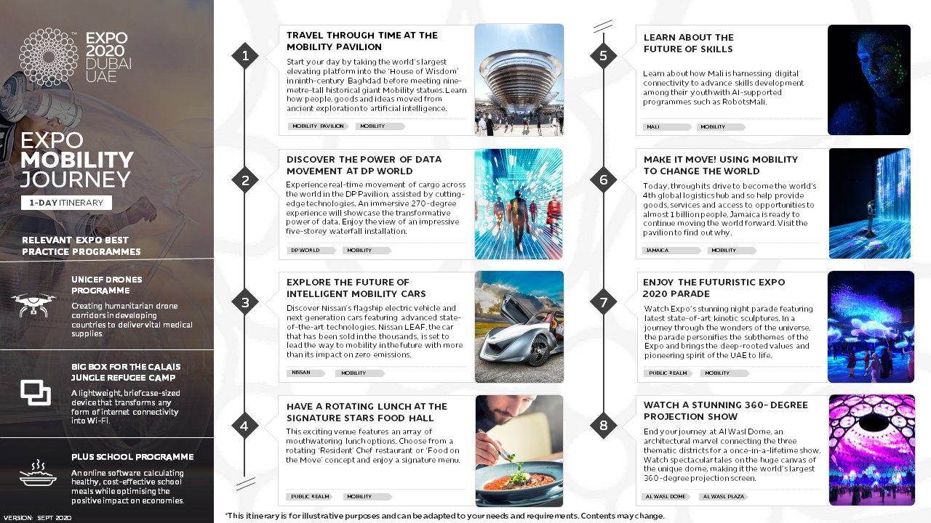

Slide 11

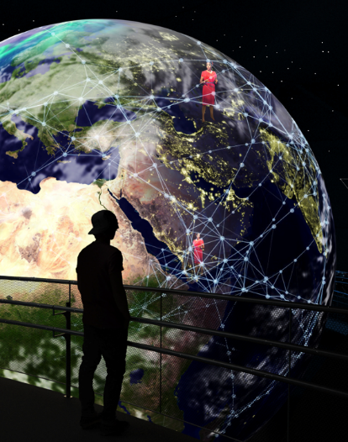
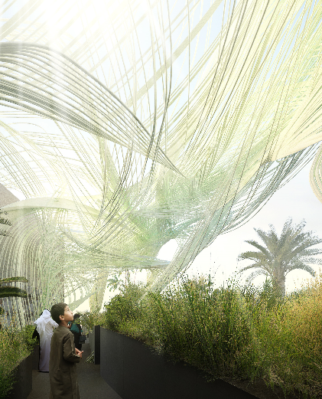

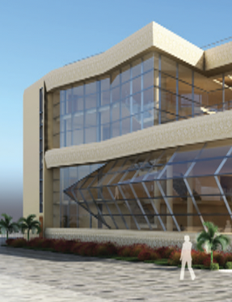


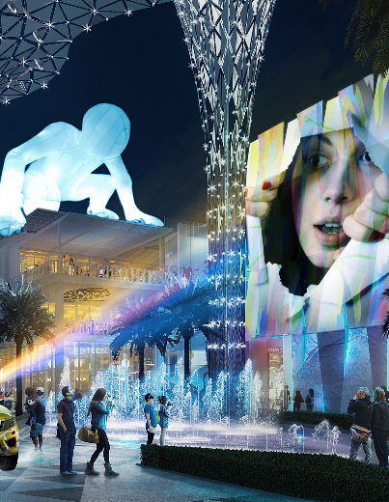

TRAVEL THROUGH TIME AT THE MOBILITY PAVILION
LEARN HOW SOLAR ENERGY CONVERTS DESERTS INTO OASES
1
Start your day by taking the world’s largest elevating platform into the ‘House of Wisdom’
in ninth-century Baghdad before meeting nine-metre-tall historical giant Mobility statues. Learn how people, goods and ideas moved from ancient exploration to artificial intelligence.
5
See how fertile land can be created in barren conditions such as the desert by extracting water vapour from the air using nothing but solar energy. Discover a rotating exhibition that will delve into the cultural side of Czech Republic.
EXPO FOR TECHIES & INNOVATORS
MOBILITY PAVILION
MOBILITY
CZECH REPUBLIC
MOBILITY
LEARN HOW SMART KOREA IS MOVING THE WORLD TO YOU
ENJOY AN ENTERTAINMENT FILLED WALK AT THE PUBLIC REALM
2
The Korea Pavilion explores the impact of virtual reality on our everyday life. Using display technology, 5G network, holograms, and VR technology, visitors can embark on an interactive smart journey to Korea in real time, ultimately experiencing Korea’s vision for mobility.
6
On your way to the next district, soak in the lively spirit of Expo and admire the Arab-style vistas featuring palm groves, jasmine trees, a wadi, figs and more. Get some nibbles at one of the many local joints nearby and lounge under shaded canopies provided by native Ghaf trees.
1-DAY ITINERARY
HIGHLIGHTS
REPUBLIC OF KOREA
MOBILITY
PUBLIC REALM
OPPORTUNITY
FARMING DRONES
Learn about agricultural drones fitted with cameras for farmers to monitor and protect their crops.
SMART LIVING AND
SMART THINKING
MEET THE AI SERVICE STATION OF THE FUTURE
3
With inventions ranging from an e-bike that can travel 380 kilometers on a single charge, to blinds that use sunlight to generate electricity, the Ukrainian pavilion will showcase the country’s innovative spirit while exploring its cultural heritage.
7
Learn about solar power and artificial intelligence to help driving ENOC’s service station of the future. Observe how wind turbines and waste water recycling assist in creating alternative energy, while data analytics and sensors will cut queueing times.
WINDOW SOLAR CELLS
See transparent solar cells that turn any window or sheet of glass into a means of harvesting clean energy.
UKRAINE
OPPORTUNITY
EMIRATES NATIONAL OIL COMPANY
OPPORTUNITY
TRY THE FUTURE OF FOOD IN AN IMMERSIVE LUNCH
ADMIRE LIGHT & PROJECTIONS WITH THE KALEIDOSCOPE
4
Explore a fully immersive, experiential lunch with the ‘Future of Food’ concept combining technology and entertainment with delectable dishes. Travel into the future and explore ideas such as aerogel meringues or soups glowing in the dark.
8
Enjoy lights art, illuminated inflatables, film strips and stirring photography in the daily kaleidoscope, stretching across the Expo site. During the 6 months of Expo, several themed art illuminations will be featured such as the ‘Solar system-Mission to Mars’ or ’Wildlife Day’.
EXOSKELETONS
Explore how to reduce workplace injuries, enhance sport experiences and lend robotic strength to people with physical limitations.
PUBLIC REALM
MOBILITY
PUBLIC REALM
SUSTAINABILITY
VERSION: MAR 2021
*This itinerary is for illustrative purposes and can be adapted to your needs and requirements. Contents may change.
Notes:
t

Slide 12
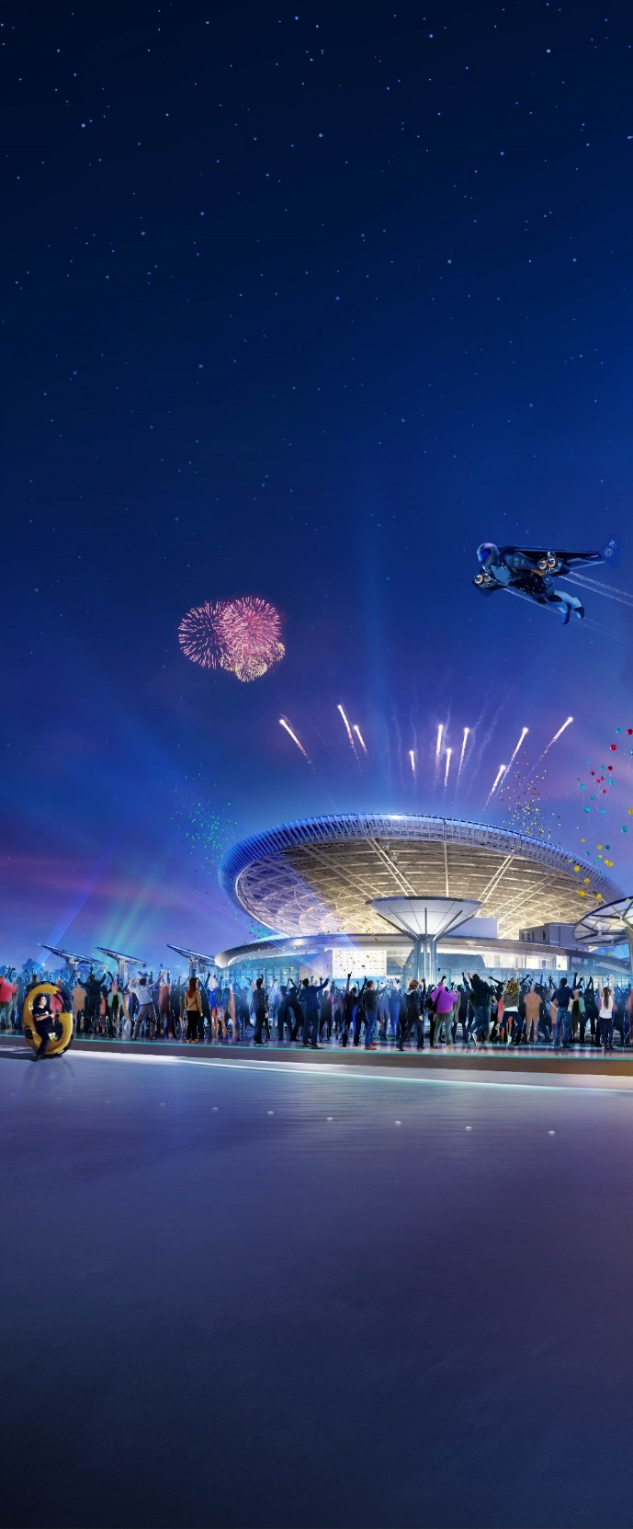
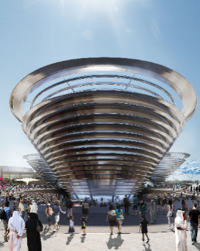



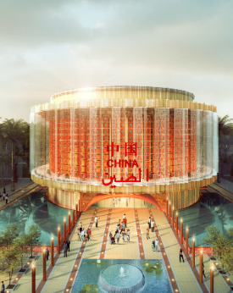


TRAVEL THROUGH TIME AT THE MOBILITY PAVILION
EXPLORE AI & HUMAN INTERACTIONS AT THE UK PAVILION
1
Start your day by taking the world’s largest elevating platform into the ‘House of Wisdom’
in ninth-century Baghdad before meeting nine-metre-tall historical giant Mobility statues. Learn how people, goods and ideas moved from ancient exploration to artificial intelligence.
5
Explore leading British innovative expertise in sectors including artificial intelligence, machine learning and space. Inspired by Stephen Hawking, designed by Es Devlin and powered by AI, this pavilion will blend human creativity and technology.
MOBILITY PAVILION
MOBILITY
UNITED KINGDOM
OPPORTUNITY
EXPO ESSENTIALS
ENTER A WORLD OF CHARMING HIGH TECH IN THAILAND
LISTEN TO A BEETHOVEN-INSPIRED ROBO-BAND IN GERMANY
2
Experience Thai warm hospitality, innovation and flora. Covered on the outside by a curtain of 500-plus woven artificial flowers, the nation will present its capabilities in digital innovation and technology in transportation, logistics, digital connectivity and personal mobility.
6
Wear cutting-edge connected devices through-out the pavilion and listen to a band of robots playing Beethoven tunes. Ride on the world’s first ropeless elevator powered by magnetic technology. And learn about sustainability in the Energy, Future City and Biodiversity Labs.
1-DAY ITINERARY
HIGHLIGHTS
THAILAND
MOBILITY
GERMANY
SUSTAINABILITY
VIRTUAL & AUGMENTED REALITY EXPERIENCES
Experience innovative virtual reality gamification, technology and more.
UNWIND OR SHOP AT EXPO'S ENTERTAINING PUBLIC REALM
WATCH A STUNNING 360-DEGREE PROJECTION SHOW
3
On your way to the Opportunity District, watch live performances of talents from all over the world. Choose from a wide range of dining options from more than 200 F&B outlets on site, from food trucks, coffee shops, country-specific delicacies to virtual dining .
7
Head towards the iconic Al Wasl Dome, an architectural marvel connecting the three thematic districts for a once-in-a-lifetime show.
Watch spectacular tales on the huge canvas of the unique dome, making it the world’s largest 360-degree projection screen.
UNIQUE CULINARY JOURNEYS
Try dishes that cater to your taste buds while also stimulating your mind.
PUBLIC REALM
MOBILITY
AL WASL DOME
AL WASL PLAZA
TALK TO ALIENS AT THE CHINA PAVILION
EXPERIENCE THE FUTURE OF FOOD FOR DINNER
4
8
Witness the world’s largest radio satellite capable of detecting signals from alien life. The pavilion will highlight 5,000 years of advancements including paper and the compass and will showcase the future of 5G-tech in a 5G time and space tunnel.
Go on a fully immersive, experiential journey with Expo’s ‘Future of Food’ concept combining technology, entertainment, lasers and fog with delectable dishes, and try aerogel meringues or soups glowing in the dark.
CULTURAL & LIVE PROGRAMMES
Enjoy daily live entertainment from around the world.
CHINA
OPPORTUNITY
PUBLIC REALM
MOBILITY DISTRICT
VERSION: MAR 2021
*This itinerary is for illustrative purposes and can be adapted to your needs and requirements. Contents may change.

Slide 13
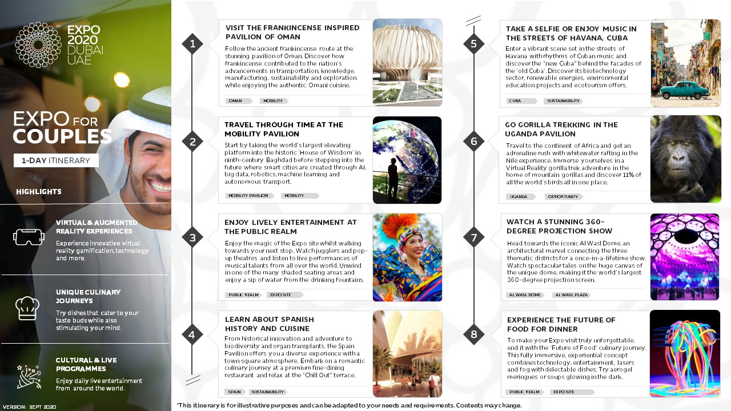

Slide 14
