Slide 1


Slide 2
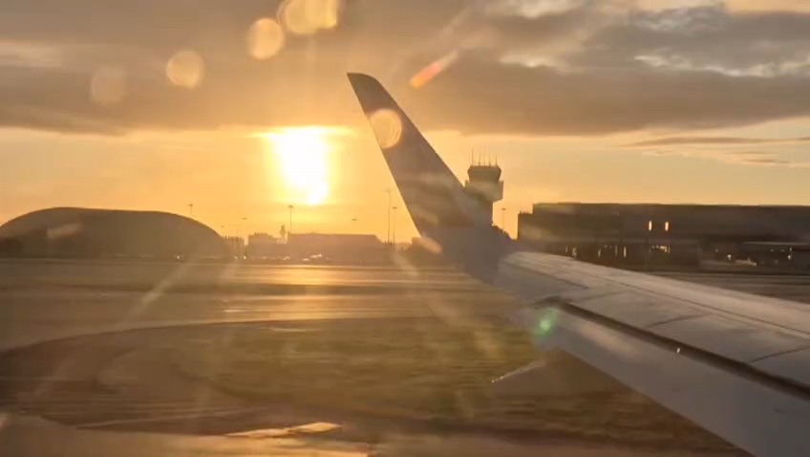

Slide 3
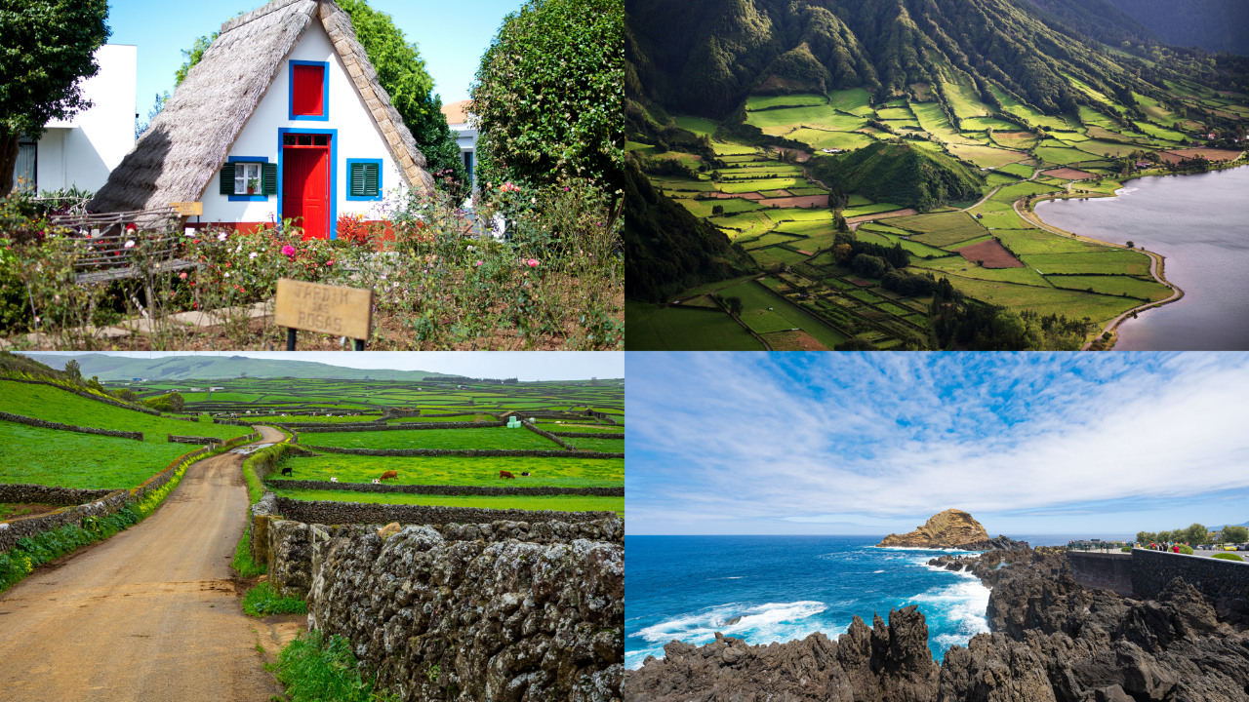


ABOUT US!
HighSun is a premier DMC specialized in bespoke experiences for groups, FITs, and MICE.
We craft tailor-made itineraries that showcase the very best of Portugal—from its rich culture and exquisite gastronomy to world-class wines and breathtaking landscapes.
With seamless coordination of experiences, accommodations, and transfers, we ensure a truly unforgettable journey through our beautiful country.

Slide 4


Slide 5


Slide 6
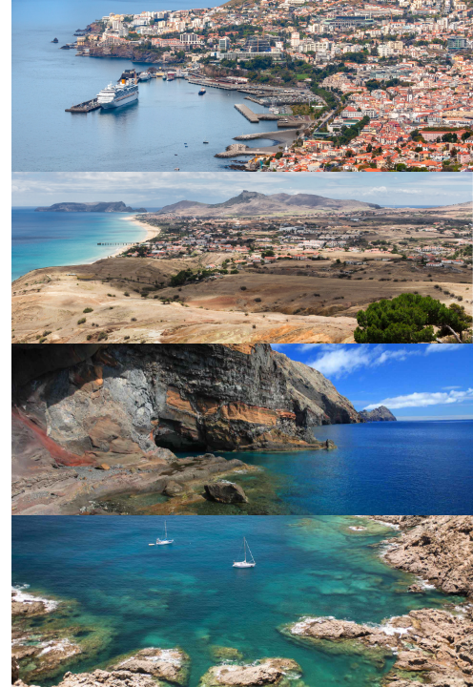
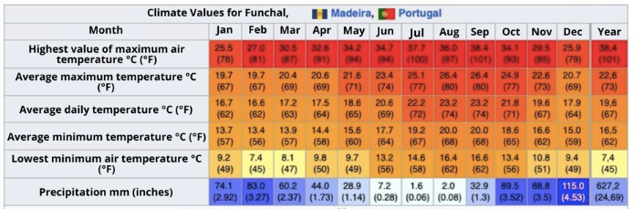
ABOUT MADEIRA
Islands: Madeira, Porto Santo, Desertas and Selvagens
Gastronomy: Espetada, bolo do caco, black scabbard fish, grilled limpets, poncha
Curiosities: World-famous New Year's Eve, Laurissilva Forest (UNESCO)
Populotion: 250 769 (2021)
Climate: Subtropical, mild all year round

Slide 7
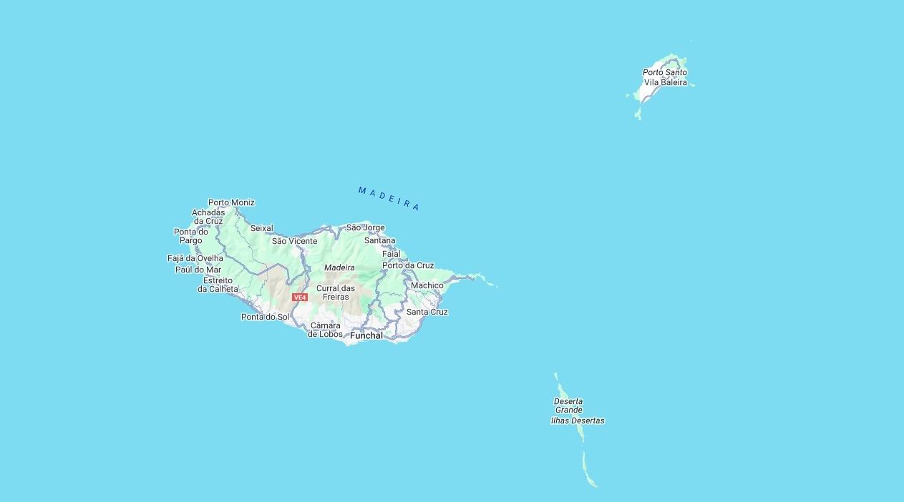

Slide 8
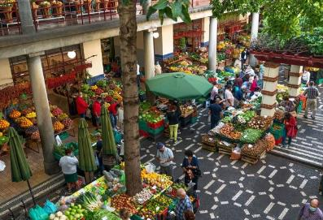
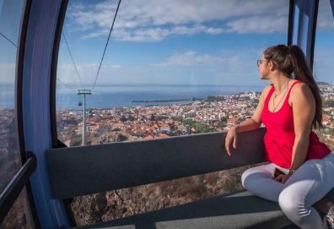
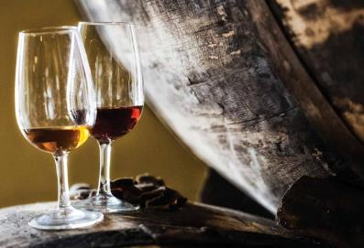
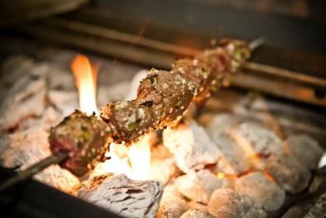
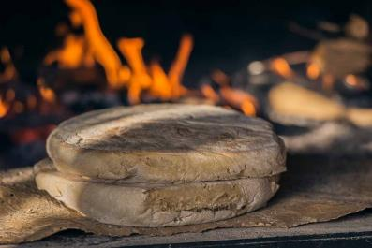
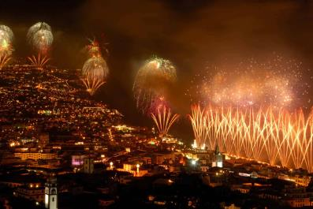
MADEIRA
For Leisure (families and groups)
LAVRADORES MARKET VISIT
RIDE THE CABLE CAR
WINE TYPICAL TASTING
WORKSHOP BOLO DO CACO
NEW YEAR´S EVE
Image_CopyRight: Visit_Madeira
TASTE TYPICAL “ESPETADA DA MADEIRA”

Slide 9
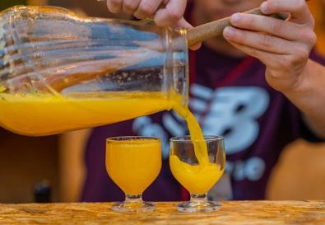
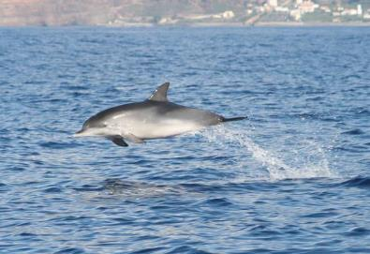
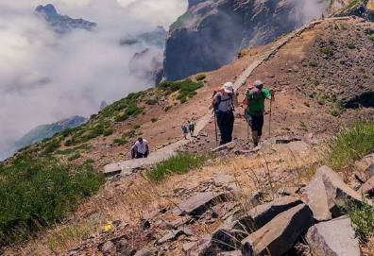
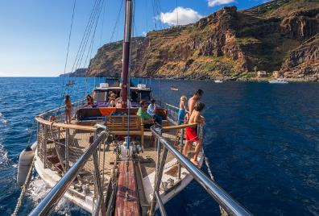
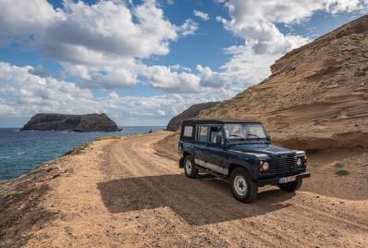

MADEIRA
For Incentives
JEEP PONCHA HUNT
DOLPHIN AND WHALE WATCHING
EXPLORE PICO DO AREEIRO
BOAT TRIPS
JEEP TOURS
LOWERING BASKET CARS
Image_CopyRight: Visit_Madeira

Slide 10
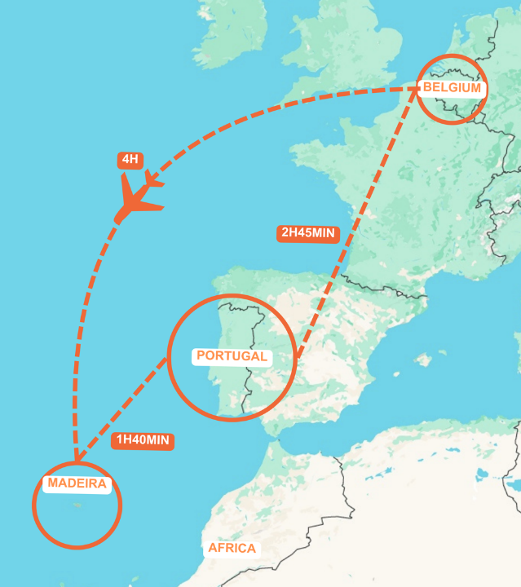
DIRECT FLIGHTS
Belgium - Madeira
Direct Flights Available
Ryanair
TUI fly Belgium
Brussels Airlines

Slide 11


Slide 12


Slide 13
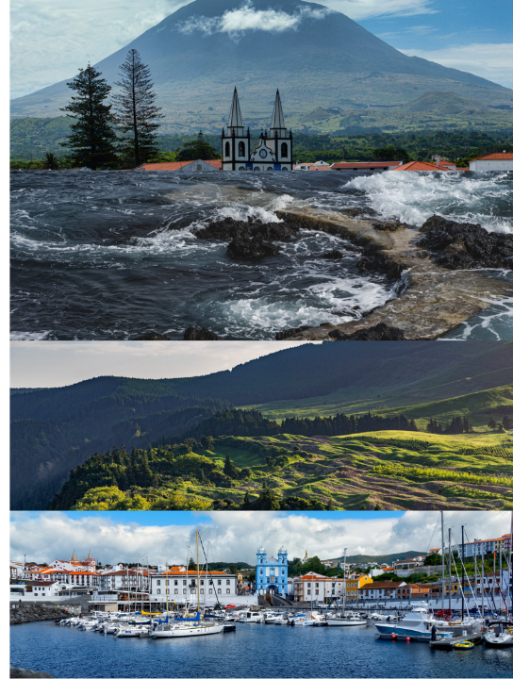
ABOUT AZORES
Climate: Oceanic, mild all year round,
9 islands (São Miguel, Terceira, Pico, Faial, São Jorge, Santa Maria, Graciosa, Flores, Corvo),
Gastronomy: Cozido das Furnas, cheeses, fresh fish, vinho de cheiro,
Curiosities: Pico Mountain (the highest point in Portugal).
Population: 236 413 (2021)

Slide 14
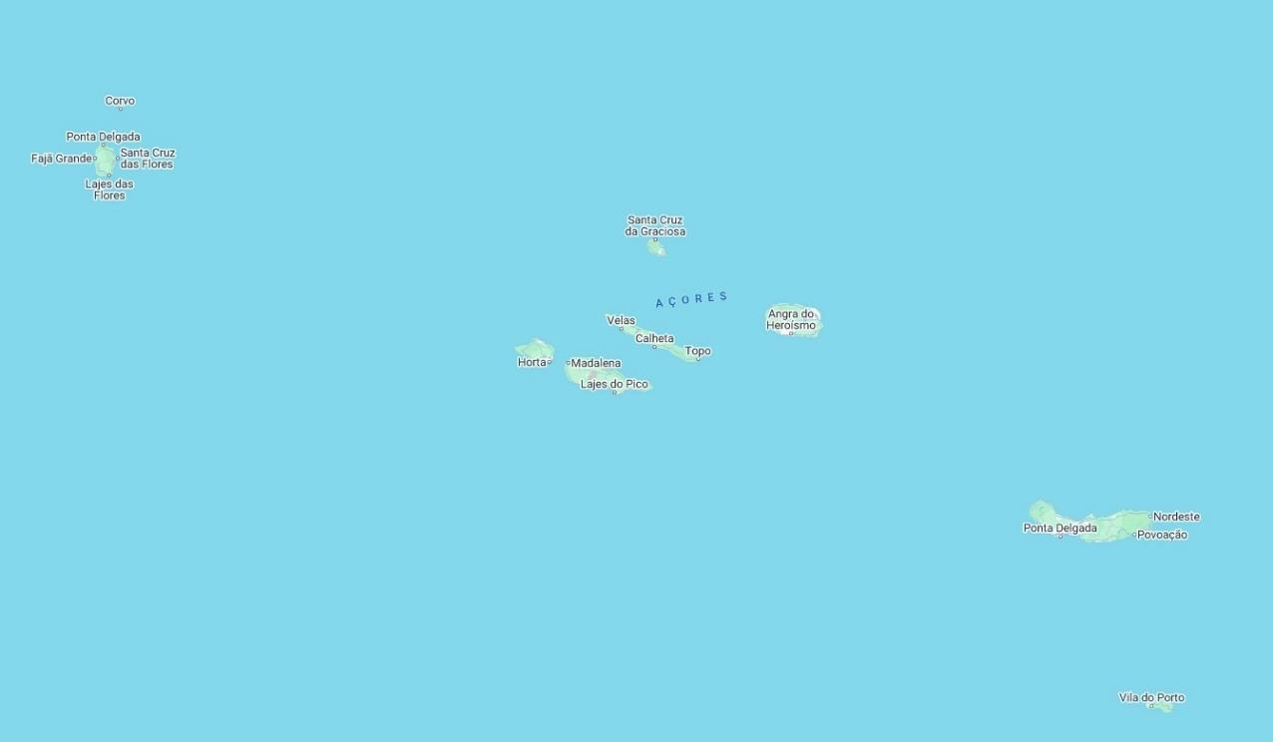

Slide 15
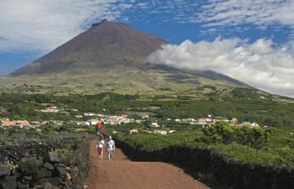
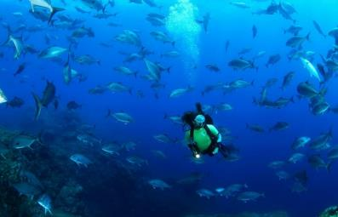
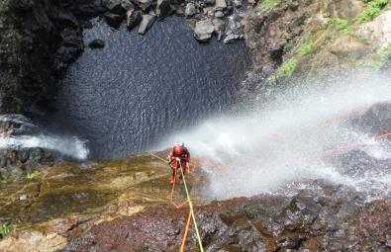
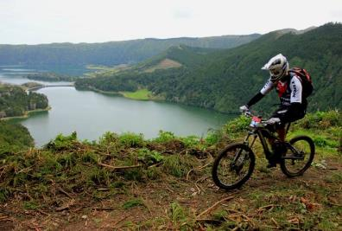
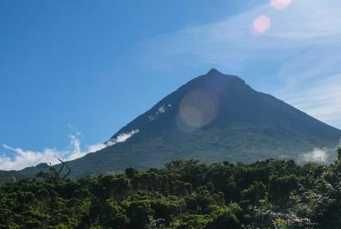
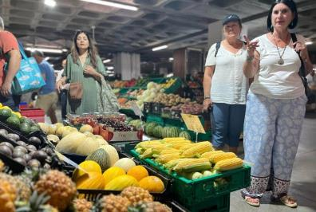
AZORES
For Leisure (families and groups)
TRAILS
DIVING
CANYONING
BIKING
PICO ISLAND CLIMB
FOOD TOUR
Image_CopyRight: Visit_Azores, Hungry Whales

Slide 16
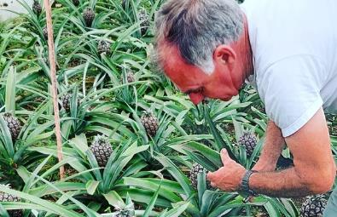
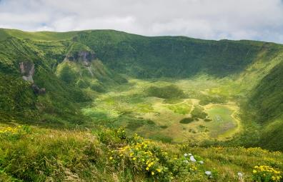
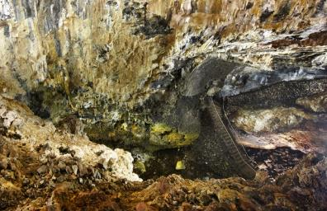
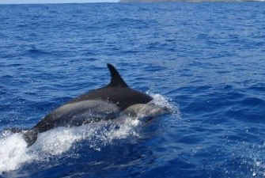

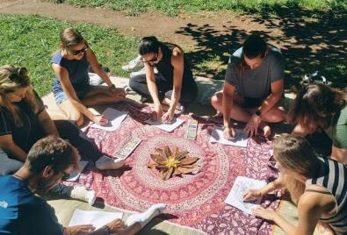
AZORES
For Incentives
PINEAPPLE TASTING
VISIT VULCANO CALDERA
VISIT VULCANIC CAVE
DOLPHIN AND WHALES WATCHING
RELAX BATHS
MEDITATION
Image_CopyRight: Visit_Azores, Parque Terra Nostra

Slide 17
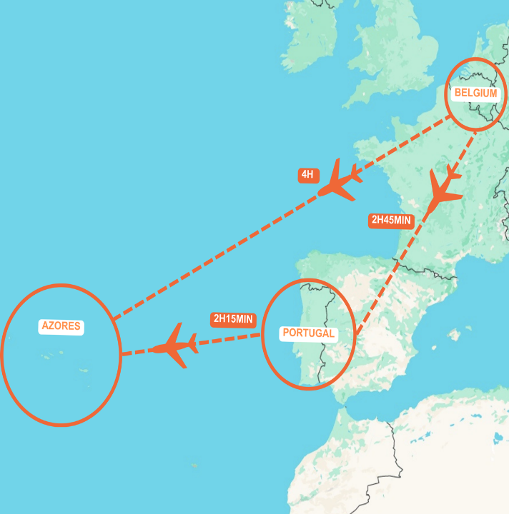
DIRECT FLIGHTS
Belgium - Azores
Direct Flights Available
Raynair

Slide 18


Slide 19


