Slide 1
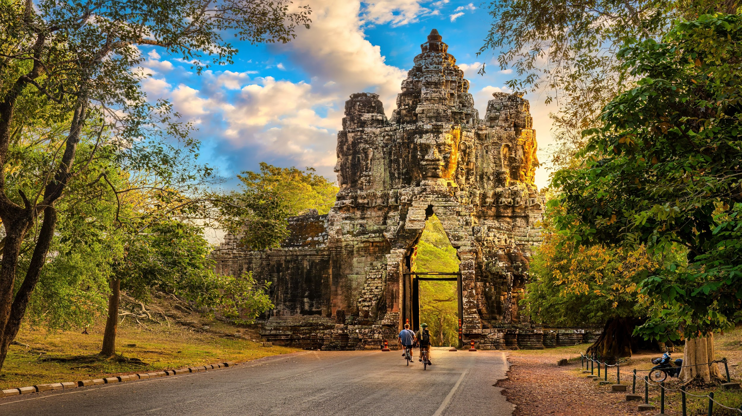

Cambodia
Famous temples
Dazzling rice paddies and swaying sugar palms
A history unlike any other

Slide 2

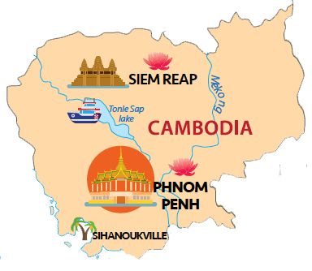
HEADLINES
1
2
Why Cambodia
Key cities
Myanmar
Vietnam
Laos
3
4
Activities
Dining experiences
5
6
Cambodia
Accommodation
Travel service
7
8
Cruising service
Tour sample
7/31/2025

Slide 3
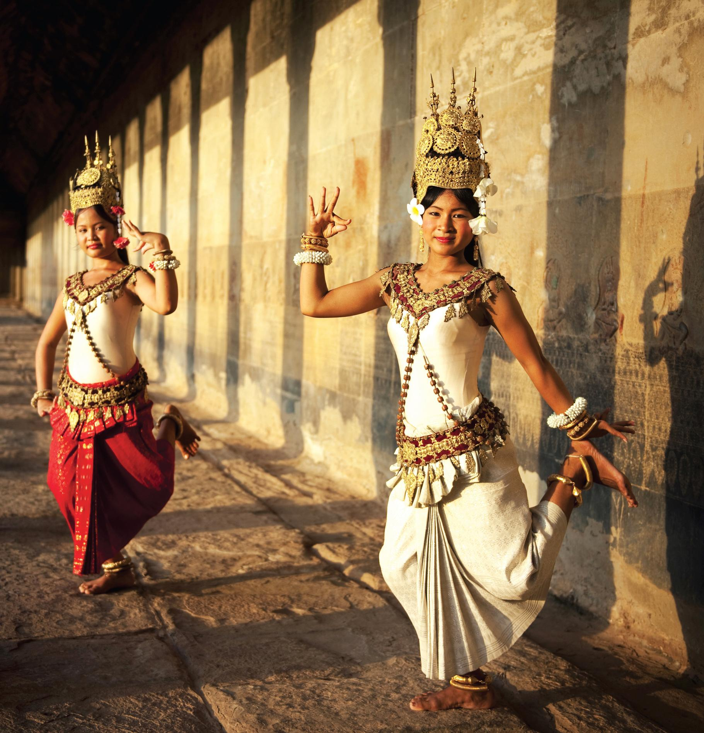
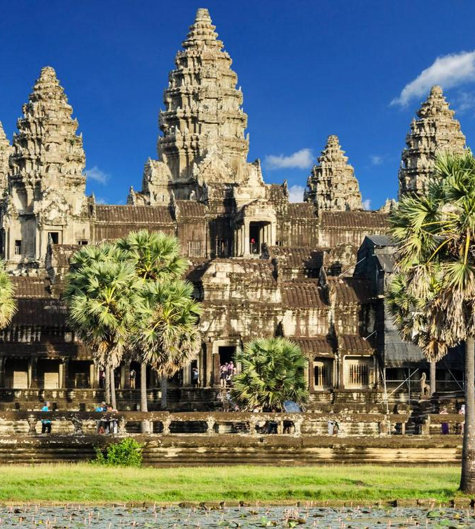
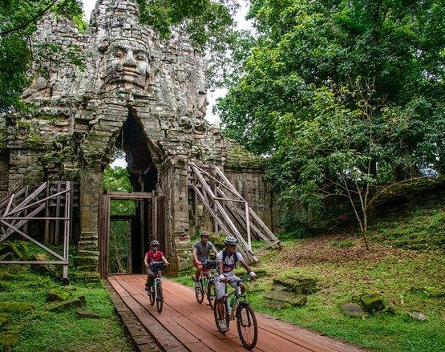
Why travel to Cambodia
Cambodia – the Kingdom of Wonder,
one of Southeast Asia’s most enjoyable destinations, plentiful attractions ranging from unspoilt beaches and colonial townscapes to dense forests, majestic rivers and lakes.
Back
7/31/2025
Simply your best local friend

Slide 4
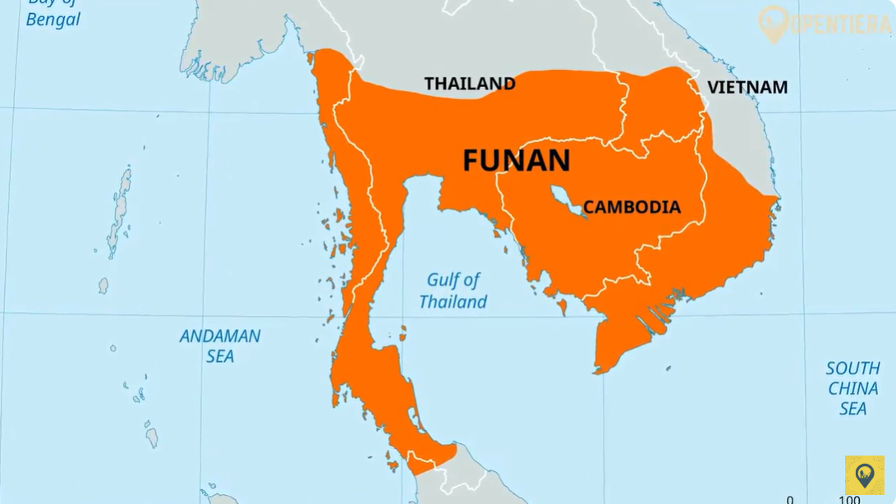
Why travel to Cambodia
Back
7/31/2025
Simply your best local friend

Slide 5
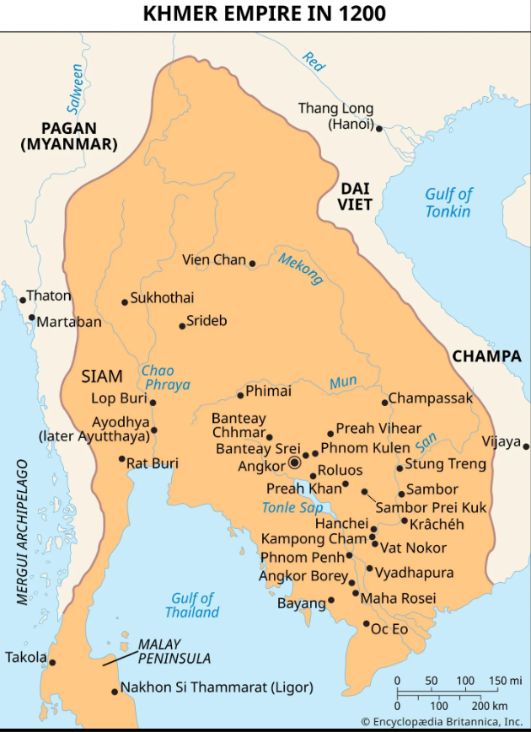
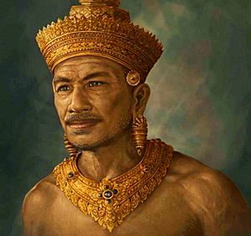
Why travel to Cambodia
Jayavarman II
Back
7/31/2025
Simply your best local friend

Slide 6
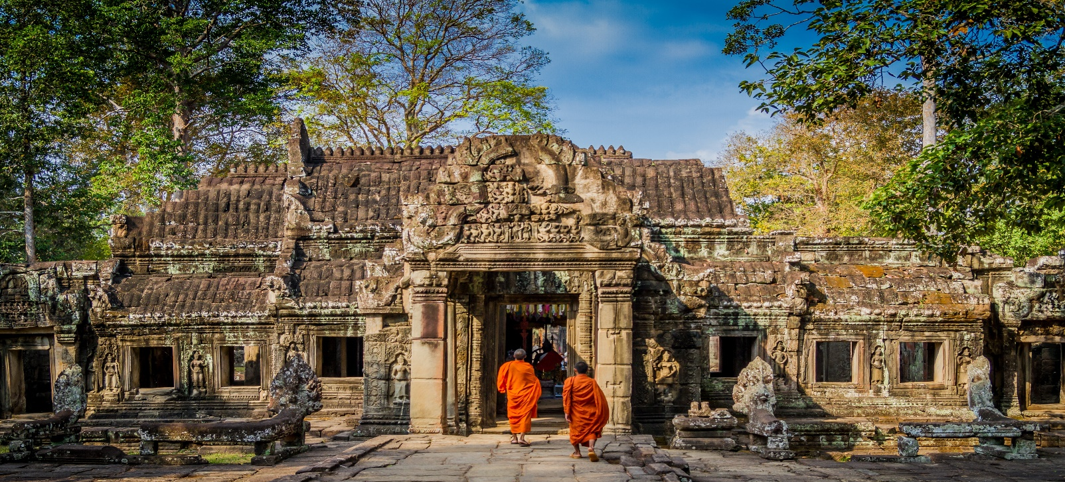
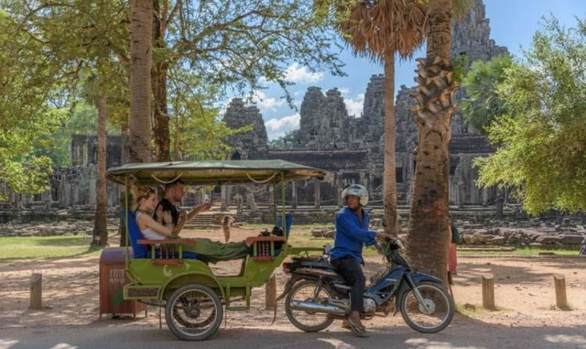
History
Once the great Khmer Empire with its heyday from 9th to 13th Century. Witnessed the downturn from 15th century until first half of 19th with many wars against the neighbor countries.
Felt under French colony in 90 years after that and gained independence in 1953 but experienced darkest time of civil war from 1975-1979 also known as the Khmer Rouge which devastated the country severely.
Culture
Largely homogeneous in population with majority is Khmer people (90%), some minor groups including Vietnamese, Chams, Chinese, and Khmer-Loeu or Montagnards.
Majority of population (95%) practice Theravada Buddhism which is deeply influenced by Hinduism and native animism. People tend to live in harmony and avoid aggression and conflict.
Back
7/31/2025
Simply your best local friend

Slide 7
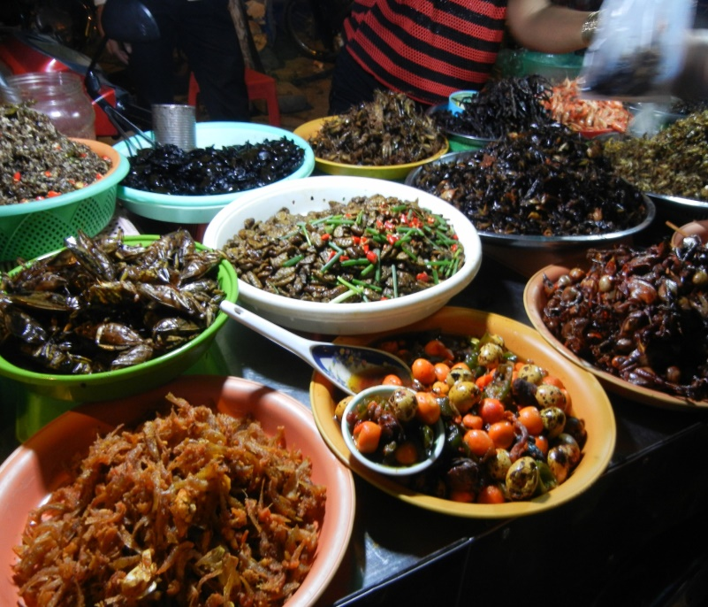
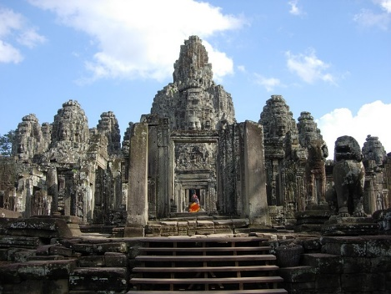
Food
Offer plentiful choices of other restaurants like Western restaurant (Italian, French), fast food for those who are not familiar with Asian food or Asian restaurants (Vietnamese, Chinese, Korean, Japanese) for Asian food lovers who love to try different cuisines in one destination.
Khmer’s cuisine: influenced by Chinese and Indian cuisine by using many spices and much of oil in cooking; shares many common dishes and ingredients in cooking with its neighbors Vietnam and Thailand. French cuisine is also reflected in Cambodia food more or less as a result of colonial time in the past.
Architecture
Influenced by Hinduism that featured in most of the Angkor temples
Traditional architecture can be seen in rural Cambodia typically by house-on-stilts while French colonial architecture legacies are remained in Phnom Penh, Kep, Battambang, Kampot.
Back
7/31/2025
Simply your best local friend

Slide 8




Weather – Best time to travel
Cambodia – A tropical monsoon climate country
Tropical monsoon climate country with the average temperature is 27 °C.
There are two seasons, the monsoon season from May to October, and dry season from November to April.
December to January is the coolest period while the hottest time is up to 40 °C during mid of Mar to April.
Jan | Feb | Mar | Apr | May | Jun | Jul | Aug | Sep | Oct | Nov | Dec
Siem Reap / Phnom Penh
Beach
Back
7/31/2025
Simply your best local friend
Notes:
Vietnam’s weather varies in regions, it would not be the one-size-fits-all answer.

Slide 9
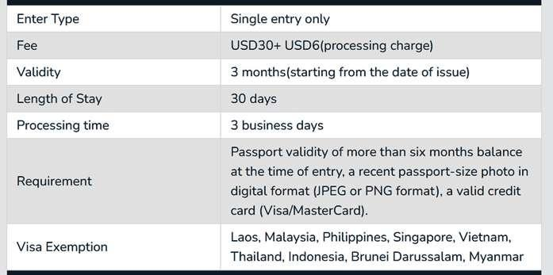

VISA
Visa on arrival
Documents required: passport copies, air tickets in/out Vietnam and travel insurance
Cambodia Visa stamp fee at USD 30/pax, one month, single entry is to be settled directly at the Immigration Office at international airports.
The process may take around 3 working days
E -Visa
E-Visa can be done on your own or assisted by Threeland Travel
Documents required: Passport copies, flight details and 1 passport-sized photo (clear, without glasses on)
Back
7/31/2025
7/31/2025
Notes:
Visa approval letter to Vietnam can be arranged by Threeland Travel

Slide 10


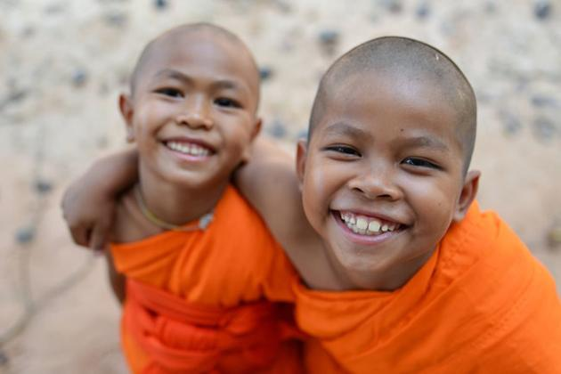
Safety
Stable politic, safe to go, no terrorism or demonstration
Peaceful & friendly people
Back
7/31/2025
Simply your best local friend

Slide 11
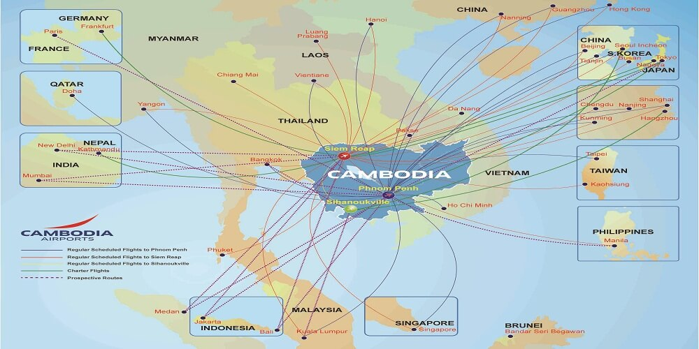
International connection
1-stop Indirect flight
You can connect to Cambodia with a flight transit in Doha (Qatar), Seoul (Asiana Airlines) or Dubai (Emirates) with the average flight time is 18-23 hours.
Madrid/ Barcelona
Doha;
Istanbul
Back
7/31/2025
Simply your best local friend

Slide 12
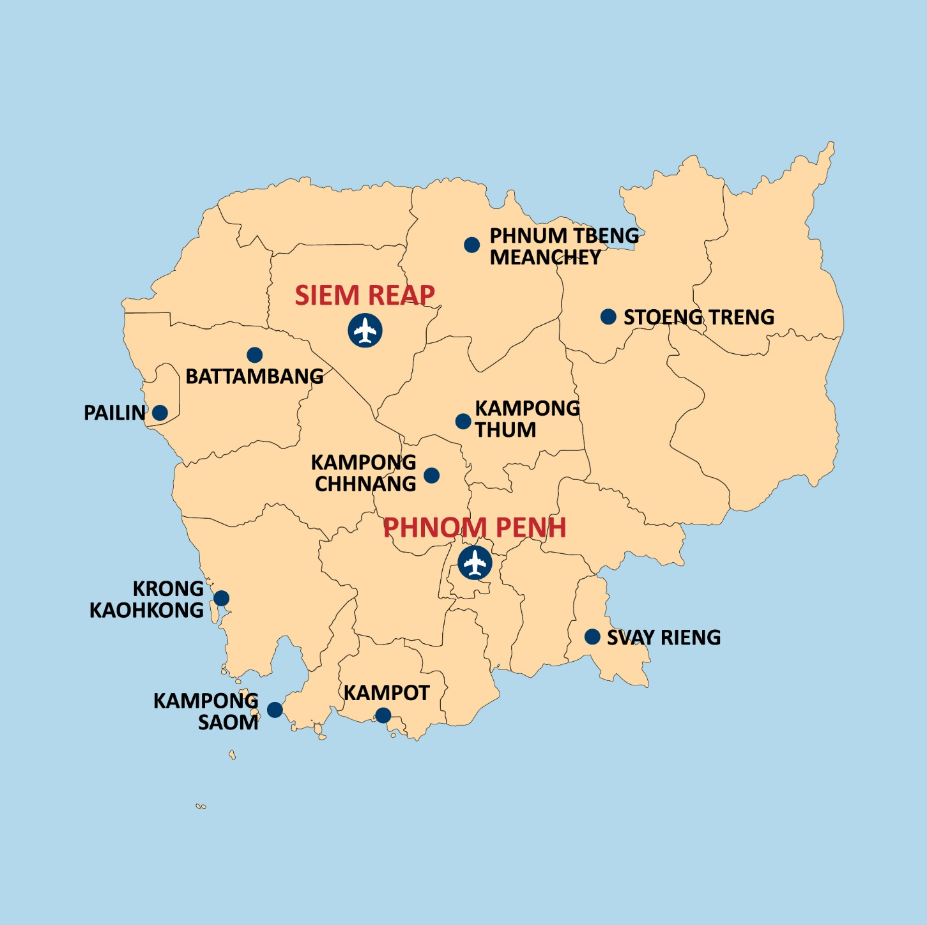

International airports
Three International airports across 3 regions
Near to must-see attractions in the region
Convenient for your immigration process
Back
7/31/2025
Simply your best local friend

Slide 13

International airports – service available
Free drinking water
Car rental service
Medical service
Baggage wrapping service
VIP services (business lounge, meeting rooms, shower).
Tourism information counters
Currency exchange counters
Free Wi-Fi
Ticketing
Exchange currency
Smoking area
ATM
Post and telegraph offices
Airport information counter
Duty free shops
Restaurants & cafes
Back
7/31/2025

Slide 14
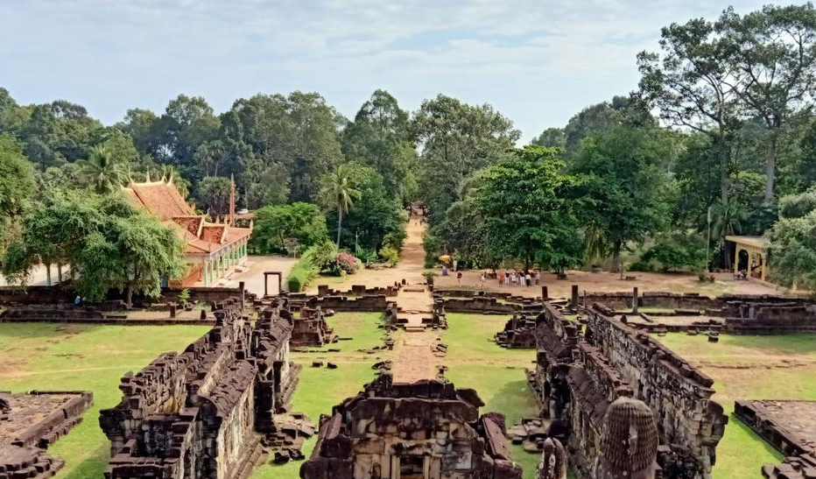



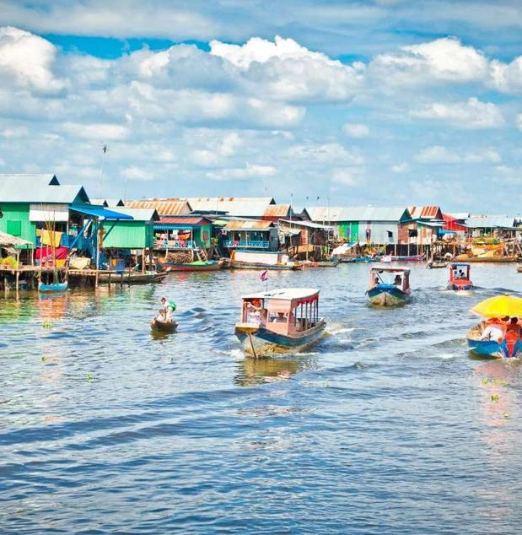
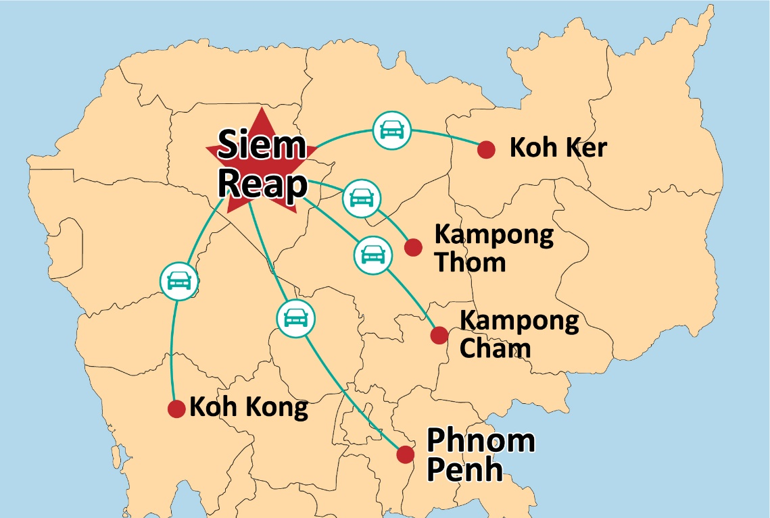
Siem Reap
Siem Reap is located in the Northwest of Cambodia, which is the ultimate boomtown, the most popular tourist destination of Cambodia. This city offers a gateway to the temples of Angkor. More than one hundred Angkorian monuments lie spread over some 3000 square kilometers of the countryside around the town.
Attractions:
+ Temples of Angkor
+ Roluos Group
+Tonle Sap
+Phnom Kulen
+Beng Mealea and Anlong Veng
Back

Slide 15
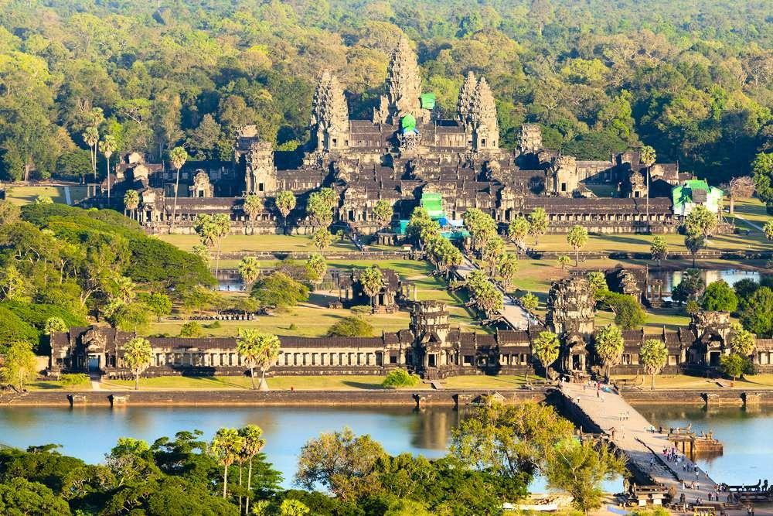
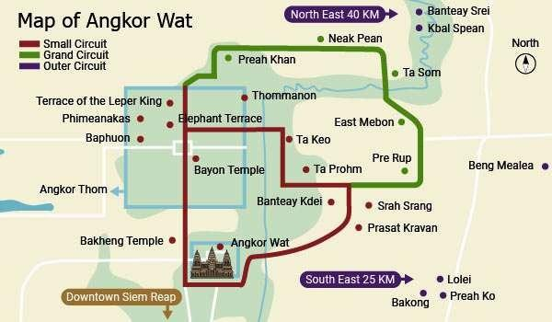
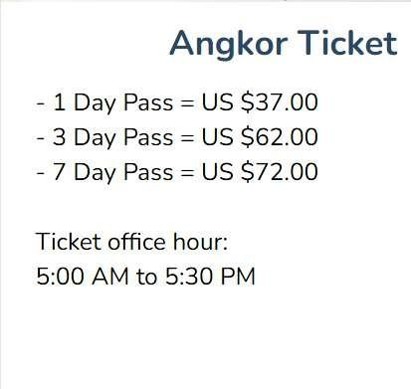
Angkor Wat Archaeological Park
Angkor is one of the most important archaeological sites in South-East Asia. They include the famous Temple of Angkor Wat and, at Angkor Thom, the Bayon Temple with its countless sculptural decorations.
1
Back
Notes:
Angkor Wat: This is the most famous temple in the Angkor complex and is considered to be one of the most impressive religious monuments in the world. It was built in the 12th century by King Suryavarman II and is dedicated to the Hindu god Vishnu.

Slide 16
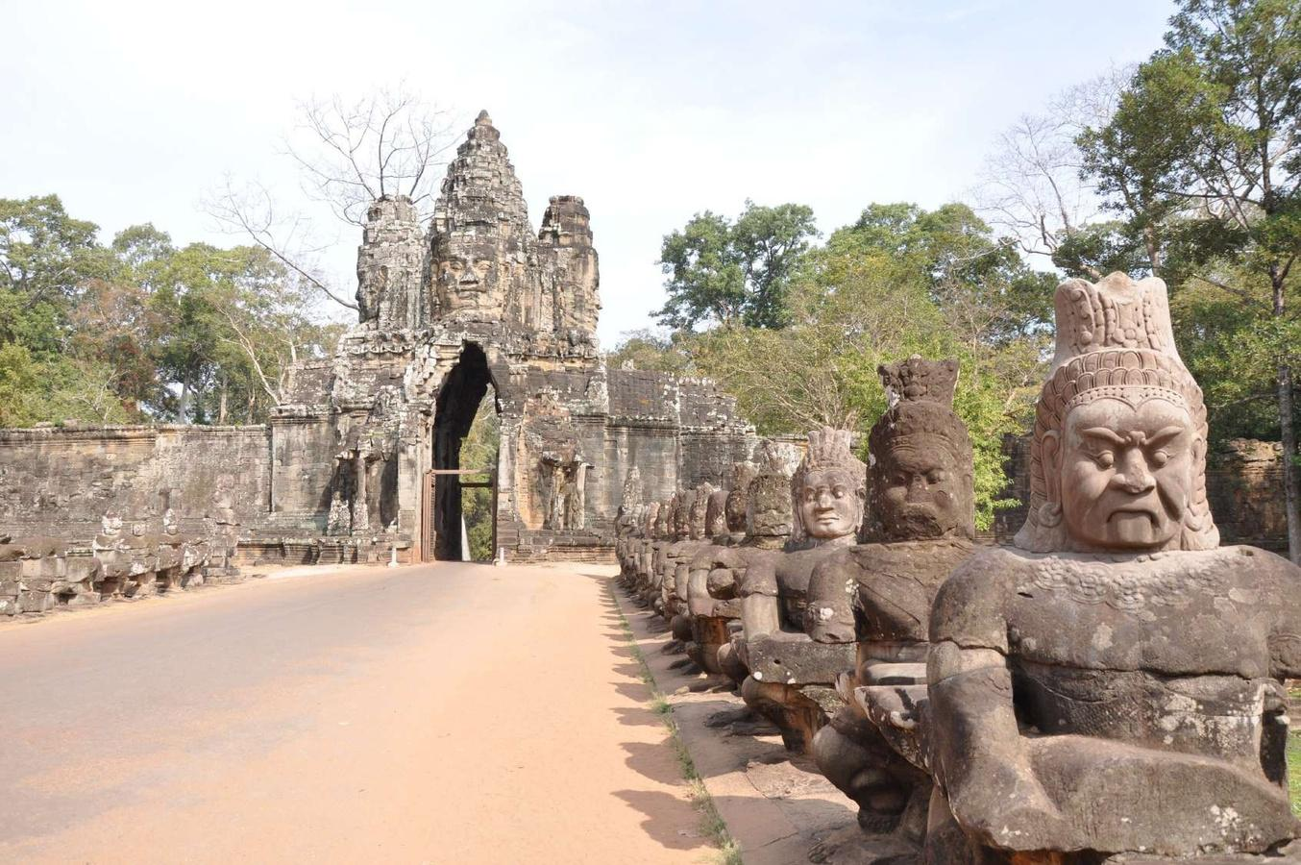
Siem Reap
Angkor Wat Archaeological Park
1
South gate of Angkor Thom along with a bridge of statues of gods and demons. Two rows of figures each carry the body of seven-headed naga. The south gate is now by far the most often visited, as it is the main entrance to the city for tourists.
Back

Slide 17
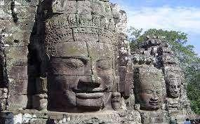
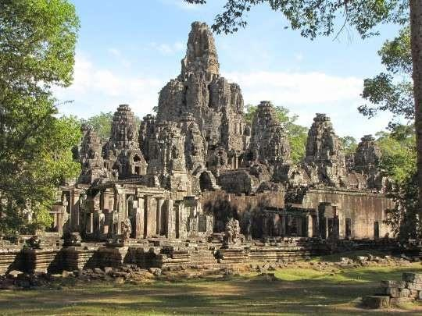
Siem Reap
Angkor Wat Archaeological Park
1
Bayon Temple: This temple is known for its 216 smiling faces that are carved into the towers. It is located in the center of Angkor Thom, which was the capital of the Khmer Empire.
Back

Slide 18
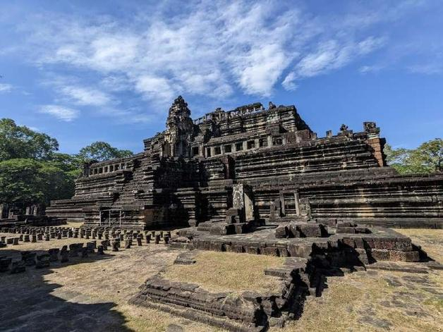
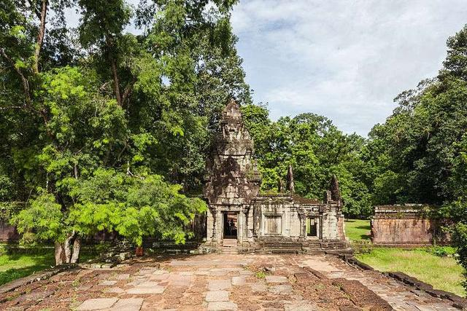
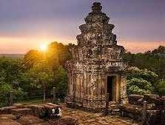
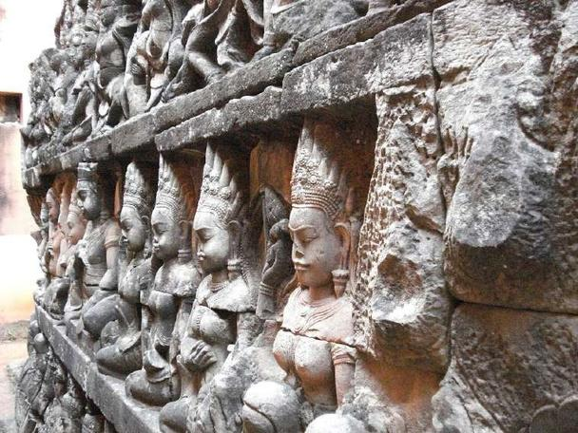
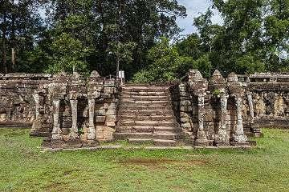
Siem Reap
Angkor Wat Archaeological Park
1
Inside Angkor Thom: Baphuon temple, Royal Palace Area and Phimeanakas , Leper King and Elephant terraces
Back

Slide 19
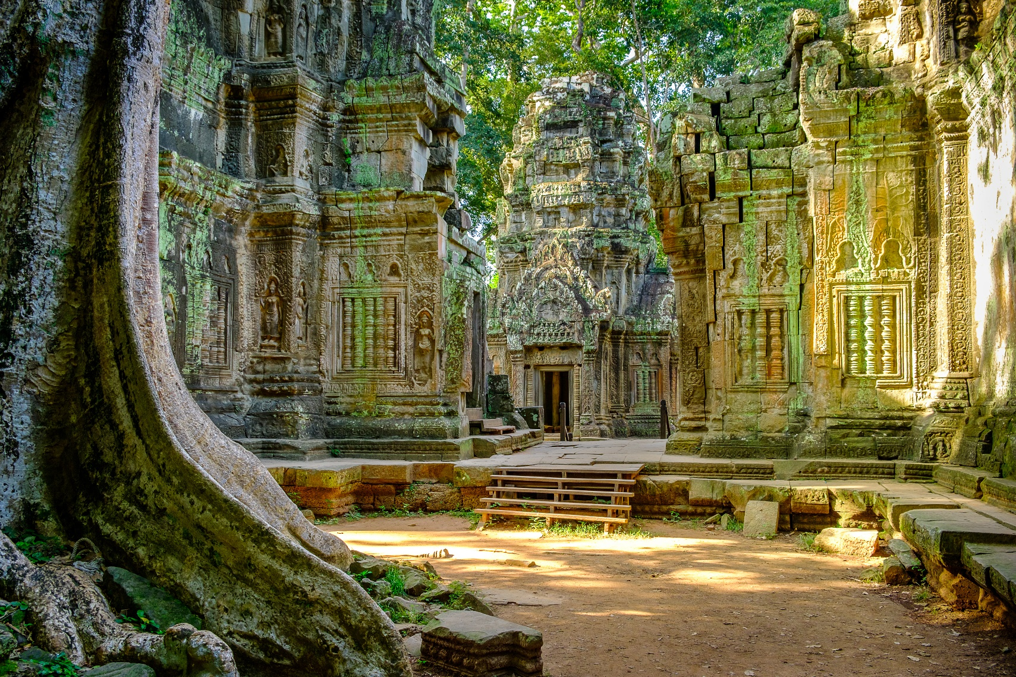
Angkor Wat Archaeological Park
1
Ta Prohm: This temple is known for its overgrown appearance and has been featured in several movies, including "Tomb Raider."
Back

Slide 20
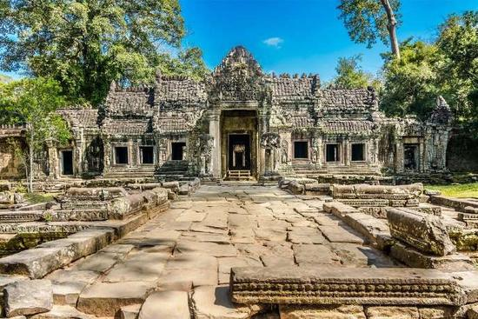
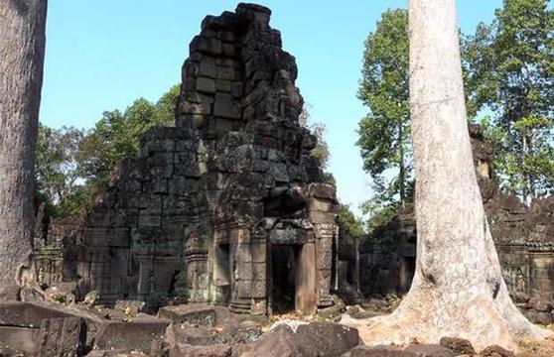
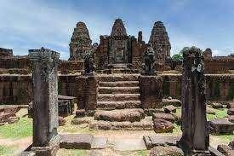
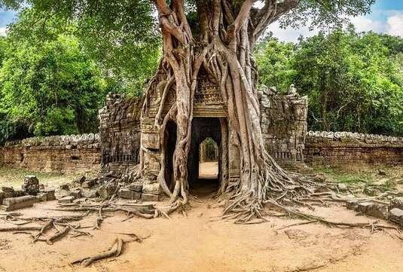
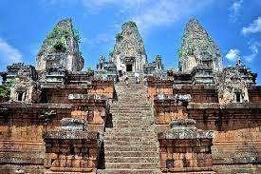
Angkor Wat Archaeological Park
1
Grand Circuit: Preah Khan, Banteay Prei, Ta Som, East Mebon, Prerup
Preah Khan
Banteay Prei
East Mebon
Ta Som
Prerup
Back

Slide 21
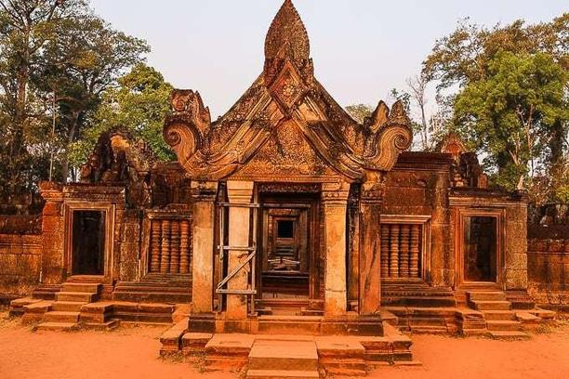
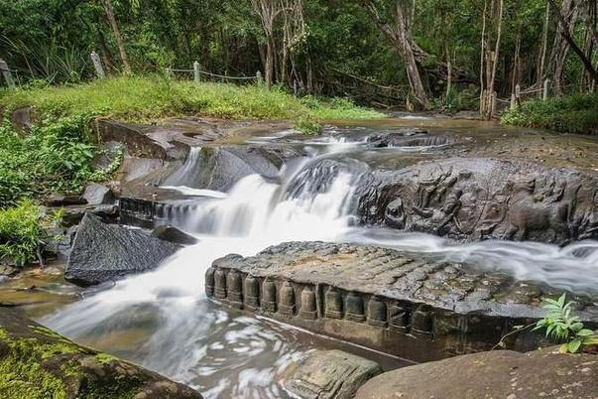
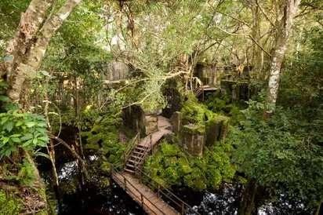
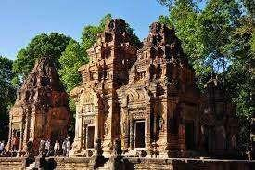
Angkor Wat Archaeological Park
1
Outer Circuit: Banteay Srei(built largely of red sandstone) , Kbal Spean(The River of a Thousand Lingas), Beng Mealea, Roluos
Banteay Srei
Kbal Spean
Beng Mealea
Roluos
Back

Slide 22
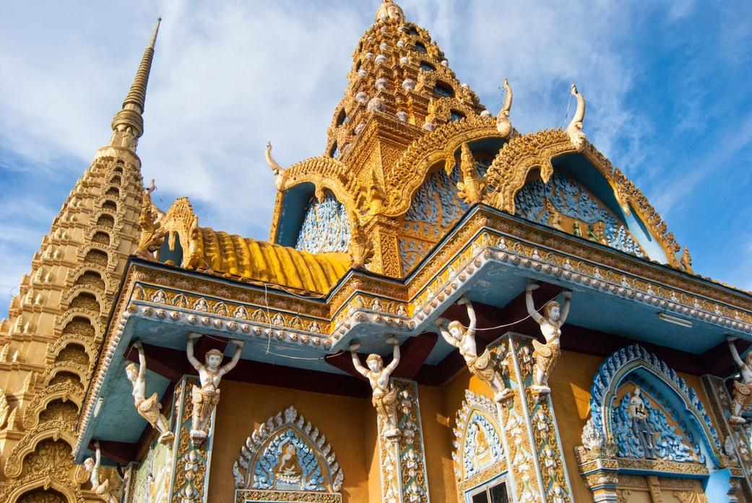

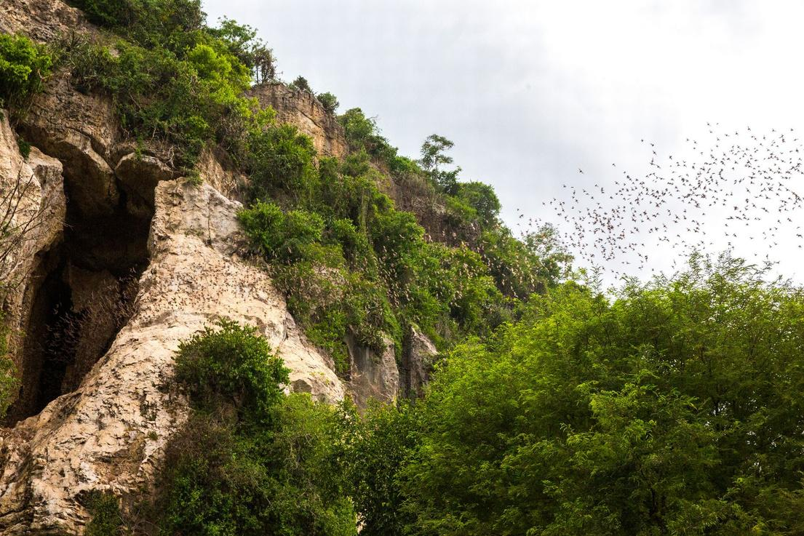
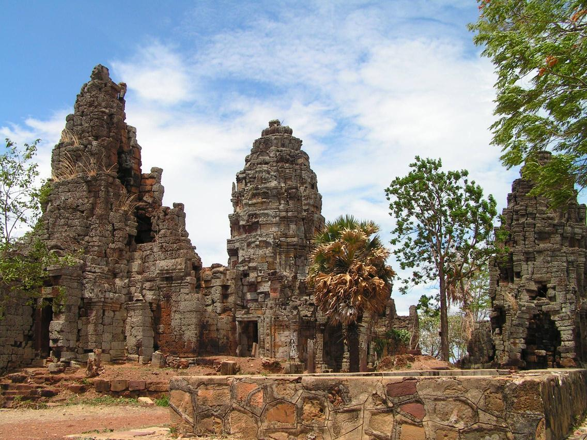
Battambang
Being called the ‘’most intellectual city’’ of Cambodia, laidback Battambang is worlds apart from Phnom Penh’s urban bustle and not nearly as a tourist spot as Siem Reap. It has a growing number of ex-pats fueling the growth of arty cafes, restaurants and bars.
Attractions:
+Phnom Sampeou
+Battambang Bat Caves, Killing Caves of Phnom Sampeau.
+Wat Banan, Wat Ek Phnom.
Back

Slide 23

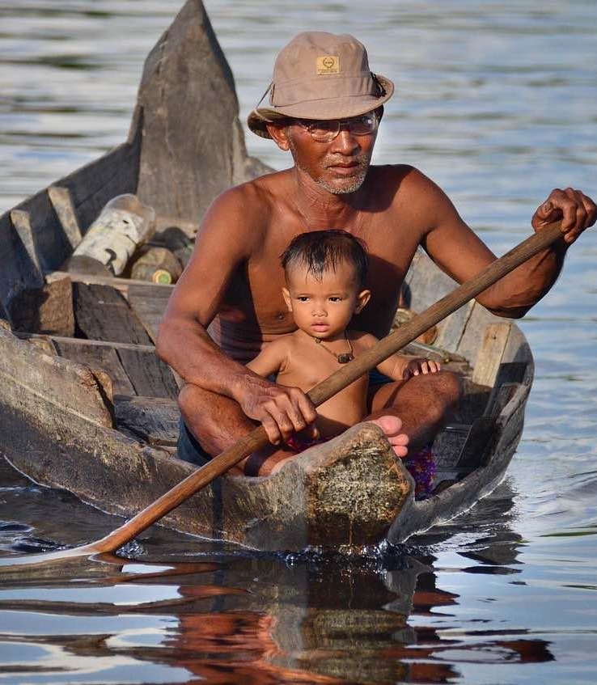
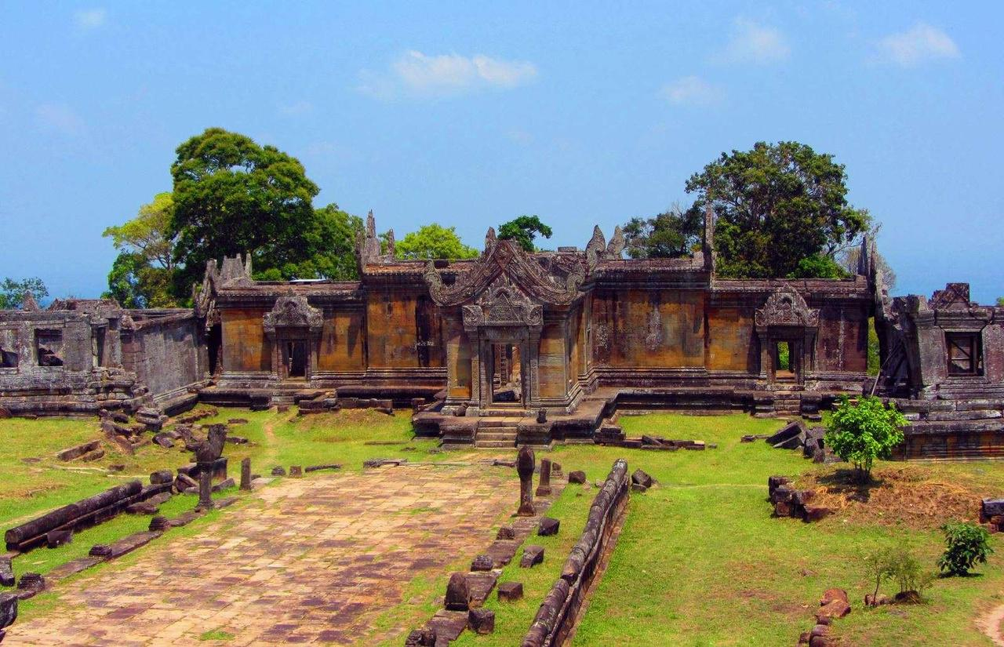

Kampong Thom
Being known as big provinces of the Kingdom of Cambodia, Kampong Thom and Preah Vihear are both next to Siem Reap and have big potentials for tourism development not only by location but also by their history, nature and culture. They are mainly about temples visit but who are interested in remote villages, Preah Vihear & Kampong Thom also can match the demand.
Attractions
The temples:
+ Old capital of Khmer Empire
+ Old worship place Preah Khan
+ Sambor Prei Kuk
The villages:
+ Villages in Preah Vihear
+ Tonle Sap Biosphere Reserve
Back

Slide 24
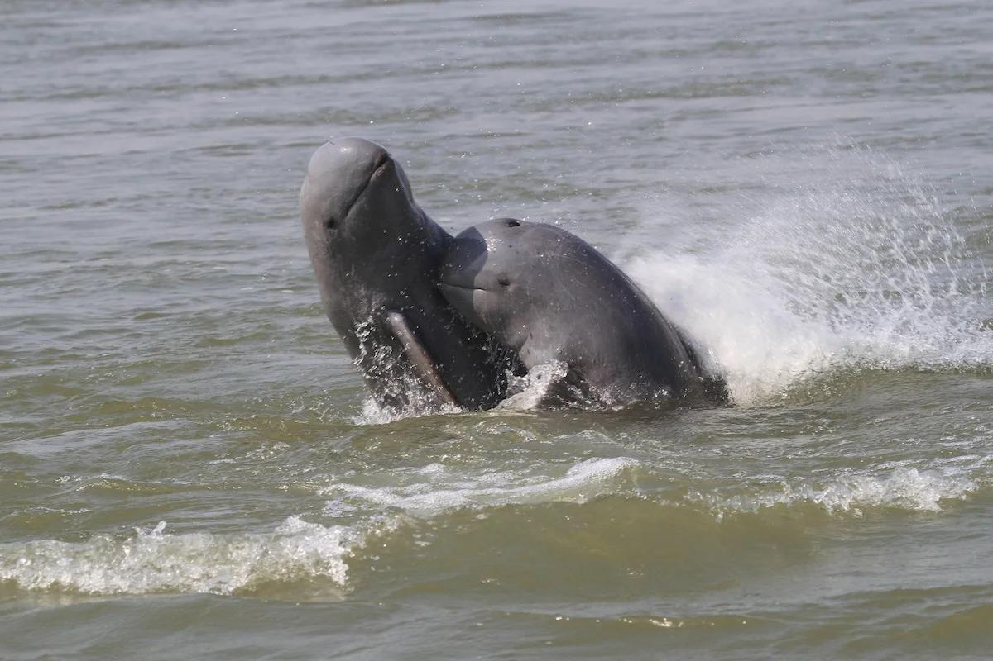
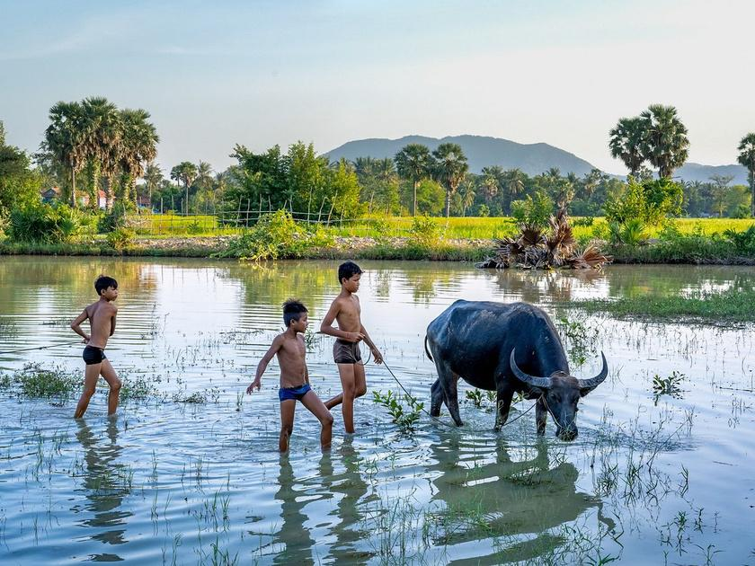
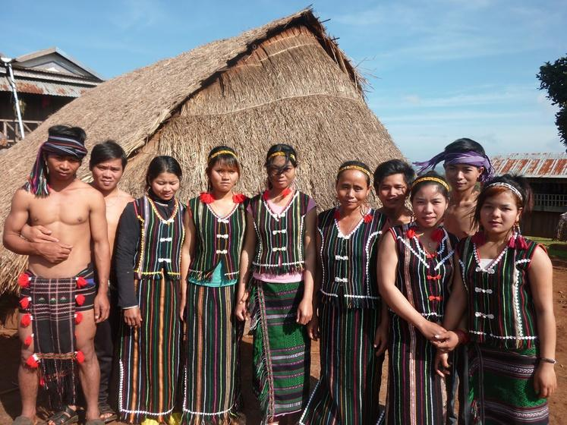

Kampong Cham
- Kratie - Mondulkiri
Kampong Cham - Located in the East of Cambodia where the Mekong river runs along, the city name means “the port of Cham people '', home to a minor group living for a long time who follow Muslim together with Christians and ethnic Chinese backgrounds.
Kratie - Known as the destination of rare freshwater dolphins in the world – Irrawaddy dolphins.
Mondulkiri - the original wild east, a perfect eco-tourism destination, natural beauty, elephant sanctuaries, ethnic communities and ecotourism
Highlights:
+ Irrawaddy dolphins
+ Natural sites
+ Diversity of culture leads to the variety of languages being used
Back

Slide 25
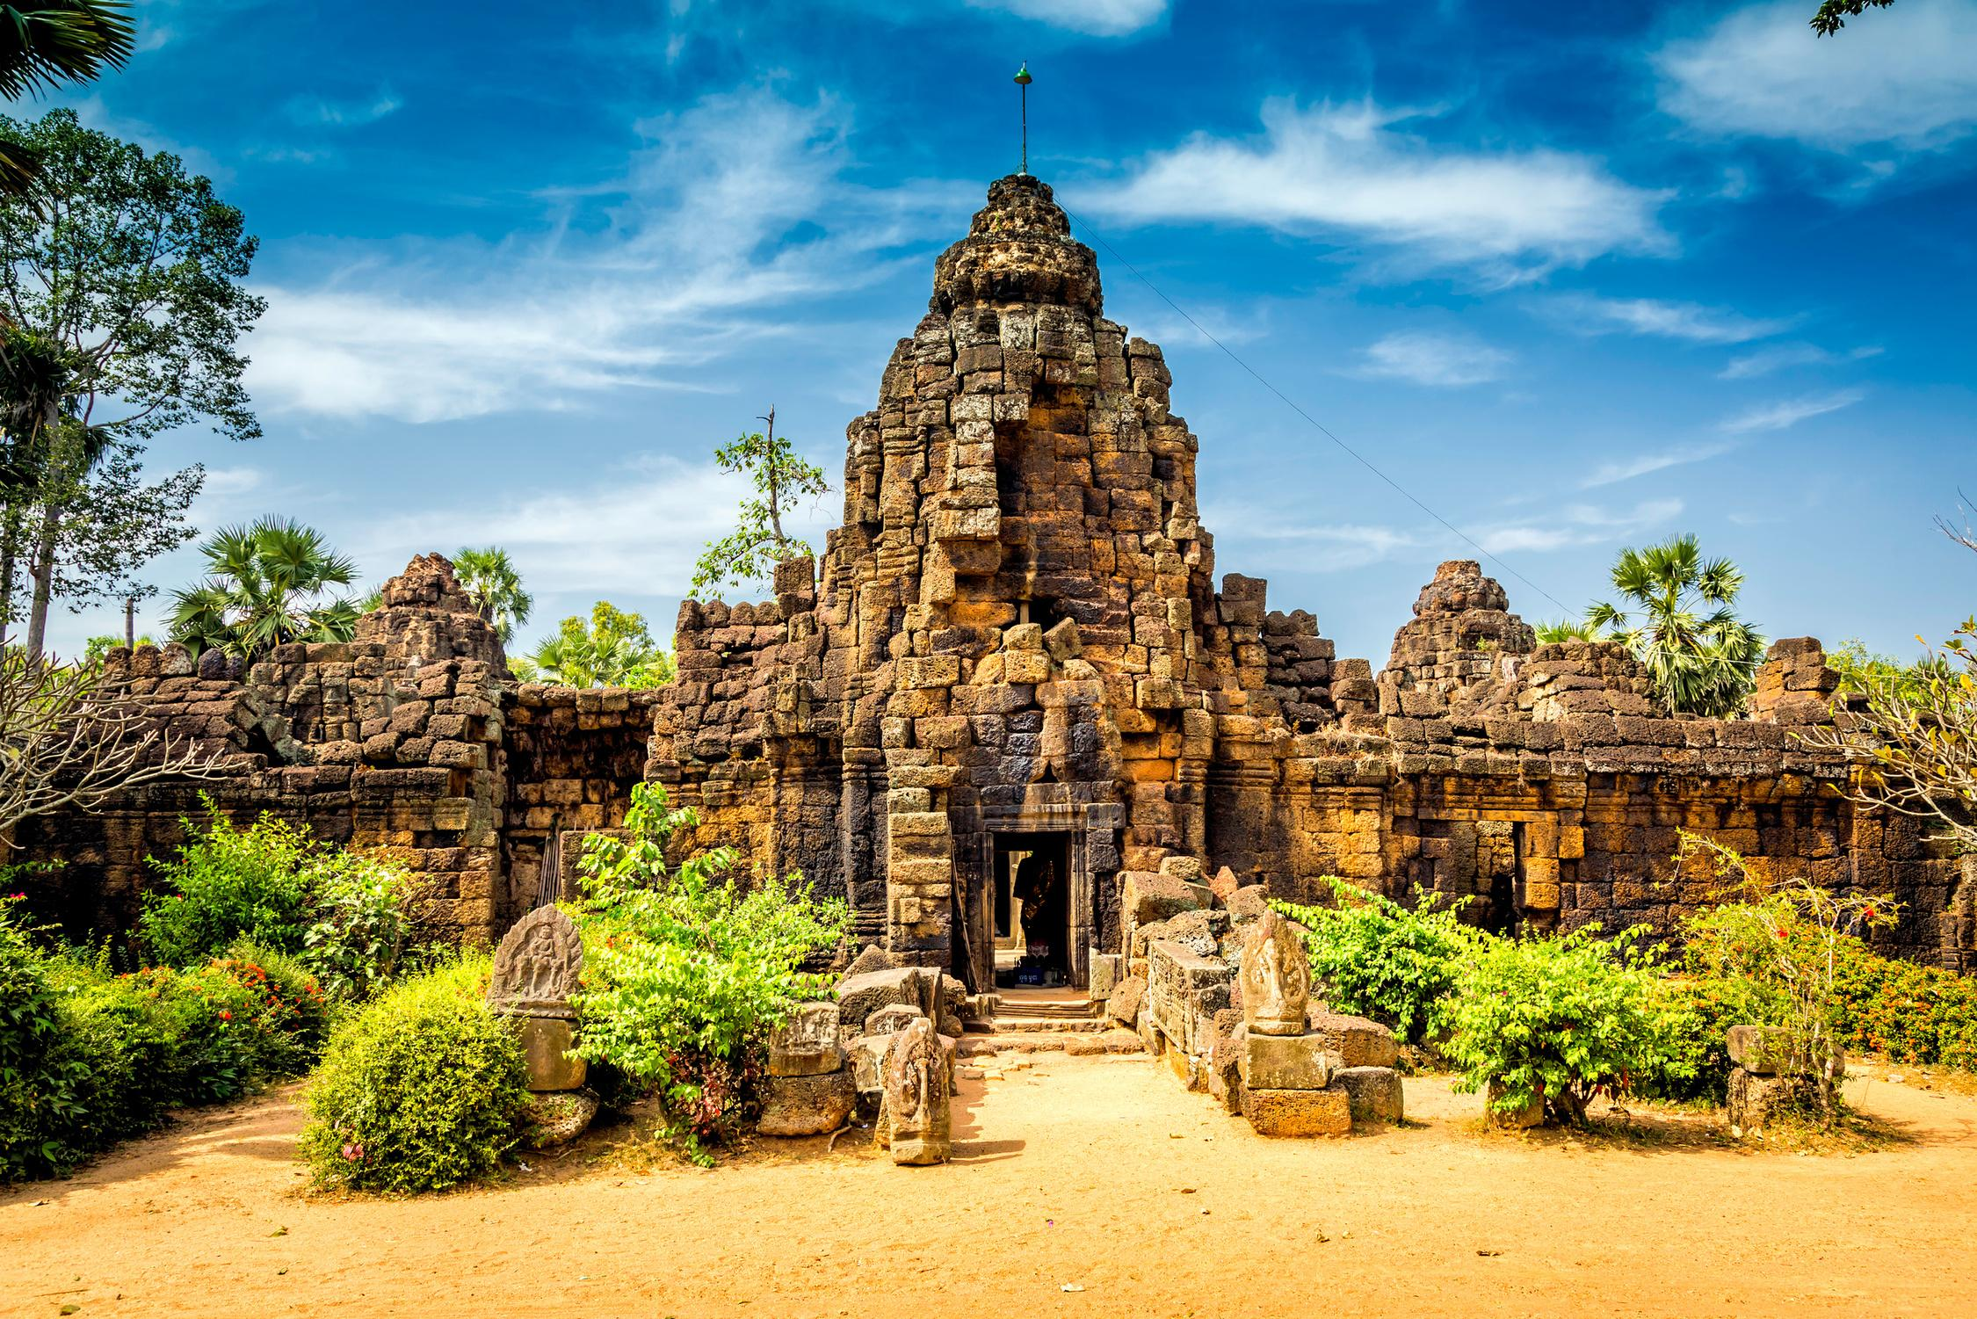
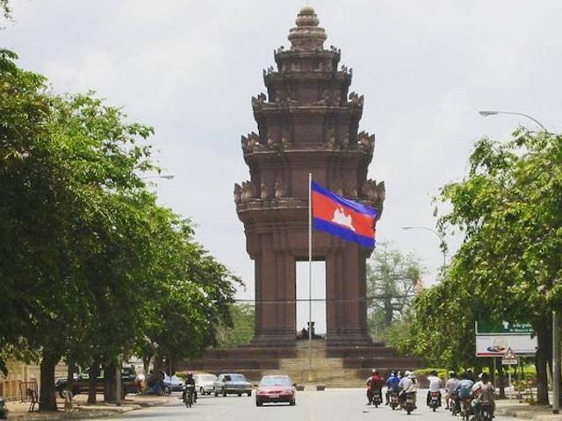



Phom Penh
It is the capital city of Kingdom of Cambodia, which is the center of culture, political, and economy of the country. Travelling to the city, it is easy to reach the lost Khmer ancient empire, and the vibrant streets of modern life.
Attractions:
+ National Museum
+ Royal Palace and Silver Pagoda
+Wat Phnom
+Killing Field
+The rivers Tonlé Bassac
+ Tonle Bati
+ Koh Dach
Back

Slide 26




Sihanouville
It is a coastal province in the South of Cambodia, which is the lead center of trading, economy and beach tourism of the country. Sihanoukville is located near to the Gulf of Thailand that brings this city value of economy, one of them is tourism.
Highlights:
+Water sports
+Mini golf, Tuk tuk trip
+National park
Sea Breeze Resort
Sokha Beach Resort
Sandy Beach Bungalows
Back

Slide 27





Other beach destination
Long Beach, Koh Rong
Lazy Beach, Koh Rong Samloem
Fine white sand, rolling blue water
Kep Beach
Clean, clear water, excellent diving conditions
Evason Ana Mandara
Coral Beach, Koh Ta Kiev
Back
7/31/2025
Simply your best local friend

Slide 28


Highlight activities
Phare Circus
The Pub Street
An amazing vibe & energy show which transforms the lives of Cambodian youth
The liveliest area in Siem Reap after dark falls
Back
7/31/2025
Simply your best local friend
Notes:
There are many experiences that we can add but here are a few highlights

Slide 29


Highlight activities
Helicopter experience
Angkor Zipline
For the ultimate luxury experience in Cambodia, try a helicopter ride for spectacular views over Phnom Penh city or Siem Reap and the Angkor Complex
See the Angkor Archaeological Park from a unique perspective on this zipline tour
Back
7/31/2025
Simply your best local friend
Notes:
There are many experiences that we can add but here are a few highlights

Slide 30


Highlights Activities
Dinner with Apsara Show
Hot air balloon over Angkor complex
A taste of classical Khmer culture
A chance to sail with clouds & admire the majestic Angkor Wat from bird eyes
Back
7/31/2025
Simply your best local friend

Slide 31


Highlights Activities
Ride a bamboo Train
Trek through the jungle
Take a fun ride on the bamboo train, or nori, which is a bamboo flatbed on wheels, and powered by a small motorcycle/ tractor engine.
Explore the jungle at Cardamom Mountains, Southeast Asia’s largest remaining rainforest.
Back
7/31/2025
Simply your best local friend

Slide 32


Highlights Activities
Sample street food
Elephant feeding
The country’s streets are awash with street food vendors selling a variety of local delicacies for visitors to sample. Try out this in your Cambodia trip.
Animal lovers are in for a treat because a variety of endangered and rare wildlife call Cambodia home
Back
7/31/2025
Simply your best local friend

Slide 33





Restaurants
You will have several of choices from the fine-dining restaurants to fast foods or street foods, from local/Chinese/Thai/Asian/European/Italian/Indian, as well as the vegetarian cuisine, under different ways of serving from set menu or buffet to alacart.

Slide 34




Restaurants
Cambodia Cuisine
Cambodian cuisine is heavily influenced by Chinese, Thai, and Vietnamese cuisine.
Water, rice and freshwater fish exert the most profound influences on Khmer cuisine.
Sugar and coconut cream are used for flavour
Back
7/31/2025
Simply your best local friend

Slide 35




Restaurants
Western Cuisine
Match with variety of demands from visitors of all cultures
Plentiful choices Italian, French, Western food, Middle East, Turkish, fast food
Back
7/31/2025
Simply your best local friend

Slide 36




Restaurants
Vegetarian Cuisine
New philosophy of a well-balanced and healthy life.
Easily find a quality vegetarian restaurants throughout the countries
Back
7/31/2025
Simply your best local friend

Slide 37




Unique dining Experience
New concept of the dining places:
Bon Phum
Temples Gala dinner
Lunch at local village
Sunrise breakfast
Sunset cocktail
… and so on
Back
7/31/2025
Simply your best local friend

Slide 38

Unique dining Experience
Sunset Dinner Cruise in Phnom Penh
On this 2-hour dinner cruise, enjoy the sunset, listen to live traditional Khmer music, coast past floating villages, see the Royal Palace, and marvel at the Phnom Penh skyline from a different perspective
Back

Slide 39

Unique dining Experience
Enjoy Dinner On Tara Boat
Board the legendary Queen Tara, one of the biggest floating restaurants in Siem Reap, and share a romantic evening with your loved ones when you embark on the Queen Tara sunset cruise in Siem.
Back

Slide 40

Accomodation in Cambodia
Wide range of options:
from numerous international brand hotels with well-equipped conference facilities to deluxe homestays
Other services included: Restaurants, Pool, Gym, Spa treatment, Outdoor activity's facilities… and so on.
Photo: Palace Gate Resort & Spa
Photo: Raffles Grand Hotel D'angkor.
Back
7/31/2025

Slide 41









5 STAR BRANDS
Back
7/31/2025

Slide 42






06- HOTELS / SIEM REAP
Hotels in Siem Reap
5 STAR HOTELS
Angkor Miracle Resort & Spa
Sokha Angkor Resort
Borei Angkor Resort and Spa
Total 324 rooms
( Standard)
Total 188 rooms
(Superior)
Total 276 rooms
(Superior)
Back

Slide 43




Hotels in Siem Reap
5 STAR HOTELS
(Luxurious)
Anantara Angkor Resort
(Luxurious)
Sofitel Angkor Phokeethra Golf & Spa Resort
Total 39 rooms
Total 238 rooms
Back

Slide 44






06- HOTELS / SIEM REAP
Hotels in Siem Reap
5 STAR HOTELS
Park Hyatt Siem Reap
Le Méridien Angkor
Raffles Grand Hotel d'Angkor
Total 119 rooms
Total 104 rooms
Total 220 rooms
Back

Slide 45




06- HOTELS / SIEM REAP
Hotels in Siem Reap
4 STAR HOTELS
(Standard)
(Superior)
MEMOIRE SIEM REAP HOTEL
SOMADEVI ANGKOR RESORT & SPA
Back
Total 74 rooms
Total 170 rooms

Slide 46






Hotels in Phnom Penh
5 STAR HOTELS
KVL hotel Total 76 rooms
(Superior)
Tribe Phnom Penh Post Office
Palace Gate Hotel & resort
Total 260 rooms
Total 105 rooms
( 4 stars international)
(Superior)
Back

Slide 47




Hotels in Phnom Penh
5 STAR HOTELS(fav list)
Sofitel Phnom Penh
Hyatt regency Phnom Penh
Total 74 rooms
(Luxurious)
Total 247 room
(Luxurious)
Back

Slide 48




Hotels in Phnom Penh
4 STAR HOTELS (fav list)
(Standard)
(Standard)
G Mekong Hotel
Sensory Park Urban
Total 91 rooms
Total 78 rooms
Back

Slide 49




Hotels in Phnom Penh
4 STAR HOTELS (fav list)
(Superior)
(Superior)
Sunway hotel
Sun and Moon hotel
Back
Total 138 rooms
Total 80 rooms

Slide 50


Travel service – accessibility between regions
Domestic flight
245 (nonstop) flights from from Siem Reap to Phnom Penh per week, avg 35 per day. As of June, there are 38 flights per week flying from Siem Reap to Sihanoukville.
MAINSTREAM AIRLINES: Cambodia Angkor Air.
LOW COST CARRIERS: Lanmei Airlines, Cambodia Airways and JC International Airlines.
Indochina flight
Back
7/31/2025
Simply your best local friend

Slide 51

Travel service – accessibility between regions
From Siem Reap to:
Battambang: Land transfer (3.5hours);
Phnom Penh:
By Land transfer in 6 hours
By Flight in 1 hour.
Sihanoukville: Flight in 55 minutes.
Kratie:
By Land transfer: overnight bus (not recommend) or private car in 6-7 hours
By flight (just one flight per week) in apx 1 hour
From Phompenh to:
Kep: Land transfer in 3 hour (175km)
Sihanoukville:
By Land transfer in bus (not recommend) or car in 3.5 hours
By flight (3 flights per week) in 45 minutes.
Back

Slide 52

Travel service – accessibility between regions
OVERLAND ROUTES
Bangkok - Siem Reap : 8-9 Hours (Poipet) (400km)
Siem Reap - Phnom Penh : 5.5- 6 Hours (320km)
Phnompenh - Hochiminh City: 7 Hours ( Bavet/ Moc Bai) 280km
Phnom Penh - Chau Doc (Vietnam): depart 07:30 AM, speedboat 5.5 hours, Vinh Xuong
Border crossings with Vietnam: Cambodian visas are available at most crossing points including the Bavet/Moc Bai and Chau Doc (Kaam Samnor) crossings.
Back

Slide 53


Travel service – accessibility between regions
Visa on arrival – fast track service, VIP services
Welcoming at the aircraft gate
Get visa stamp at visa counter without waiting in line
Be assisted and escorted throughout immigration procedure
Baggage porters available on request
Back
7/31/2025
Simply your best local friend

Slide 54


Airport transfer: We’ve served 24/7 at all international airports with onsite staff
Cambodia: Siem Reap, PhnomPenh, Sihanoukville international airport
Business transfer for corporate, golf or business traveler
Limo services with luxury brands such as Mercedez S class, BMV series 7… for VIP group
Back
7/31/2025
Simply your best local friend

Slide 55







4 seat
7 seat
16 seat
TRAVEL SERVICE – VEHICLES
24 seat – 35 seat
45 seat
Limousine Service
Back
7/31/2025
Simply your best local friend

Slide 56


Mekong Cruises between Vietnam & Cambodia
3 nights & 4 nights cruise between Saigon & Phnom Penh
Day 1: Saigon
Day 2: Cai Be
Day 3: Chau Doc
Day 4: Phnom Penh
Back
7/31/2025
Notes:
Easy to connect to: Rach Gia – Phu Quoc
Chau Doc – Phnom Penh

Slide 57

Mekong Cruises between Vietnam & Cambodia
8 days & 7 nights cruise between Saigon (Ho Chi Minh), Phnom Penh & Siem Reap
(only run in high water season: Jul - Apr)
Day 1: Ho Chi Minh City
Day 2: Cai Be–Sa Dec
Day 3: Chau Doc–Cambodian Border Crossing
Day 4: Phnom Penh
Day 5: Phnom Penh–Prek Bang Kong
Day 6: Wat Hanchey–Angkor Ban
Day 7: Konpong Louang–Kampong Tralach
Day 8: Siem Reap
Back
7/31/2025
Notes:
Easy to connect to: Rach Gia – Phu Quoc
Chau Doc – Phnom Penh

Slide 58




Mekong Cruises between Vietnam & Cambodia
Standard | Superior | First class
Le Cochinchine Cruise | Toum Tiou Cruise | Aqua cruise
 | Jayavarman cruise
 | Jahan cruise
Back

Slide 59

TOUR SAMPLE
HIGHLIGHTS IN VIETNAM & CAMBODIA
Cambodia – Temple and Beach - 7D6N
Threeland's first feeling – 13D12N
Back
7/31/2025
Simply your best local friend

Slide 60

TOUR SAMPLE
HIGHLIGHTS IN VIETNAM & CAMBODIA
Cambodia – Temples and beach – 7D6N
Day 1: Siem Reap arrival
Day 2: Siem Reap exploration
Day 3: Siem Reap exploration
Day 4: Siem Reap – flight to Sihanouk Ville - boat to Koh Rong
Day 5: Koh Rong free & easy
Day 6: Koh Rong boat to Sihanoukville – by car Phnom Penh
Day 7: Phnom Penh city tour - Departure
Back
7/31/2025
Simply your best local friend

Slide 61

TOUR SAMPLE
HIGHLIGHTS IN VIETNAM & CAMBODIA
Threeland's first feeling – 12D11N
Day 01 Luang Prabang arrival – City Tour
Day 02 Luang Prabang City Tour – Khoangsi Waterfall
Day 03 Luang Prabang – Pak Ou Caves – Fly To Hanoi
Day 04 Hanoi City Tour
Day 05 Hanoi – Halong – Overnight Cruise
Day 06 Halong – Hanoi – Fly To Saigon
Day 07 Saigon City Tour
Day 08 Saigon – Mekong Delta – Saigon
Day 09 Saigon – Cu Chi Tunnels – Fly To Siem Reap
Day 10 Siem Reap – Angkor Temples
Day 11 Siem Reap City Tour & Floating Village
Day 12 Siem Reap – Departure
Back
Back
7/31/2025
Simply your best local friend

Slide 62





