Slide 1

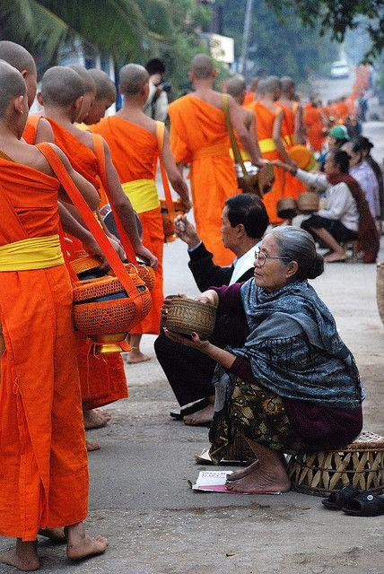

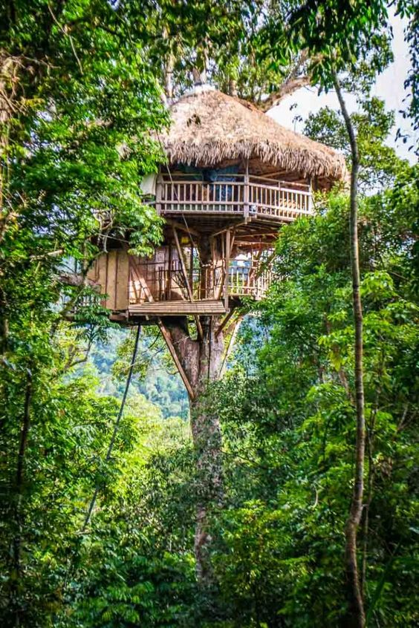

LAOS
7/31/2025

Slide 2
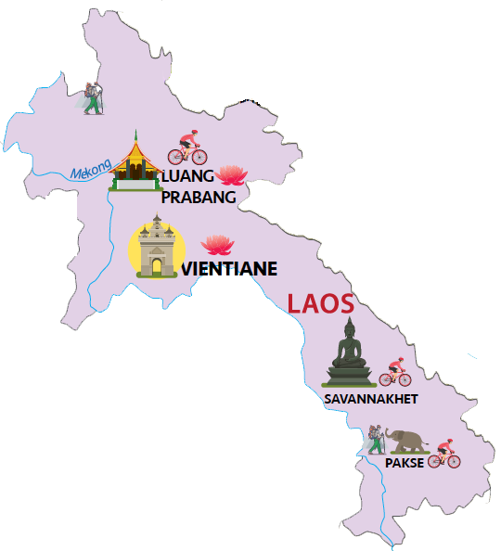
HEADLINES
Myanmar
Vietnam
1
2
Laos
Why Laos
Key cities
3
4
Activities
Dining experiences
Cambodia
5
6
Tour sample
Accommodation
7/31/2025

Slide 3

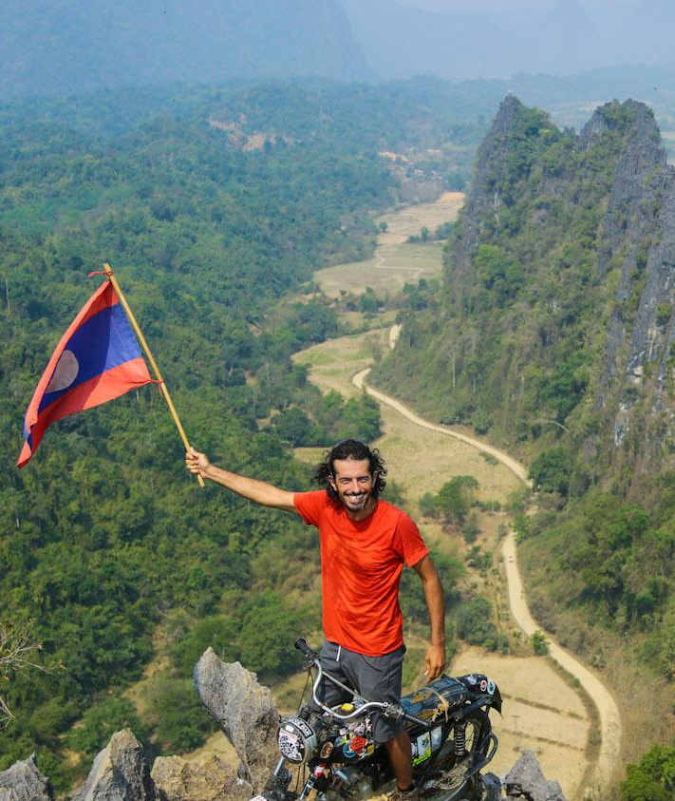
WHY LAOS
Laos
Capital
Vientiane
Big hubs
Luang Prabang, Vang Vieng, Xieng Khouang, Pakse
A completely landlocked and largely mountainous topography
A wide range of adventurous activities with different levels
Special features
‹#›
7/31/2025
Simply your best local friend

Slide 4
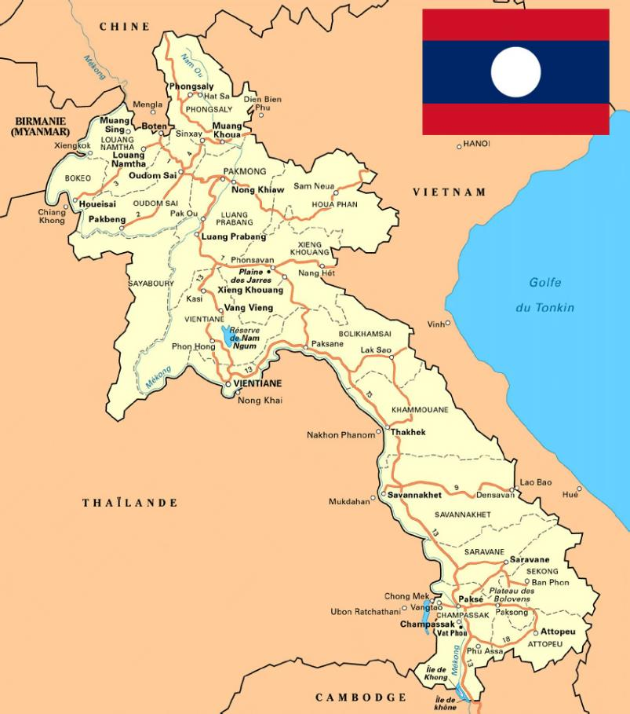
LAOS GENERAL INFORMATION
LAOS INFO
LAOS INFO
LAOS INFO
  Lao People’s Democratic Republic
  Capital: Vientiane
  Population: 7,875,178 (est 2025)
  Area: 236,800 sq km
  Borders to
  Vietnam: 2,161 km
  Thailand: 1,845 km
  Cambodia: 555 km
  China: 475 km
  Myanmar: 238 km
  Terrain: 70-80% covered by mountain, hills
  Religion: 67% Buddhism
  Ethnics: About 49 groups
  Currency: KIP
70-80% of territory is covered with mountains / hills
The only landlocked country in South East Asia
Phou Bia is the highest mountain of 2817 meter

Slide 5


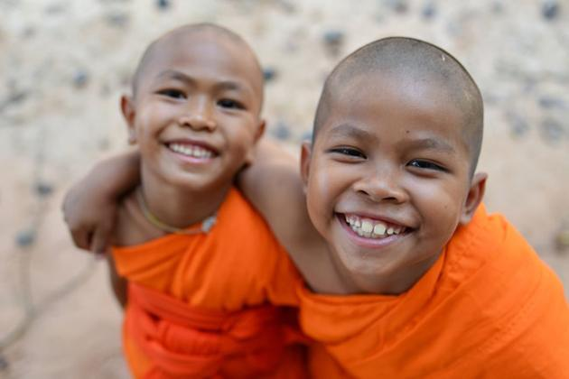
WHY LAOS
Security
Stable politic, safe to go, no terrorism or
demonstration, peaceful & friendly people
Back
7/31/2025
Simply your best local friend

Slide 6
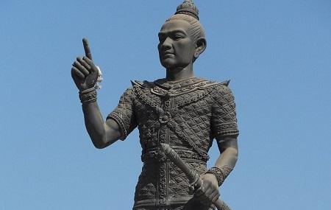
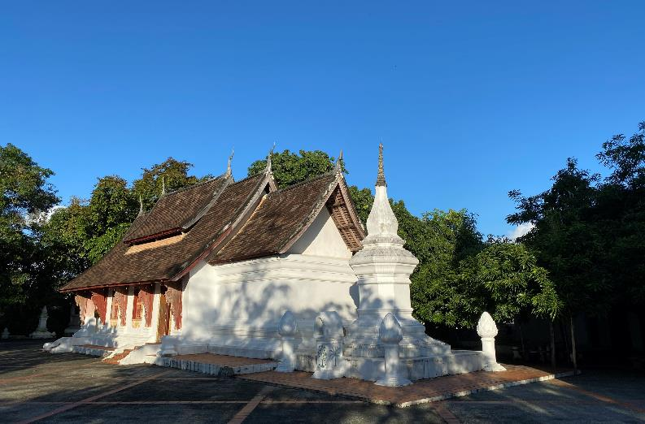
HISTORY
The Lao people were a tribe originally from Yunnan, China. Pushed down south in 12th century
The first Lao kingdom, called Lan Xang, was founded by Fa Ngum in 1353. Last until 16th century when the capital was moved to Vientiane
THE ORIGIN OF LAOS KINGDOM
The peak of Lan Xang Kingdom was in 17th century under King Vongsa. Declined at the start of 18th century, split into 3 kingdoms before being ruled by Siamese - Thai by the end of century.
CLASHES OF KINGDOMS
The French reunited the 3 kingdoms and named it Les Laos. Secretly joined the war, got independence on 2nd, Dec, 1975
COLONIALIZATION & WAR & INDEPENDENCE

Slide 7
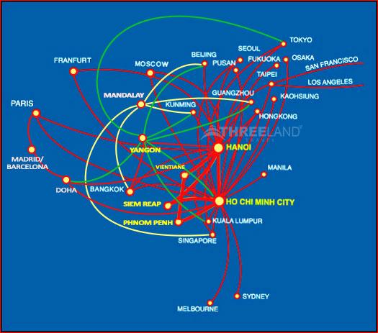
WHY LAOS
Connection
Indirect flight
Madrid/ Barcelona
You can connect to Laos with a flight transit in Singapore, Bangkok, Ho Chi Minh, etc.
Back
7/31/2025
Simply your best local friend

Slide 8
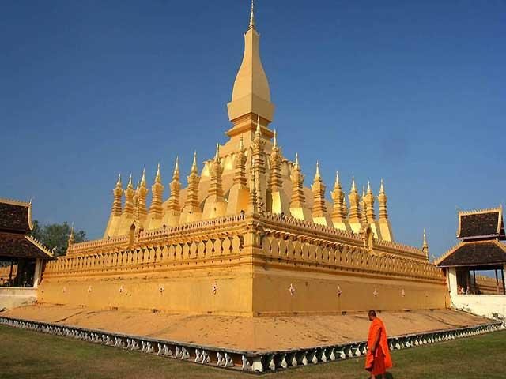
WHY LAOS
History
Caught in the middle of the two Indochina wars and long isolated from the rest of the world, the country retains a slow, rather old-fashioned charm, and its people – incredibly laidback and friendly, even by Asian standards – are undoubtedly one of the highlights of any visit.
Laos’s lifeline is the Mekong River, which runs the length of the country, at times bisecting it and at others serving as a boundary with Thailand; the rugged Annamite Mountains historically have acted as a buffer against Vietnam, with which Laos shares its eastern border.
Colorfully dressed hill tribes populate the higher elevations, while in the lowland river valleys, coconut palms sway over the Buddhist monasteries of the ethnic Lao.
Culture
Back
7/31/2025
Simply your best local friend

Slide 9
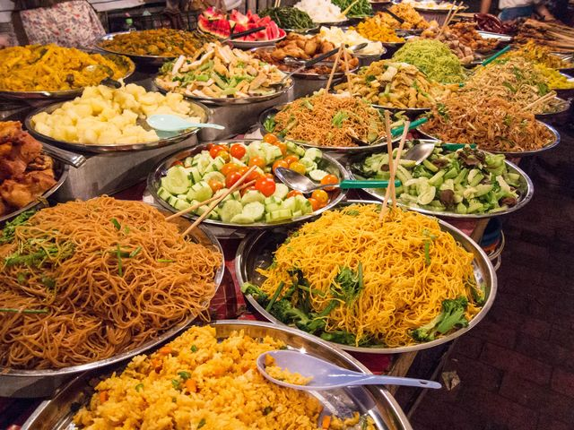
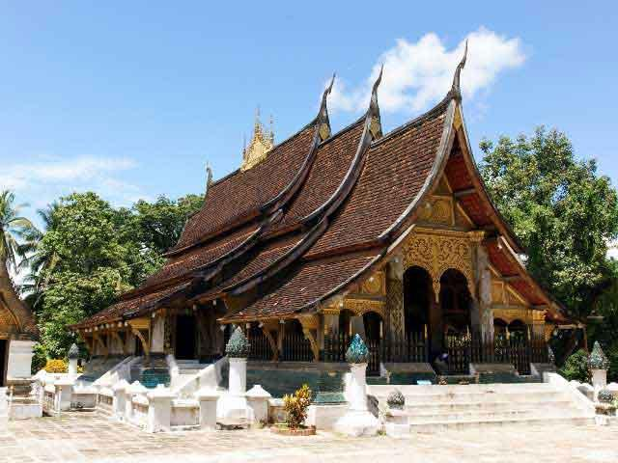
WHY LAOS
Food
Laotian cuisine is distinct from other Southeast Asian cuisines and has many regional variations, corresponding in part to the fresh foods local to each region. A French legacy is still evident in the capital city, Vientiane, where baguettes are sold on the street and French restaurants are common and popular.
Luang Prabang - main attraction in Laos- offers various of choices from the fine-dining restaurants to fast foods or street foods, from local/Chinese/Thai/Asian/European/Italian/Indian, though not much, as well as the vegetarian cuisine.
There are three distinct Lao styles of temple design in Luang Prabang, Vientiane, and Xieng Khuang: Luang Prabang with temples in this style have low, sweeping roofs that almost touch the ground Temples in the Vientiane style feature a veranda and a heavily ornamented roof, while the Xieng Khuang style melds features of both Luang Prabang and Vientiane styles.
Both Luang Prabang and Vientiane have beautiful restored colonial buildings influenced by French colonial architecture in the 19th century.
Architecture
Back
7/31/2025
Simply your best local friend

Slide 10
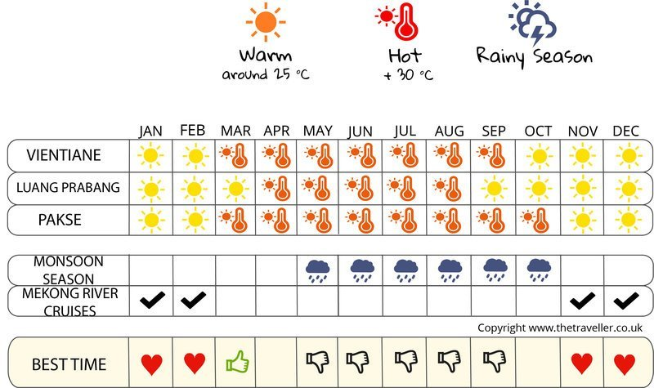
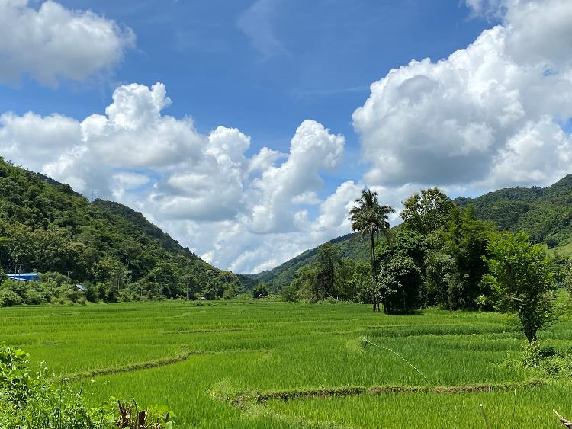
WHY LAOS
Weather
Laos – A tropical monsoon country
Laos have two distinct weather seasons: a dry season - from October to late April & a wet season - from May to late September.
March to June is the hottest time of the year. In May to July, it remains very hot and rainfall is often short lived, while from late July until September the rains become more constant and can be heavy at times, especially in southern parts of the country.
Back
7/31/2025
Simply your best local friend

Slide 11
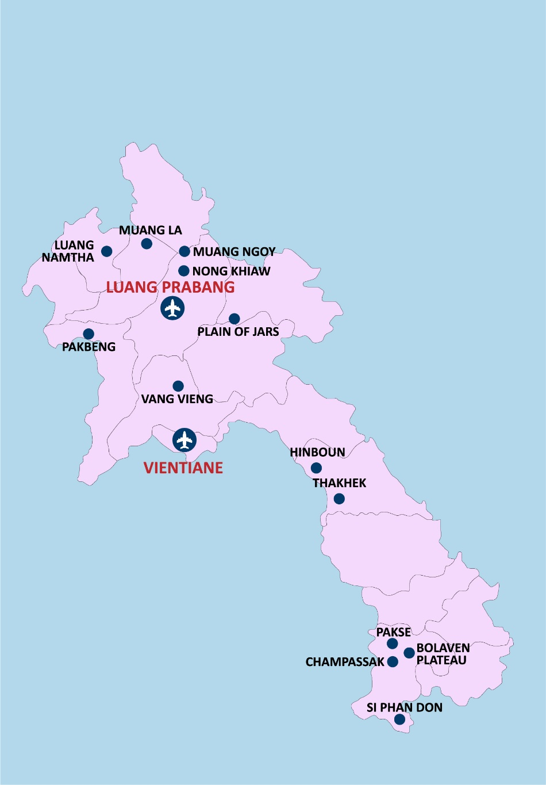
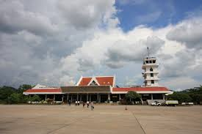
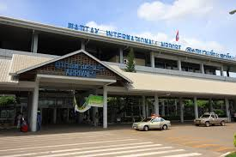
WHY LAOS
Luang Prabang International Airport
International Airports
Two main international airports
Near to must-see attractions in the region
Convenient for your immigration process
Wattay International Airport (Vientiane)
Back
7/31/2025
Simply your best local friend

Slide 12
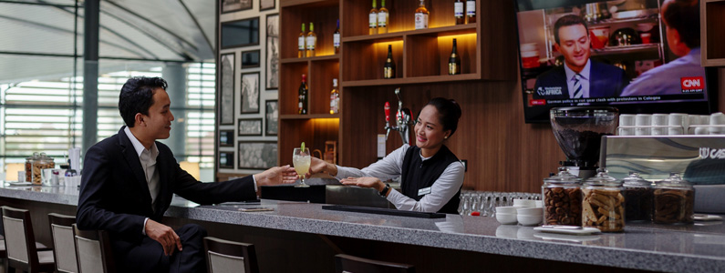
WHY LAOS
International Airports
Free drinking water
Car rental service
Medical service
Baggage wrapping service
SERVICE AVAILABLE
VIP services (business lounge, meeting rooms, shower).
Tourism information counters
Currency exchange counters
Free Wi-Fi
Ticketing
Exchange currency
Smoking area
ATM
Post and telegraph offices
Airport information counter
Duty free shops
Restaurants & cafes
Back
7/31/2025

Slide 13

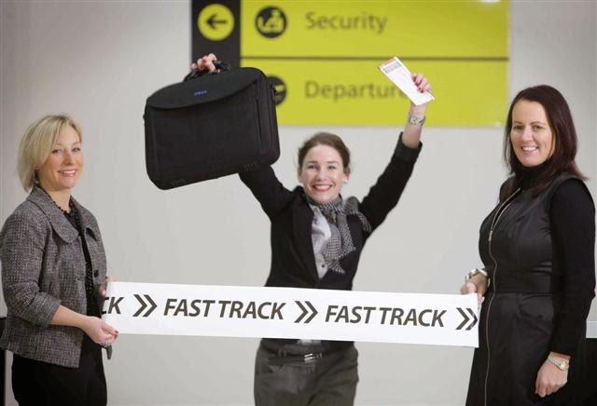
WHY LAOS
WHY VIETNAM – CAMBODIA?
Visa and Immigration
Visa upon arrival in Laos
Laos Visa stamp fee at USD 35/pax, one month single entry is to be settled directly at the Immigration Office at international airports
Back
7/31/2025
Simply your best local friend

Slide 14
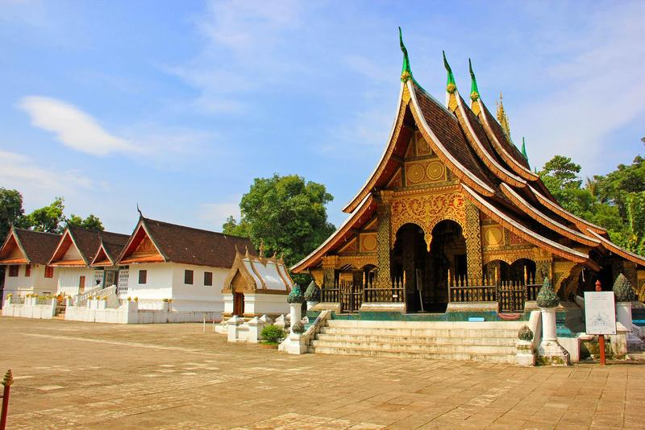
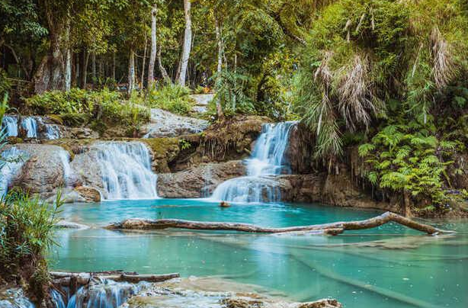
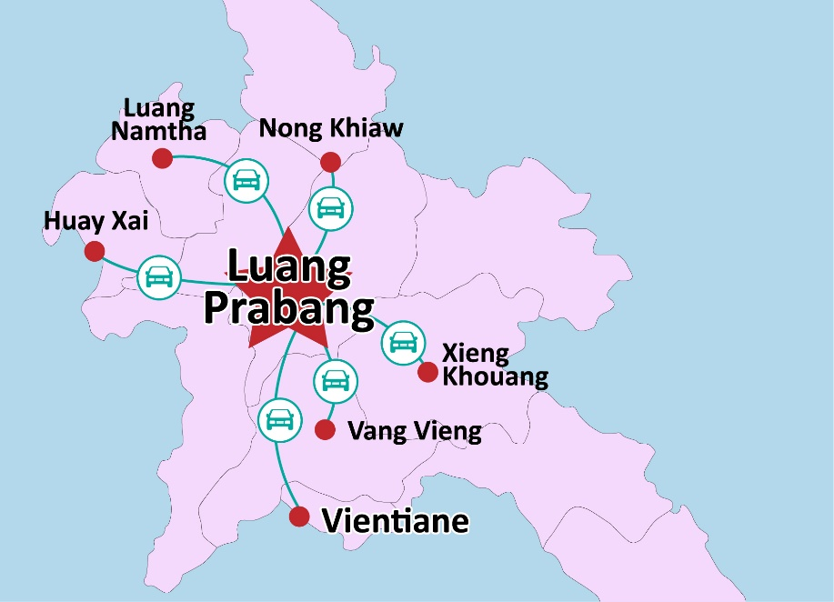
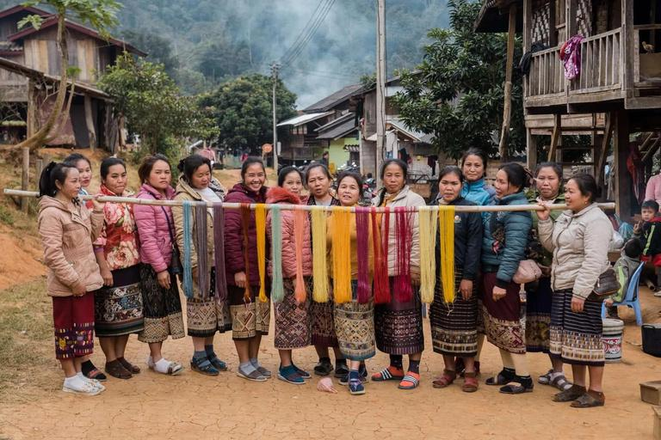
KEY CITIES
Luang Prabang
Luang Prabang locates in the Northern Laos at the heart of a mountainous region. The town is built on a peninsula formed by the Mekong and the Nam Khan River. Mountain ranges encircle the city in lush greenery
Wat Xieng Thong
Kuang Si Waterfall
Highlights:
  Wat Xieng Thong
  Royal Palace (National Museum)
  Phousi Mountain
  Kuang Si Waterfall
  The Pak Ou Caves
  Handicraft Villages
Phousi Moutain
Handicraft Village
Back

Slide 15
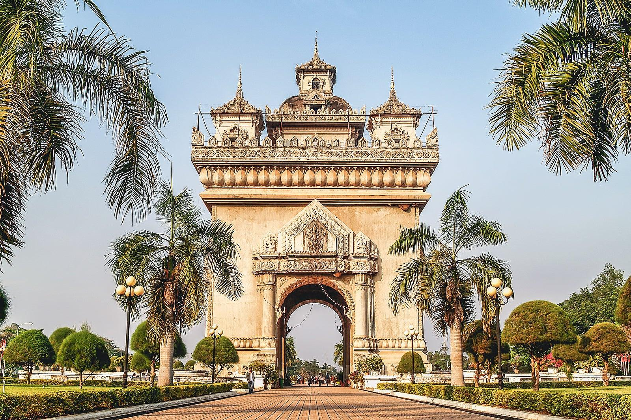
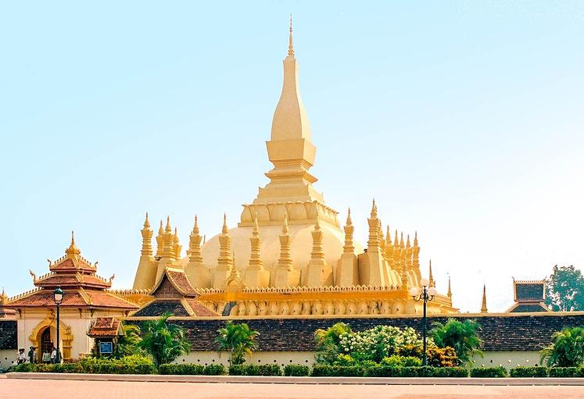
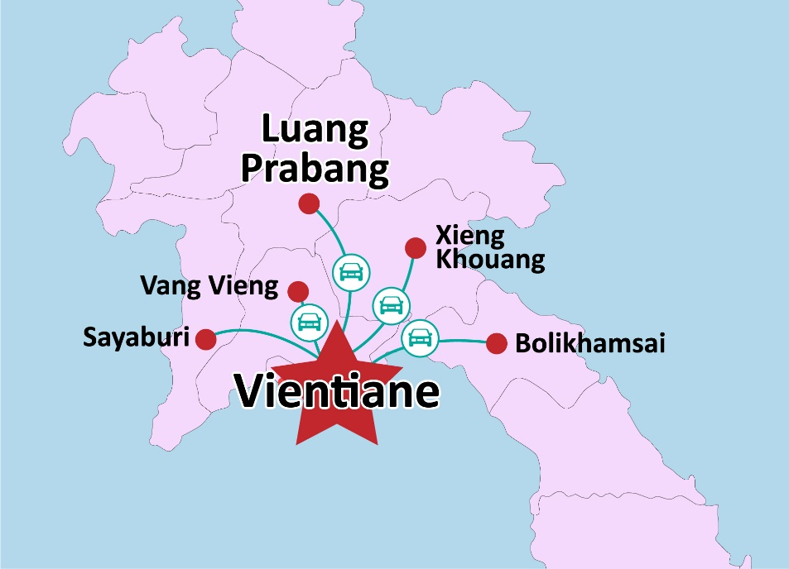
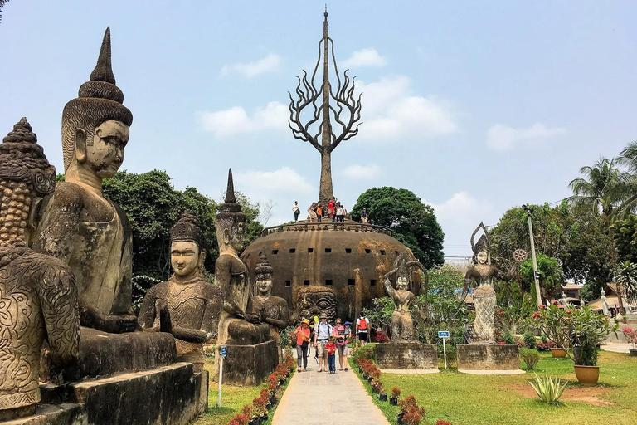
KEY CITIES
Vientiane
Located in the Northwest of Laos, Vientiane is the capital as well as the largest city of Laos. Compared to the hectic, bustling capitals in other Southeast Asian countries, Vientiane is known for its laidback atmosphere.
Highlights:
  Buddha Park
  The Wat Si Saket
  Pha That Luang
  The Patuxai Victory Gate
  The riverside area
Back

Slide 16
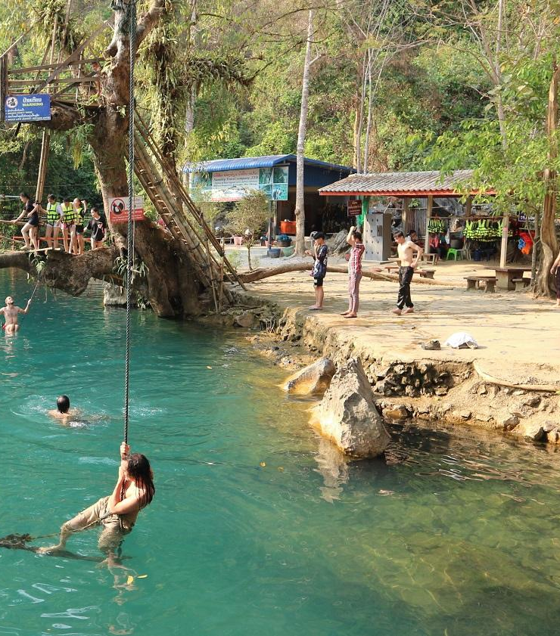
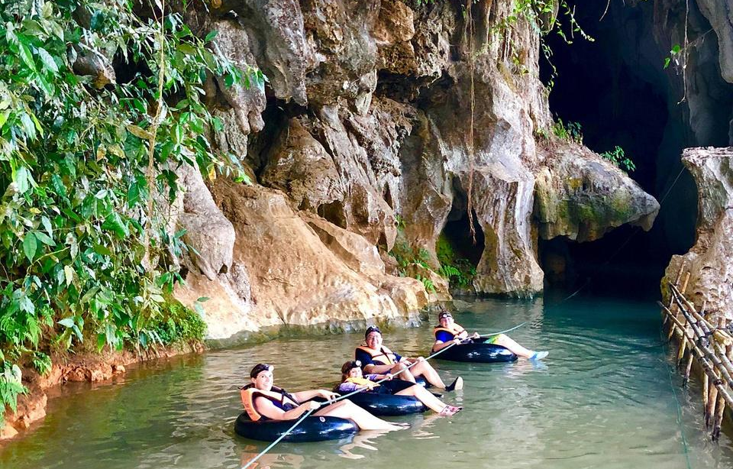
KEY CITIES
Vang Vieng
Located only around 4 hours driving to the north of Vientiane, Vang Vieng is not just a bus stop on the long journey up to Luang Prabang, but also is a real tourism destination in its own right. The town lies on the western side of Nam Song River with incredible view to the river with the karst hill landscape as the background.
Highlights:
  The amazing caves
  Nam Song River
  The lagoons
  Towering karst mountains
Back

Slide 17
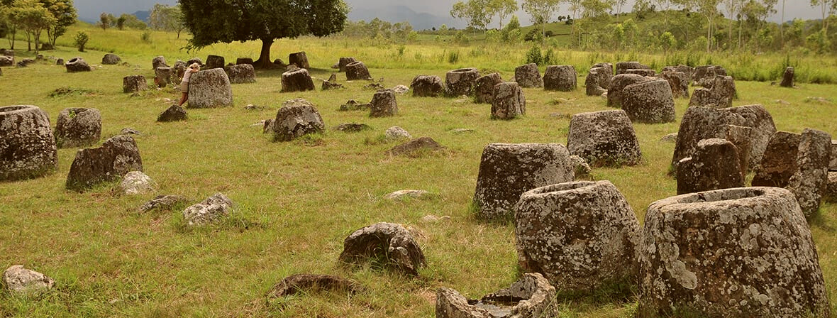
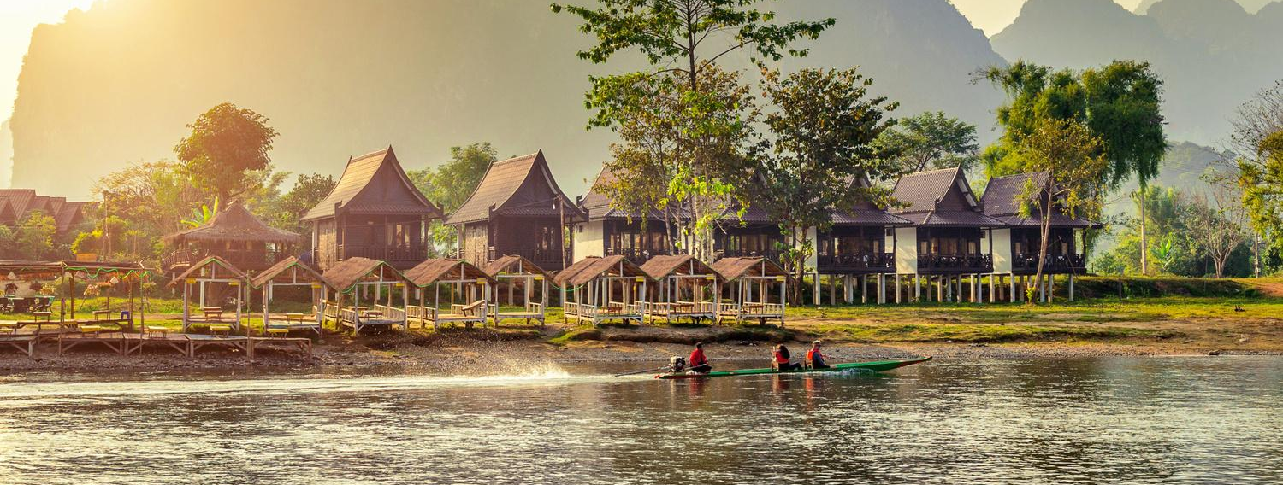
KEY CITIES
Xieng Khoang
Lies in the northeast of Laos near the Laos-Vietnam border, the province best known for the mysterious Plain of Jars site near Phonsavan, the provincial capital.
Highlights:
  Plain of Jars
  Moung Khoune
  Wat Phia Wat temple
Back

Slide 18
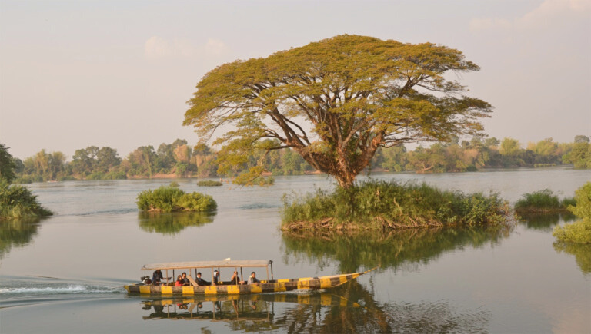
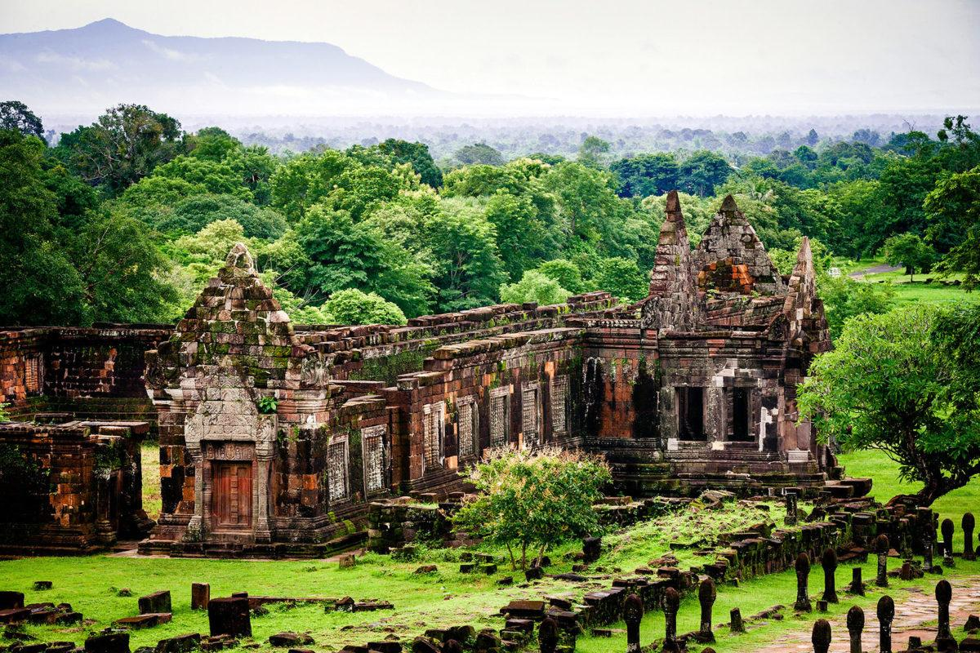
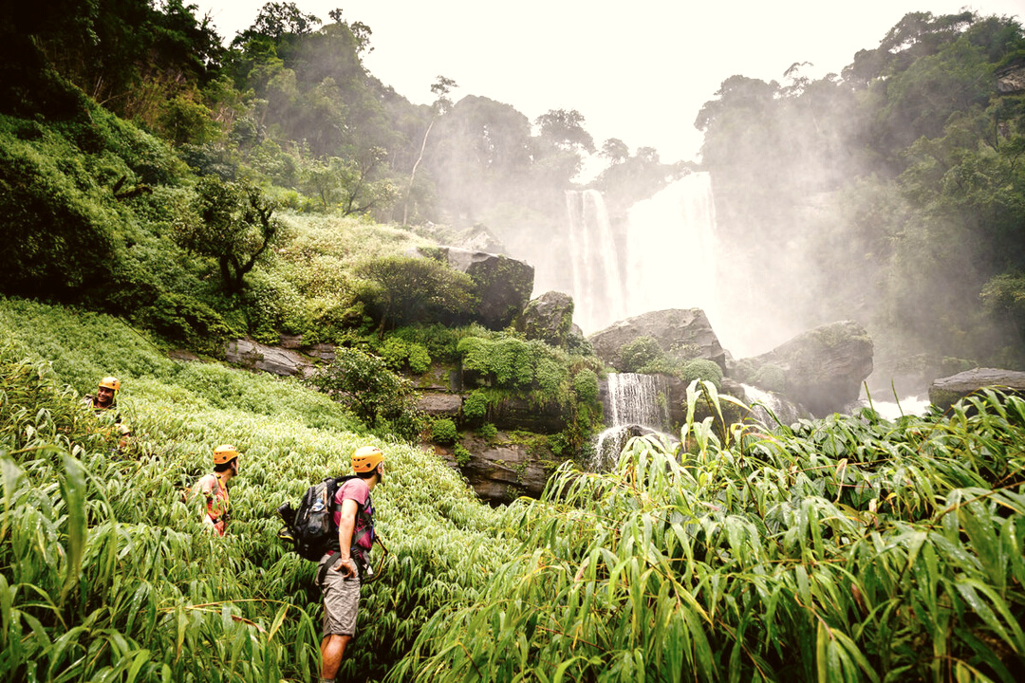
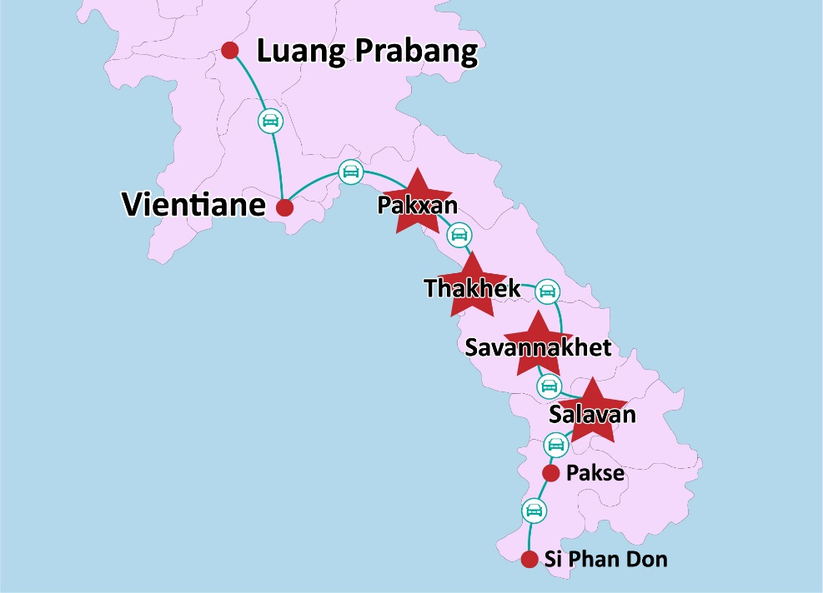
KEY CITIES
Southern Laos
This area is a riverine archipelago with the most islands in Indochina. Southern Laos not only has a beautiful scenery but also attracts many tourists thanks to the unique location. A perfect place to stop if we travel from Laos to Cambodia by land or the other way round
Highlights:
  Pakse
  Si Phan Don
  Wat Phou
  Bolaven Plateau
Back

Slide 19


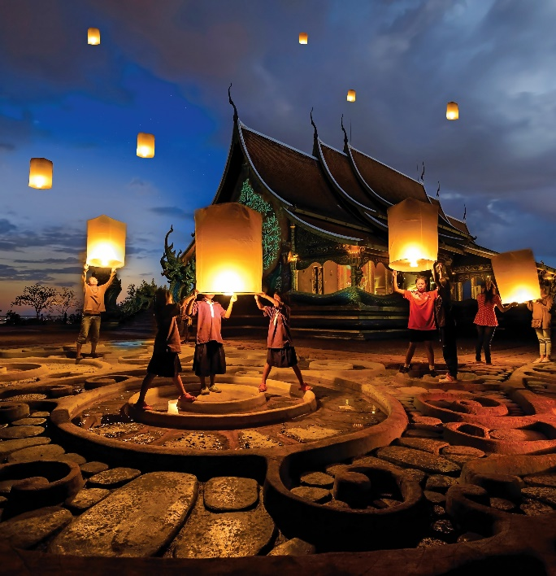

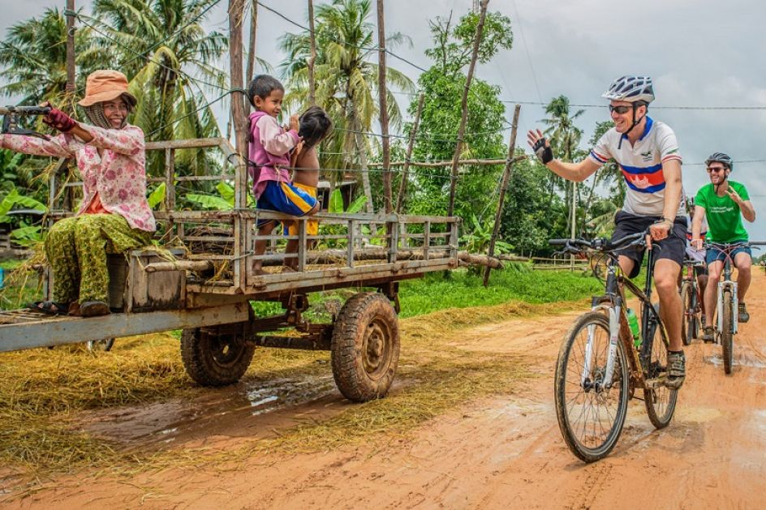


ACTIVITIES
ACTIVITIES
In Laos
Cultural tours in Luang Prabang (Northern Laos) and Champasak (Southern Laos), with excursions by land or riverway to their surrounding prefectures.
Two-way river cruises from the Golden Triangle to Luang Prabang and Vientiane; short boat trips in their suburb to numerous vestiges and villages; Elephant Camp.
Adventure from moderate to expert level: mountain biking, hard trek, easy hiking, rock climbing, river rafting, zip lining, kayaking, caravan and motor biking.
Photo tour, wildlife expedition, elephant riding, meditation and yoga, agriculture tours throughout the country.
Back
‹#›
7/31/2025
Simply your best local friend

Slide 20
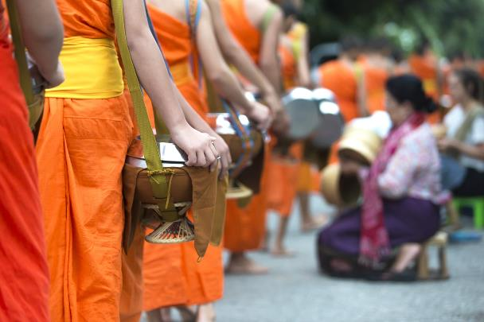
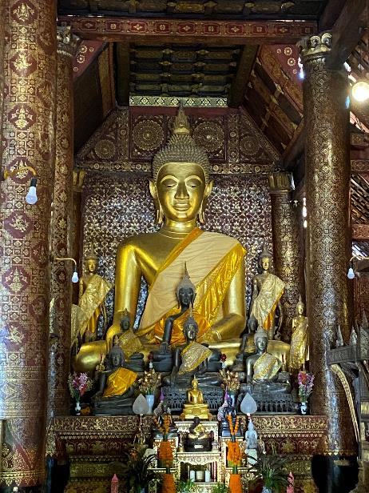
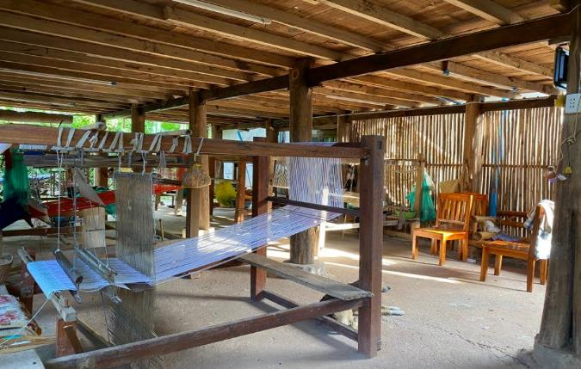
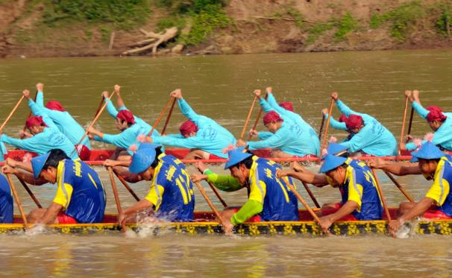
AUTHENTIC CULTURE
Ethnic diversity: Northern Laos
Indigenous foods & coffee: Cooking class, market visits, coffee plantations in the South
Learn Buddhism & visit temples: Alms giving, Baci Ceremony
Attending local festivals: Boat racing, Buddhist practices
Rice cultivation: Rice planting
Local handicrafts: Local weaving, bamboo experience

Slide 21
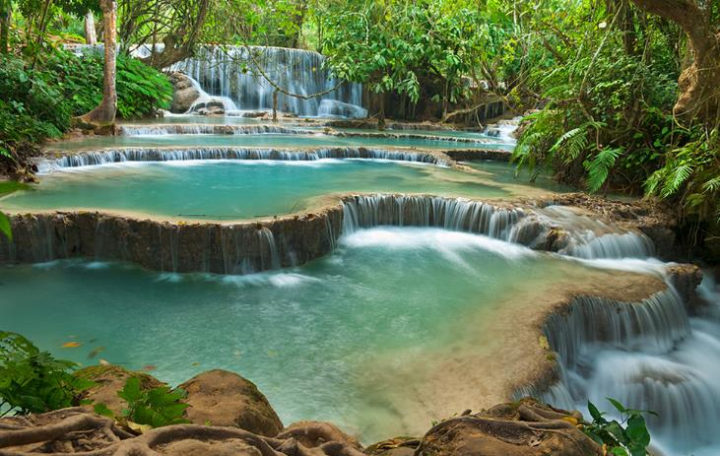
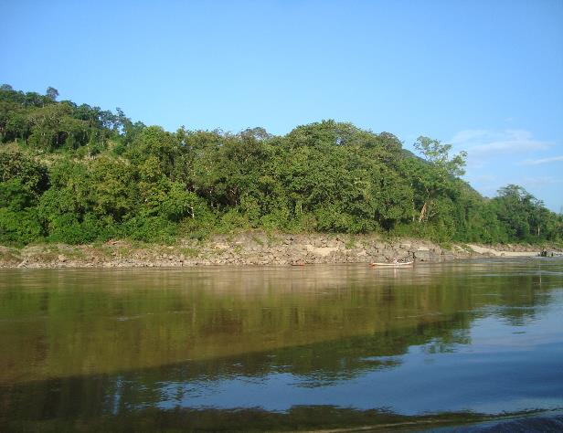
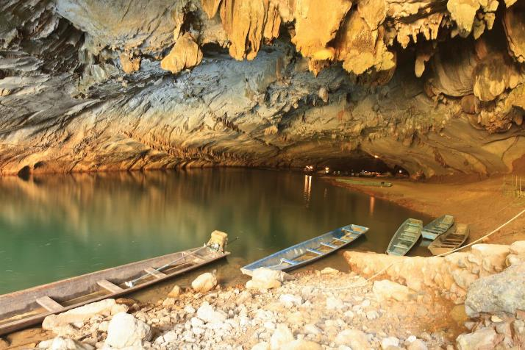
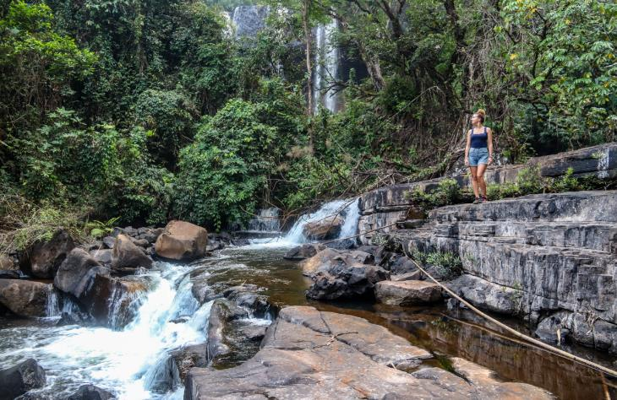
NATURAL WONDERS
Caves: Luang Prabang, Vang Vieng, Khamoun, Luangnam Tha, Oudomxay
Mekong Rivers
The Bolaven Plateau
Waterfalls
Natural park and reserves
Hin Namno National Park – Latest & 4th Laos World Heritage

Slide 22
ANCIENT RUINS & LANMARKS
Watphou Temples – World Heritage
Plains of Jars – World Heritage
Luang Prang Heritage town – World Heritage
That Luang, Buddha Park, Temples in Vientiane
Sacred temples, French influences along Mekong Rivers towns

Slide 23
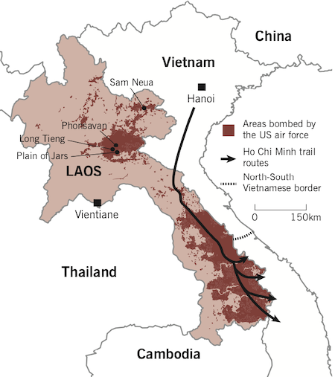
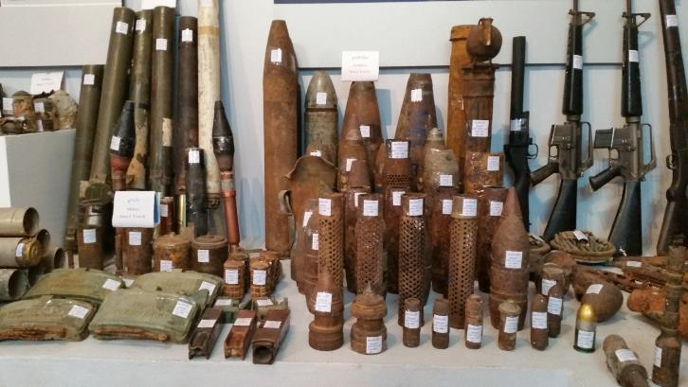
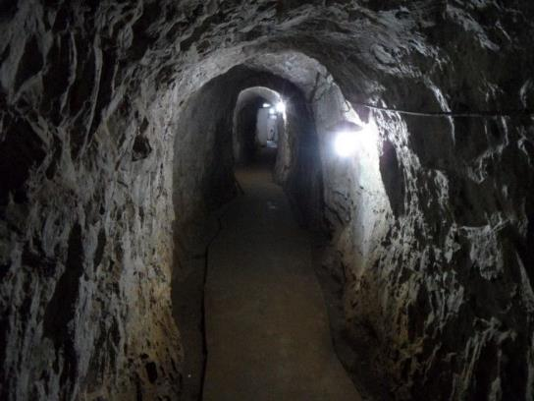
SECRET WAR
From 1964 to 1973, the U.S. dropped more than two million tons of ordnance on Laos during 580,000 bombing missions—equal to a planeload of bombs every 8 minutes, 24-hours a day, for 9 years – making Laos the most heavily bombed country per capita in history.
Vieng Xay Cave
UXO visitors center
COPE Vientiane visitor center in Luang Prabang
Ho Chi Minh Trails in Laos

Slide 24
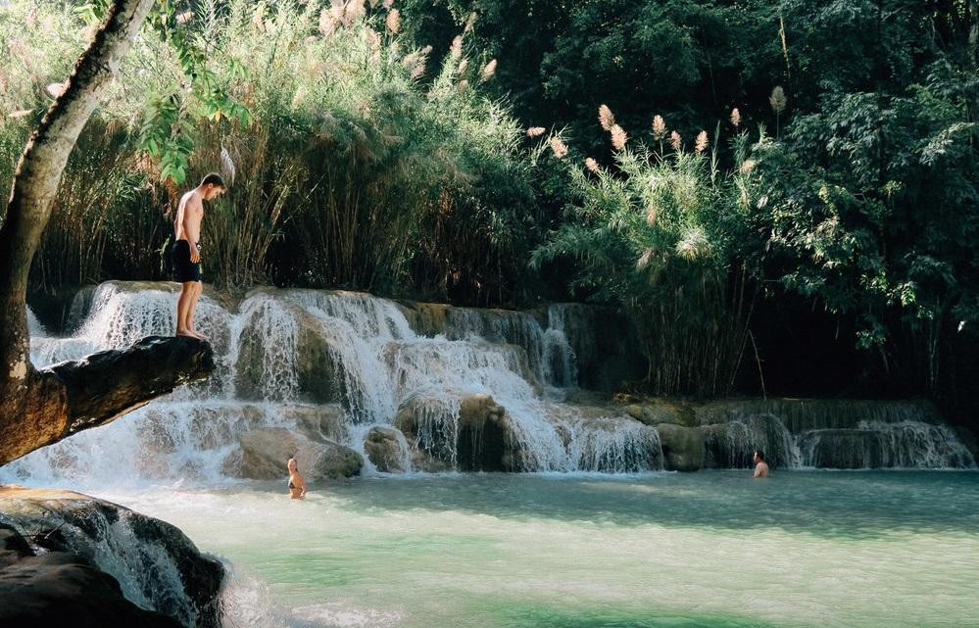
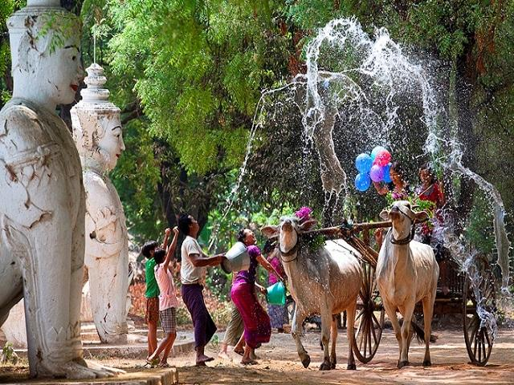
ACTIVITIES
LUANG PRABANG
Highlights Activities
Visit Khuang Si Waterfall
Colorful festivals
Admire the vibrant blue water flows down the rocks into a jungle river.
You can hike To The Top of The Falls or just take a picnic lunch at lower level to enjoy the view.
Boat racing festival
Buon Pi Mai (Water festival)
Hmong’s New Year
Back
7/31/2025
Simply your best local friend

Slide 25


ACTIVITIES
LUANG PRABANG
Highlights Activities
PHONGSALI
Join an Alm giving ceremony
Trek your way thru Phongsali
A longstanding tradition in Laos Buddhist culture and a sacred ceremony for the locals and the monks
A fun and exhilarating way to experience the hills, jungles and forests of Laos
Back
7/31/2025
Simply your best local friend

Slide 26


ACTIVITIES
LUANG PRABANG
Highlights Activities
PHONGSALI
Monkey around in Huay Xai
Soak up the waterfalls in Si Phan Don
Sleeping in sky-high treehouses alongside gibbons, and days ziplining from tree to tree
Visit this “Four Thousand Islands” and enjoy a valuable break if you are looking for some laid-back days in Lao trip
Back
7/31/2025
Simply your best local friend

Slide 27




Bac Ha – Sunday Flower Market
ACTIVITIES
XIENG KHUANG
PAKSE
Back
7/31/2025

Slide 28





Restaurant in Laos
In general, Laotian cuisine is distinct from other Southeast Asian cuisines and has many regional variations, corresponding in part to the fresh foods local to each region.
However, in Luang Prabang which may be the main attraction in Laos, we will have various of choices from the fine-dining restaurants to fast foods or street foods, from local/Chinese/Thai/Asian/European/
Italian/Indian, though not much, as well as the vegetarian cuisine
Back

Slide 29




CUISINE IN LAOS
Restaurants
Laos Cuisine
The cuisine of Laos is generally like this: often unassuming, but packed with flavor in a way that showcases the country’s prowess at marrying herbs, chilies, and the pungent bacterial riot of fermented meat and fish.
The staple food of the Lao is steamed sticky rice.
Back
7/31/2025
Simply your best local friend

Slide 30




CUISINE IN LAOS
Restaurants
Western Cuisine
Match with variety of demands from visitors of all cultures
Plentiful choices Italian, French, Western food and fast food
Back
7/31/2025
Simply your best local friend

Slide 31




CUISINE IN LAOS
Restaurants
Vegetarian Cuisine
New philosophy of a well-balanced and healthy life.
Easily find a quality vegetarian restaurants throughout the countries
Back
7/31/2025
Simply your best local friend

Slide 32




CUISINE IN LAOS
HIGHLIGHTS IN VIETNAM & CAMBODIA
Restaurants
Unique dining Experience
New concept of the dining places:
Lunch on boat during cruise down from Pakou Caves.
The picnic lunch in front of Kuangsi waterfall.
Dinner with traditional show.
… and so on
Back
7/31/2025
Simply your best local friend

Slide 33

ACCOMODATION IN LAOS
Wide range of options:
from numerous international brand hotels with well-equipped conference facilities to deluxe homestays
Other services included: Restaurants
Pools
Gym
Spa treatment
Outdoor activity's facilities
… and so on.
Back
Vientiane - Setha Palace hotel
Photo: Palace Gate Resort & Spa
Back
7/31/2025

Slide 34






5 STAR BRANDS
Back
7/31/2025

Slide 35







Hotel in Luang Prabang
3* | 4* | 5*
Villa Chitdara | Muangthong Hotel | Luang Prabang View Hotel
The Capital Hotel | Villa Santi Hotel | Pullman Luang Prabang Resort
My Dream Boutique Resort | The Grand Luang Prabang Hotel | Sofitel Luang Prabang
Back

Slide 36








Hotel in Vientiane
3* | 4* | 5*
Vientiane Plaza | Donchan Palace Hotel | Lao Plaza Hotel
Vansana Riverside Hotel | Ansara Hotel | Settha Palace Hotel
Ibis Vientiane Hotel | Crowne Plaza Hotel | Landmark Mekong Riverside Hotel
Back

Slide 37



A SAMPLE OF 5 STAR HOTEL
Back
7/31/2025

Slide 38



A SAMPLE OF 4 STAR HOTEL
Back
7/31/2025

Slide 39




3 STAR SAMPLE HOTEL
Back
7/31/2025

Slide 40

TRAVEL SERVICE – ACCESSIBILITY BETWEEN REGIONS
From Luang Prabang to:
Vientiane:
  By land transfer: 11 hours
  By flight: 1 hour 35 minutes
  By car: 5,5 hours
Vang Vieng:
  By land transfer: 5 hours
  By flight: 40 minutes.
Oudomxay: by flight in 55 minutes
From Vientiane to:
Pakse: by flight in 1 hour 30 minutes.
Xieng Khouang: by flight in 40 minutes.
Back

Slide 41



TRANSPORTATION
Poor road conditions overall
Modern express trains
Modest airports and few international flights
Boats, Tuk Tuk

Slide 42

TRAVEL SERVICE – DOMESTIC/ REGIONAL FLIGHTS
Daily flights from Luang Prabang to Vientiane per week.
MAINSTREAM AIRLINES:
  National airline: Laos Airlines
  Low cost carrier: Lao Skyway
Back
7/31/2025
Simply your best local friend

Slide 43

TRAVEL SERVICE – WELCOME SERVICES
Visa on arrival – fast track service, VIP services
Welcoming at the aircraft gate
Get visa stamp at visa counter without waiting in line
Be assisted and escorted throughout immigration procedure
Baggage porters available on request
Back
7/31/2025
Simply your best local friend

Slide 44





TRAVEL SERVICE – REGIONAL FLIGHTS
Modern Airbus 330 with 250 seats
Airbus 320/321 with 160 ~180 seats
FLEET INFORMATION
Fokker 70
ATR72 with 65 seats
Airbus 321 – 184 seats
Back
7/31/2025
Simply your best local friend

Slide 45


TRAVEL SERVICE – REGIONAL FLIGHTS
TRAVEL SERVICE – DOMESTIC/ REGIONAL FLIGHTS
HIGHLIGHTS IN VIETNAM & CAMBODIA
Meals & Drink
Snack & refreshment for domestic & 60 minute international flights
Hot meals for over 2 hour flights
Back
7/31/2025
Simply your best local friend

Slide 46


TRAVEL SERVICE – VEHICLES
Airport transfer: We’ve served 24/7 at all international airports with onsite staff
Laos: Luang Prabang, Vientiane, Pakse international airport.
Business transfer for corporate, golf or business traveler
Limo services with luxury brands such as Mercedez S class, BMV series 7… for VIP group
Back
7/31/2025
Simply your best local friend

Slide 47







4 seat
7 seat
16 seat
TRAVEL SERVICE – VEHICLES
24 seat – 35 seat
45 seat
Limousine Service
Back
7/31/2025
Simply your best local friend

Slide 48





Cruises
First class |  | Superior
Anouvong cruise |  | Bohème cruise
Gypsy cruise |  | Mekong Pearl

Slide 49




RIVER CRUISES IN LAOS
CRUISE INFO
Anouvong Cruise
Luang Say Cruise
Mekong Pearl Cruise
Gypsy cruise
Back
7/31/2025
Notes:
Easy to connect to: Rach Gia – Phu Quoc
Chau Doc – Phnom Penh

Slide 50


RIVER CRUISES IN LAOS
PROGRAM
4 days - 3 nights program
3 days - 2 nights program
Day 1: Huay Xai – Huay Palang
Day 2: Huay Palang – Pakbeng – Kop Aek
Day 3: Kop Aek – Pak Ou cave
Day 4: Pak Ou cave – Luang Prabang
Day 1: Chiang Khong – Paktha
Day 2: Paktha – Pakbeng – Kop Aek
Day 3: Kop Aek – Luang Prabang
Back
7/31/2025
Notes:
Easy to connect to: Rach Gia – Phu Quoc
Chau Doc – Phnom Penh

Slide 51




RIVER CRUISES IN LAOS
PROGRAM
10 days - 09 nights program
8 days - 7 nights program
Day 1: Vientiane – Sanbank
Day 2: Sanbank (Phalat) - Sanbank
Day 3: Sanbank (Paklay) – Sanbank
Day 4: Sanbank (Khok Akha) – Sanbank
Day 5: Sanbank – Luang Prabang
Day 6: Luang Prabang
Day 7: Luang Prabang – (Pak Ou) – Gaeng Hang Ngai
Day 8: Gaeng Hang Ngai – Pakbeng – Sandbank
Day 9: Sandbank – Huay Palang
Day 10: Huay Palang – Huay Xay
Day 1: Huay Xai – Huay Palang
Day 2: Huay Palang – Pakbeng – Kop Aek
Day 3: Kop Aek – Pak Ou cave
Day 4: Pak Ou cave – Luang Prabang
Day 5: Luang Prabang – Khok Akha
Day 6: Khok Akha - Pak Lay
Day 7: Pak Lay – Sandbank
Day 8: Sandbank – Vientiane
Back
7/31/2025
Notes:
Easy to connect to: Rach Gia – Phu Quoc
Chau Doc – Phnom Penh

Slide 52









TOUR
Vientiane & Luang Prabang Combination
Highlights:
  Wandering around in Laos' capital, Vientiane and visiting some of its highlights
  Experience the tranquility of Luang Prabang with its heritage sites
  Admire Khouang Si waterfalls with its formation of water tumbling over multi-tiered limestone into cool pools
  Explore the mysterious Pak Ou caves with thousands of Buddha statues
  Visit the local handicraft villages and shop for the traditional handmade souvenir
Itinerary:
  Day 1: Vientiane Arrival – City Tour
  Day 2: Vientiane – Buddha Park – Fly To Luang Prabang (B)
  Day 3: Luang Prabang City Tour – Pak Ou Caves
  Day 4: Luang Prabang – Khoangsi Waterfall – City Tour
  Day 5: Luang Prabang – Departure
Back

Slide 53








TOUR
Luang Prabang - Vientiane - 4000 Islands
Highlights:
  Experience the tranquility of Luang Prabang with its heritage sites
  Wandering around in Laos' capital, Vientiane and visiting some of its highlights
  Hiking on the Bolaven Plateau, in Pakse, surrounded by incredible natural beauty
  We explore Khong island, the Bolevean Plateau is known for its cooler temperature being located high above the Mekong Valley. Wat Phou, a site of ancient religious significance in one of the most spectacular regions of Laos.
Itinerary:
Day 01: Luang Prabang Arrival – City Tour
Day 02: Luang Prabang City Tour – Pak Ou Caves
Day 03: Luang Prabang – Fly To Vientiane – City Tour
Day 04: Vientiane – Buddha Park – Fly To Pakse – Khong Island
Day 05: Full Day Visit The 4000 Islands Area
Day 06: Khong Island – Bolaven Plateau – Pakse
Day 07: Pakse – Departure
Back

Slide 54




TOUR
Laos Adventure
Highlights:
  Visiting the remote area in Northern Laos with its rugged mountain scenery with colorful hill tribes
  Exploring Pak Ou caves with thousands of gold lacquered Buddha statues left by pilgrims
  Admiring the small and tranquil town of Vang Vieng - nestled on a bend of the Nam Song River
  Discovering the charming and fascinating capital Vientiane with its blended multicultural influences
  Get a feel of local's customs and culture as trekking provides a greater insight and an authentic experience.
Itinerary:
  Day 01: Houeixai - Pakbeng
  Day 02: Pakbeng - Oudomxay - Nong Khiaw
  Day 03: Nong Khiaw - Pak Ou Caves - Luang Prabang
  Day 04: Luang Prabang City Tour
  Day 05: Luang Prabang - Vang Vieng
  Day 06: Vang Vieng - full day trekking
  Day 07: Vang Vieng - Vientiane
  Day 08: Vientiane - Lakxao
  Day 09: Lakxao - Departure
Back

Slide 55



TOUR
Laos Discovery
Highlights:
  Visit the ancient royal capital Luang Prabang with its gleaming temple roofs, and colonial architecture
  Indulge yourself in the rice-producing village Ban Xang Hai and the hand-weaving village Ban Phanom
  Admire Khouang Si waterfalls with its formation of water tumbling over multi-tiered limestone into cool pools
  Relish in the impressive archaeological site Plain of Jars with its hundreds of large stone jars
  Admire the small and tranquil town of Vang Vieng - nestled on a bend of the Nam Song River
  Discover an array of relics from the French colonial era in the local peaceful villages of Ban Khone
Itinerary:
  Day 1: Luang Prabang Arrival – City Tour
  Day 2: Luang Prabang City Tour – Pak Ou Caves – Khoangsi Waterfall
  Day 3: Luang Prabang – Elephant Riding + Soft Trekking
  Day 4: Luang Prabang – fly to Xieng Khoang – Muang Khoun – Plain of Jars
  Day 5: Xieng Khoang – Vang Vieng
  Day 6: Vang Vieng rafting – Vientiane
  Day 7: Vientiane City tour
  Day 8: Vientiane – Ban Na Hin
  Day 9: Ban Na Hin – Khong Lor – Ban Na Hin
  Day 10: Ban Na Hin – Savanakhet – Pakse
  Day 11: Pakse – Tadlo
  Day 12: Tadlo – Wat Phou – Khong Island (B)
  Day 13: Full Day Visit The 4000 Islands Area
  Day 14: Khong Island – Khone Pha Peng waterfall – departure
Back

Slide 56





