Slide 1
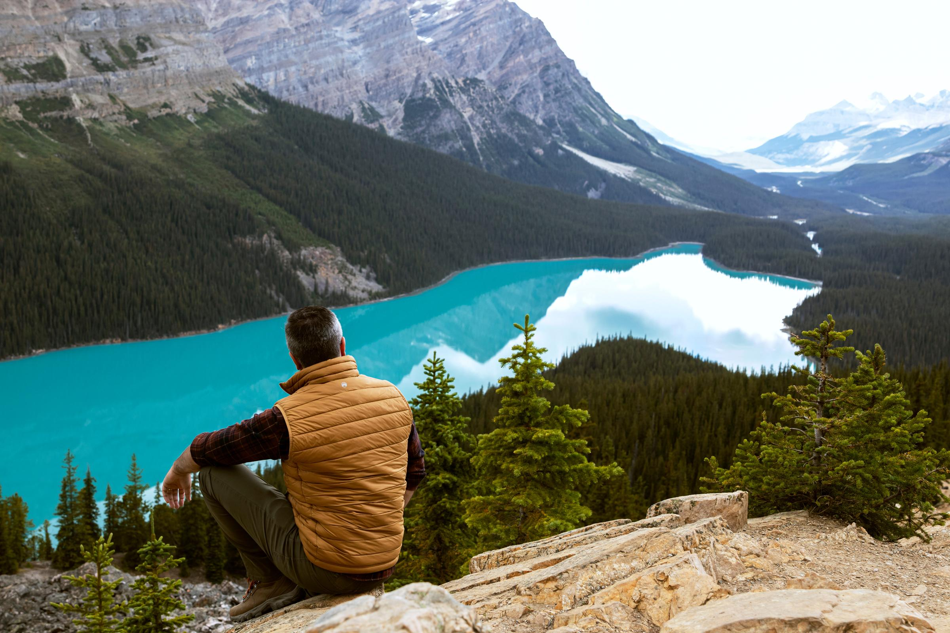


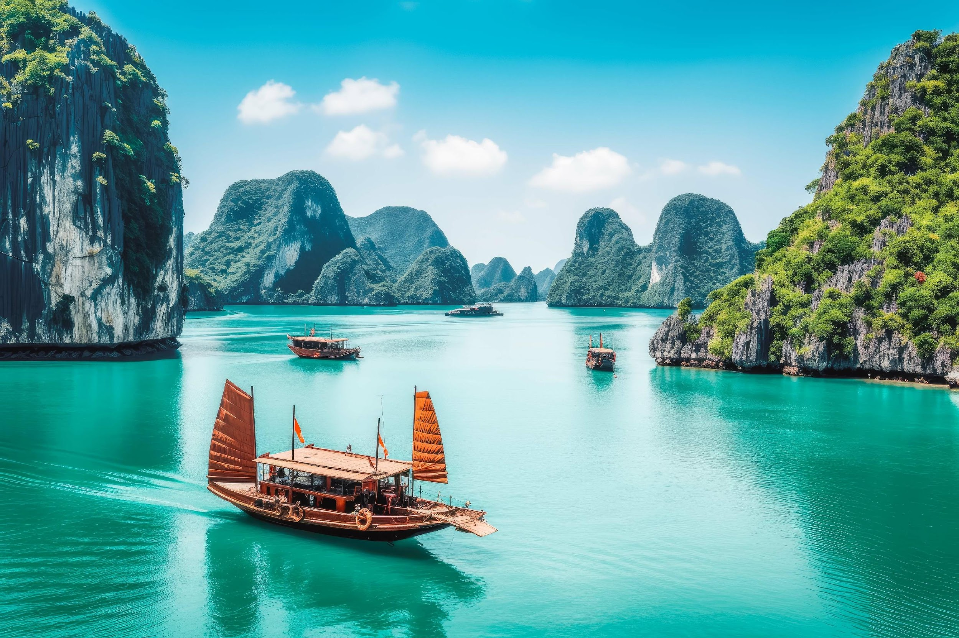
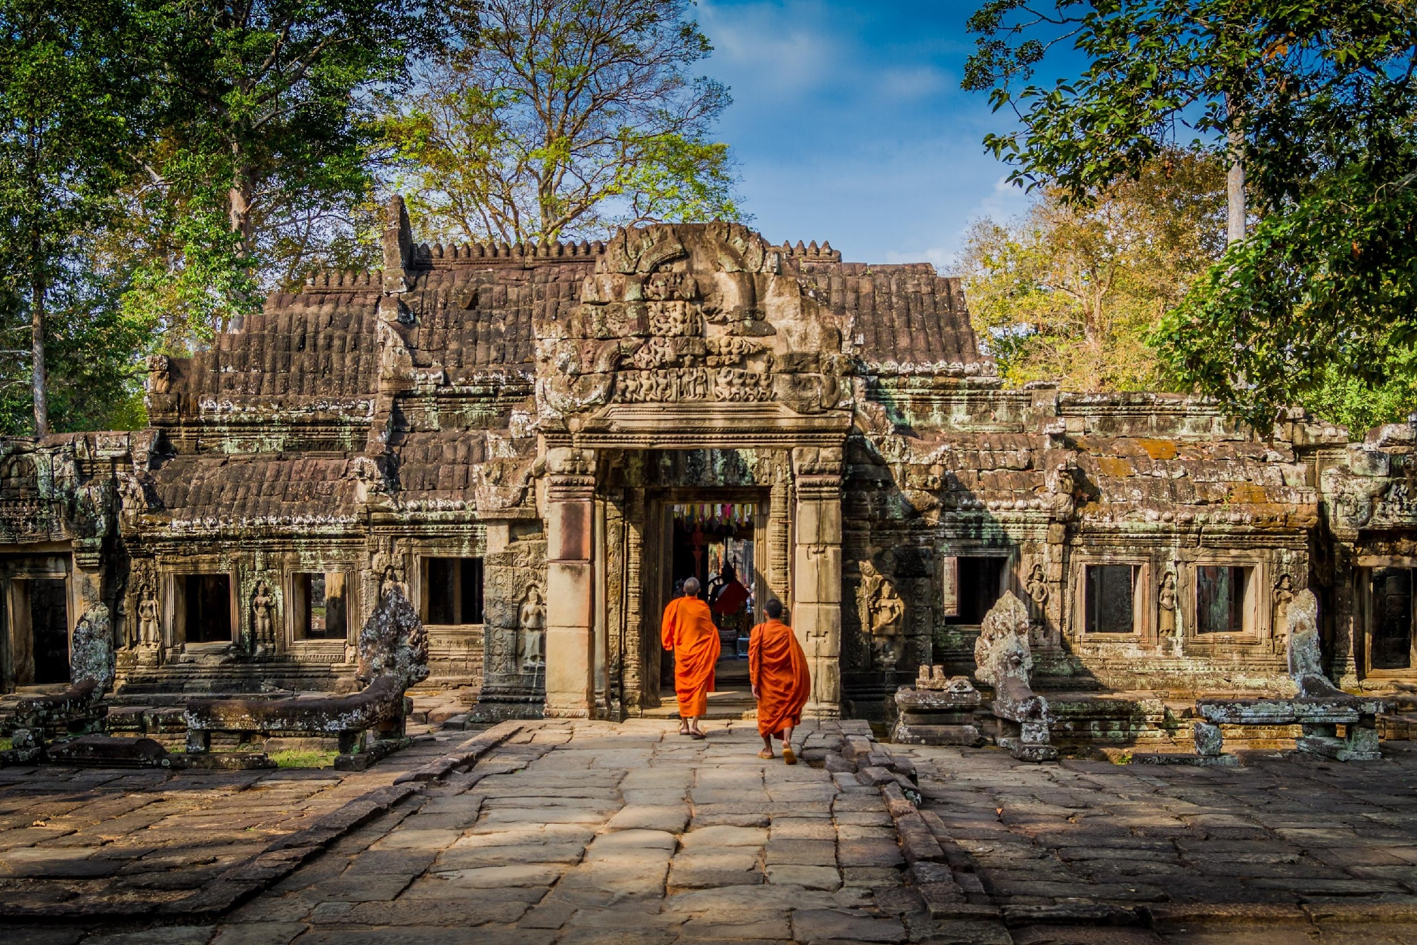
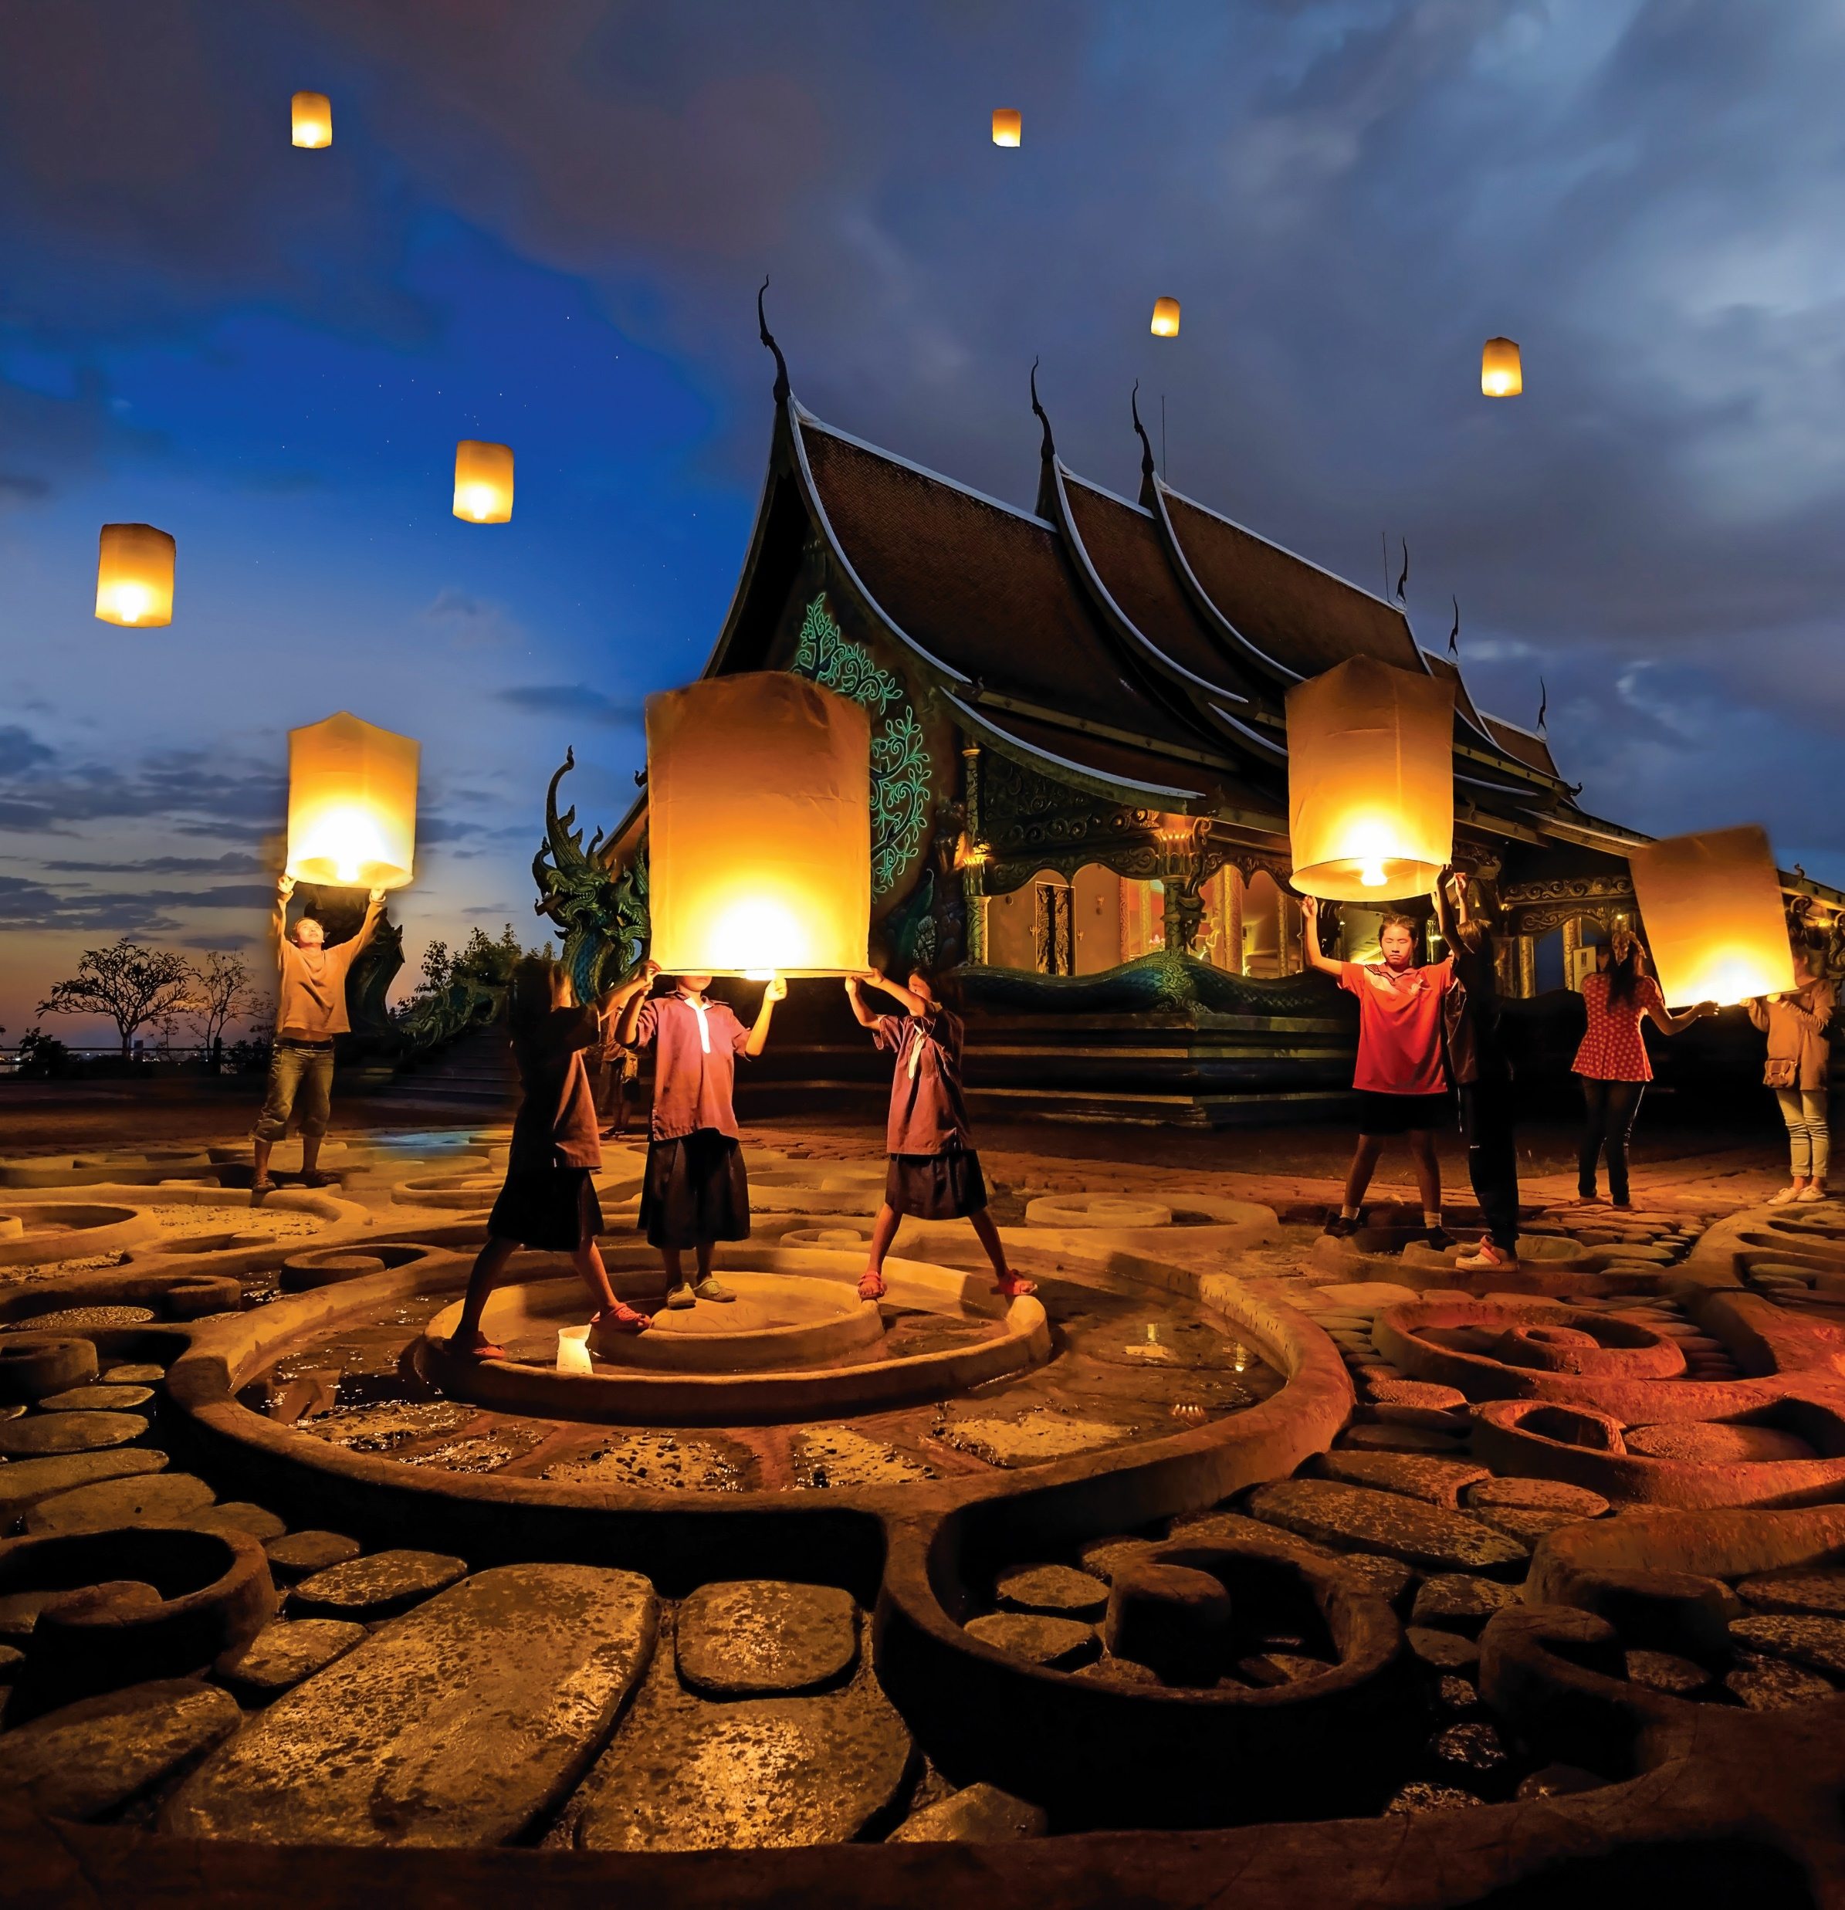
WWW.THREELAND.COM
7/25/2025

Slide 2
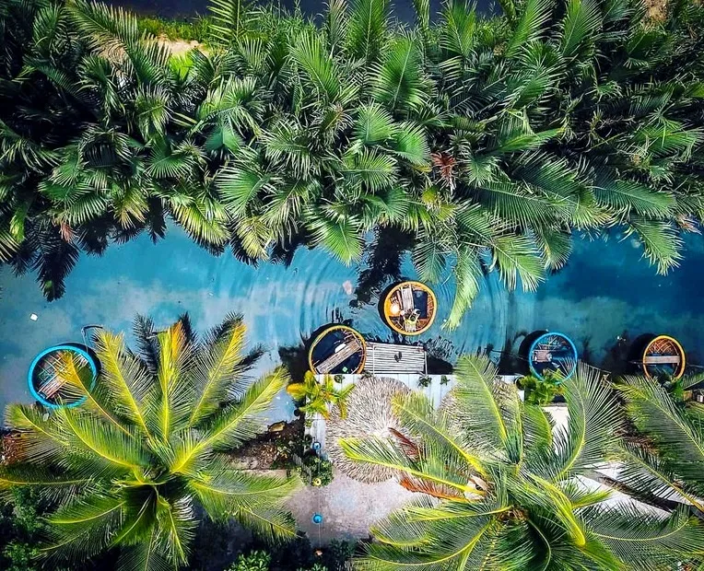


Opened new sales offices in Italy and Poland, Dach, Benelux markets; honored as a Travelife partner.
Our Milestones
Expanded into Europe and India; focused on MICE and co-invested in an eco-retreat in
Pu Luong.
2017–2025
Launched Gray Line Halong 4-star cruise, enhancing sightseeing network.
Secured exclusive Gray Line International license as Gray Line Vietnam; partnered with major global brands.
2015–2016
Established operations in Indochina; opened sales offices in the USA and Malaysia.
2013
2010
2002–2003
02
threeland.com

Slide 3






Our Certificate
T
Exclusive liensee of Gray Line Worldwide in Vietnam
NOIP’s Trademark
Protection No. 79041
US$ 1,000,000 Travel Liability Insurance
Travelife Partner
No. VN0121
03
threeland.com

Slide 4



OUR PORTFOLIO
Our Primary Brand, mainly on tour packages
Our Clients: FIT, Families, Groups ( ad hoc and set departures ), Corporate/MICE.
Product Range: Classic, Adventure, Family holidays, MICE, School tour, Wellness tour, Customized tour
White-labelling: we operate tours under your brands
A Master Licensee of Gray Line Worldwide, mainly on day trips, activities, shore excursions and transfers
Product Range: Shore excursion, Day trips, Airport transfer, Limousine service, VIP greetings and meeting, Visa fast track service
Local Suppliers for well-known OTAs: Expedia, Viator, Getyourguide, Ctrip, Rideways, Qnar, Tuniu
A division / sub franchisee of Gray Line Worldwide, mainly on cruising service.
Capacity: cruise with capacity of 14 cabins.
Product range: Cruise service, MICE and Incentives
Partner name: Agoda, Booking.com, Expedia, Hotelbeds, DOTW, Ctrip
7/25/2025
Notes:
4 brands: Threeland Travel, Gray Line Vietnam, Gray Line Halong & Puluong Retreat

Slide 5
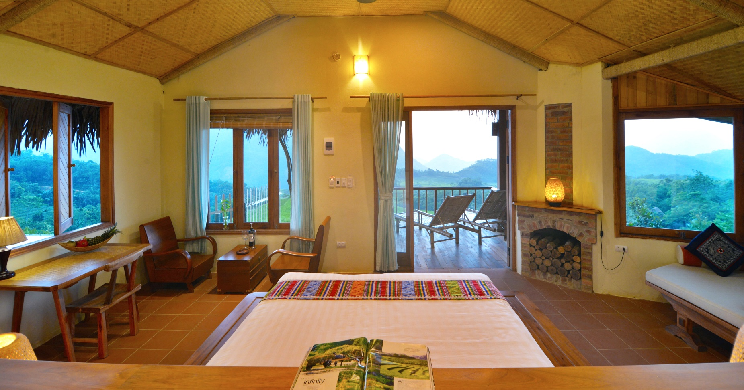


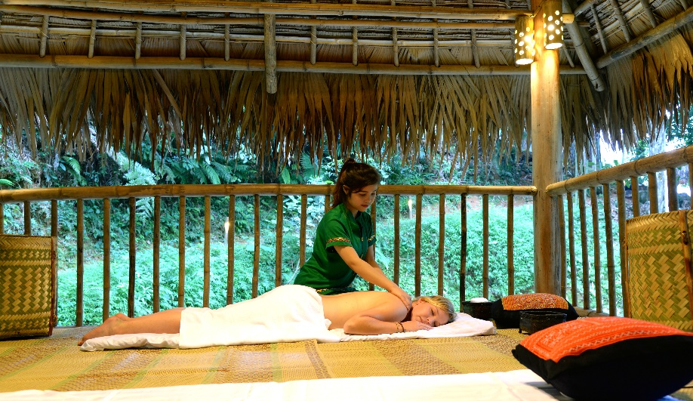
OUR PROPERTIES - PU LUONG RETREAT
Highlights:
30 boutique bungalows with panoramic valley view.
A "microcosm" of Northern Vietnam
Breathtaking mountainous view
Boutique living - Authentic life style
Ideal trekking routes with moderate / medium levels
A tranquil landscape of hill tribal villages
Pure beauty of Nature
7/25/2025

Slide 6
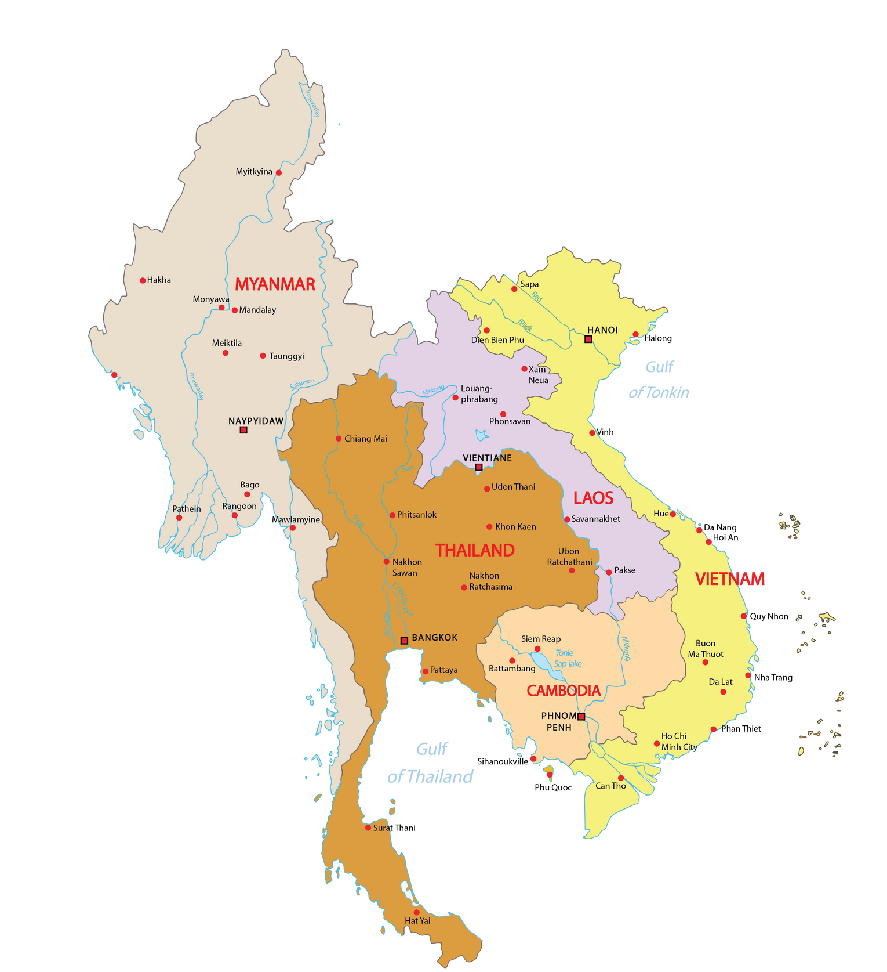





Our operation Offices
Threeland Travel is strategically positioned with operation offices in Vietnam, Cambodia, Thailand, Laos & Myanmar with a network of local and international sales offices.
This setup enhances operational efficiency, supports global collaboration, and reflects our commitment to cultural understanding ensuring exceptional travel experiences through a well-connected international presence.
08
threeland.com

Slide 7


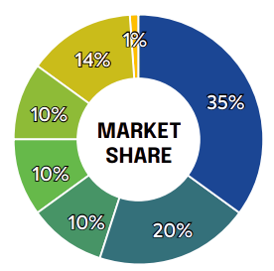
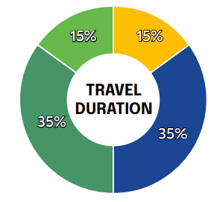
Business Insights
India and South Asian/ Middle East
Spain/ Latin America/ Portugal
Eastern Europe: Czech, Baltic countries, Slovenia...
Benelux countries
DACHs countries and Nordic countries
UK, Canada, USA, Australia
Others
Short Breaks (3-5 days)
One-week Tours (7-9 days)
Extended Tours (10-14 days)
Longer Stays (15+ days)
11
threeland.com

Slide 8
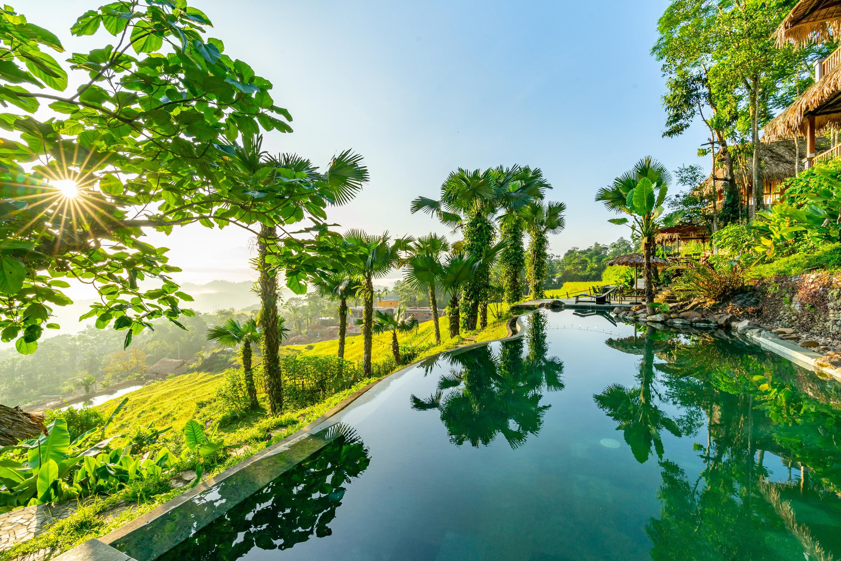
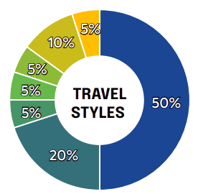
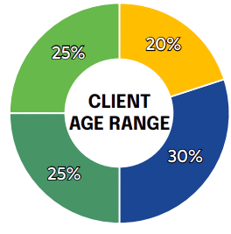
Business Insights
Leisure & Group Travel
Adventure Travel
Luxury Travel
Solo Travel
Ecotourism/Responsible Travel
MICE (Meetings, Incentives, Conferences, Exhibitions)
Wellness Travel
Young Adults (18-30 years)
Families (30-45 years)
Middle-aged Travelers (45-60 years)
Seniors (60+ years)
12
threeland.com

Slide 9
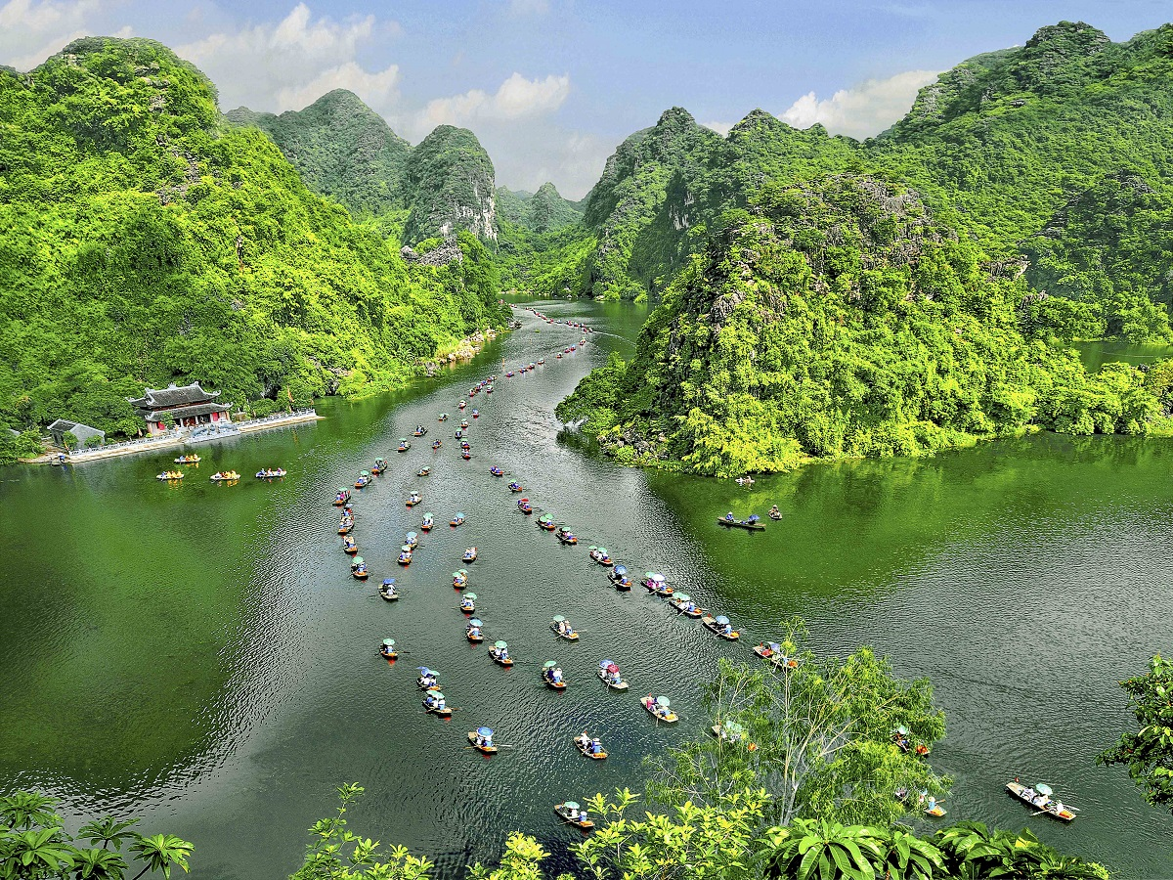


Our Scope of Service
Our core B2B products’s range from long-haul packages and family holidays to exclusive MICE
services, all uniquely crafted to meet diverse client needs.
Greeting Services
VIP airport meet and greet,
fast-tracked visa/ immigration
Hotel/Accommodation
Wide range of hotels from 3
star to luxury, API connection
Tour Packages
FIT & GIT, S.I.C Tours, theme tours (adventure, wellness, responsible, sport,
LGBT-friendly travel…)
MICE Services
Meeting & conference, incentive trips, corporate travel for group from 100 to 2000 guests
Shore Excursions | Free & Easy Packages
Shore excursion, sightseeing tours, culture show tickets, golfer & none golfer
23
threeland.com

Slide 10



Why Threeland?
With over 20 years of excellence as a comprehensive DMC in Indochina and a strong track record across diverse markets, Threeland is your reliable gateway to Vietnam and Indochina. We empower our B2B partners through strategic collaboration, tailored solutions, and unmatched value. Let’s grow together with innovation, local expertise, and a true partner-first approach.
Global Buying Power
Tailored Product Solutions
Partner
experience
  Maximize your margin with exclusive B2B rates
  Save more through our high-volume, pre-negotiated contracts
  Priority access to top-rated suppliers
  100+ expert local travel designers at your service
  Ready-made and customizable itineraries for every niche
  Fast turnaround with dedicated account support
  Trusted by 1,800+ global travel partners
  Brand Protection: Services exclusively under your brand
  Long-term win-win partnership mindset
05
threeland.com

Slide 11
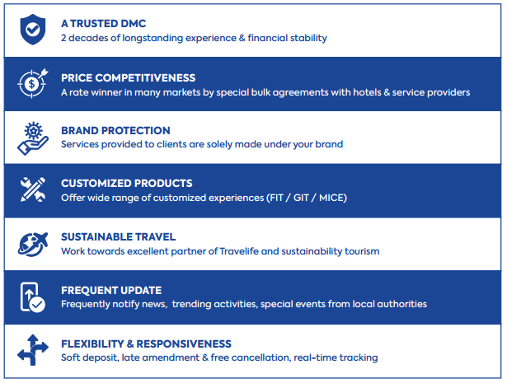
Our strength – the chance for us
Back
7/25/2025
Notes:
- Great connection with big hubs. Thanks to the globalization and convenience of traffic flow, connection within Vietnam as well as between Vietnam and the world becomes easier than ever. Numerous direct & indirect flights from Europe, Middle East, North Asia, North America, Australia and many Asian countries

Slide 12
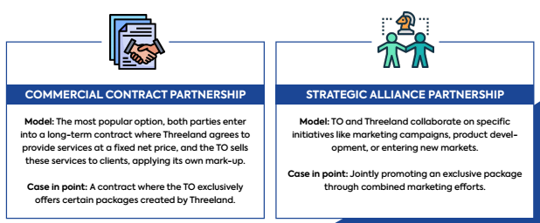
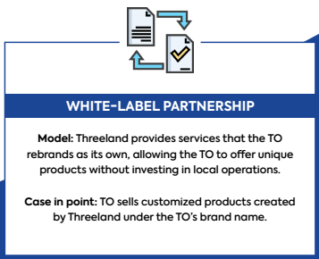
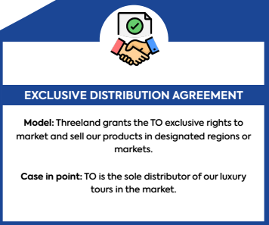
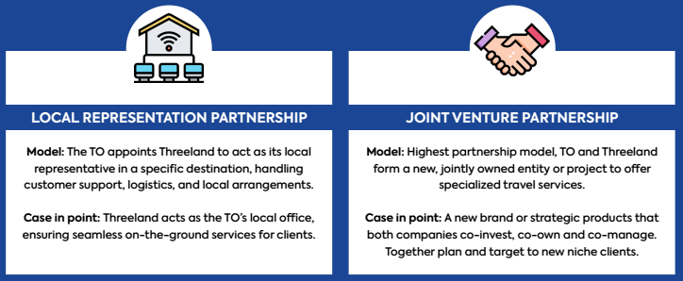
PARTNERSHIP
Back
7/25/2025
Notes:
- Great connection with big hubs. Thanks to the globalization and convenience of traffic flow, connection within Vietnam as well as between Vietnam and the world becomes easier than ever. Numerous direct & indirect flights from Europe, Middle East, North Asia, North America, Australia and many Asian countries

Slide 13




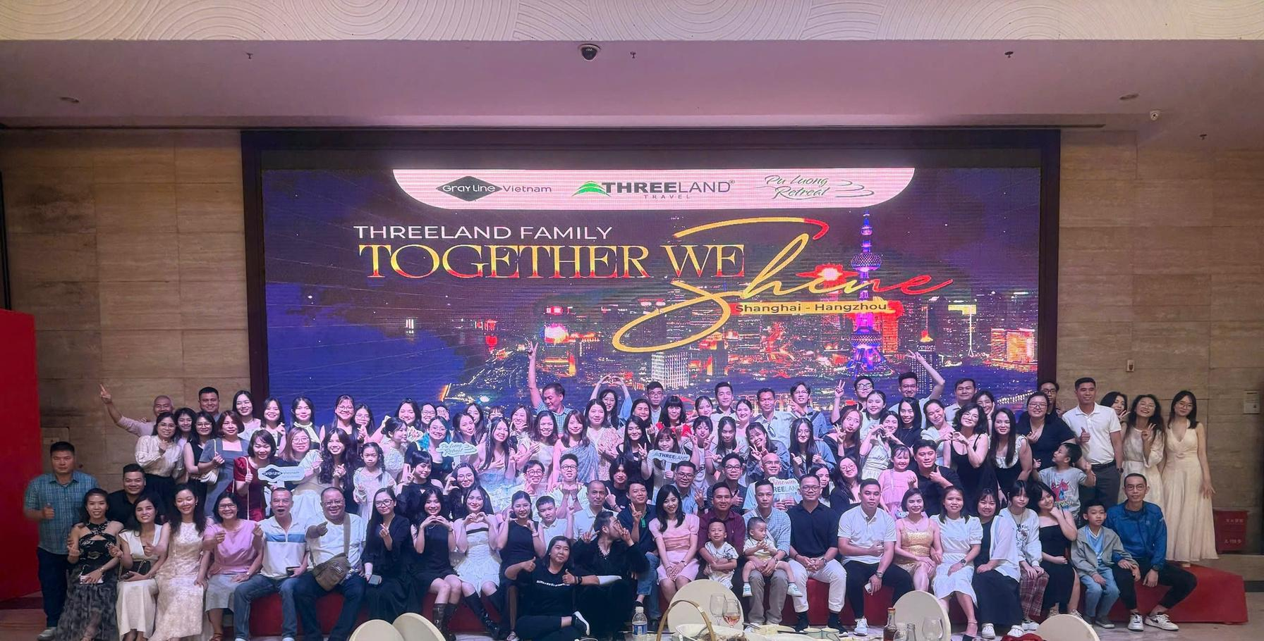
100+
Multilingual Teams
Specialized MICE & Leisure Teams
Professional Tour Guides
3
OFFICES
IN VIETNAM
8
REPRESENTATIVES OFFICES
US, INDIA, ITALY, PORTUGAL,
SPAIN, POLAND, BENELUX, DACH
3
BRANCH OFFICES
LAOS, CAMBODIA, THAILAND

Slide 14


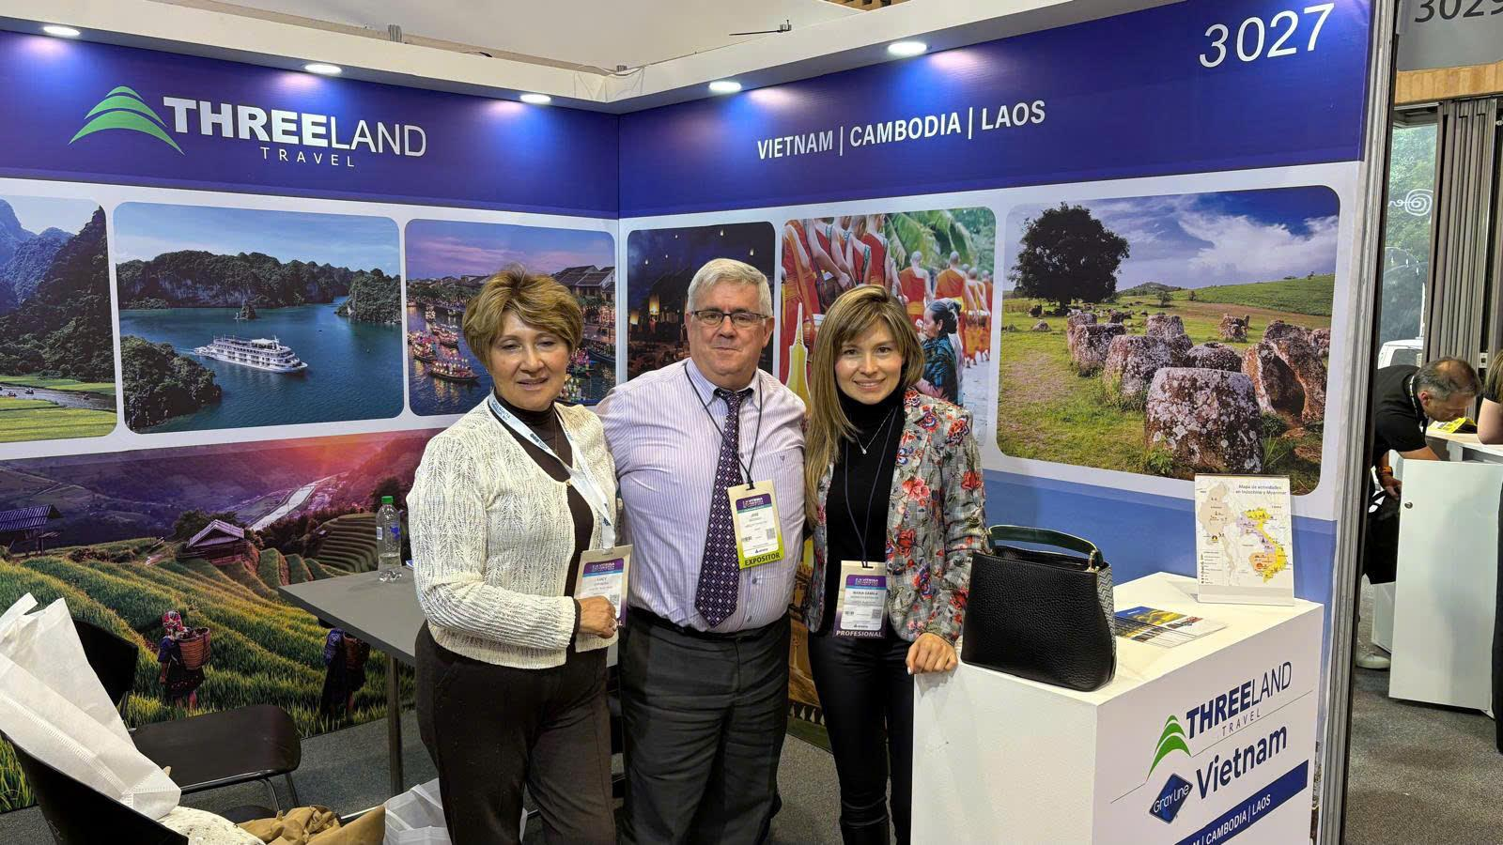




Meet our team at
14
threeland.com

Slide 15




Headquarters and Sales Office
Address: 15bis Ly Nam De Street, Ba Dinh, Hanoi, Vietnam
Tel : +84 24 3926 2056
Hotline: +84 979 016 928
Email : help@threeland.com
Website: www.threeland.com
Global Representative
Italia office - Rome:
Contact person: Mr. Giovanni Caridi
Email: italy@threeland.asia
India office - Mumbai:
Contact person: Mr. Pranav Kapadia
Email: india@threeland.asia
Portugal office - Lisbon:
Contact person: Mr. Nelson Coltez
Email: portugal@threeland.asia
Spain & Latin America:
Contact person: Mr. Jose Redondo
Email: spain1@threeland.asia
Benelux market:
Contact person: Mrs. Inèz Ruska
Email: sales@jantourism-consultancy.com
Dach market:
Contact person: Mr. Rob Knoedl
Email: Dach@threeland.asia
Cambodia Operation Office Address: #203, Sangkat: Svay Dungum, Siem Reap, Cambodia
Contact person: Mr. Bunsoeung
Email: cambodia1@threeland.com
Laos Operation Office
Address: 88/07 Ban Phonpheng, Phouvao Road, Luang Prabang, Laos
Contact person: Mr. Joy Siphanthong
Thailand Office
Hotline: +66 85 254 2899
Contact person: Ms. Nara Trithiparom

Slide 16




