Slide 1

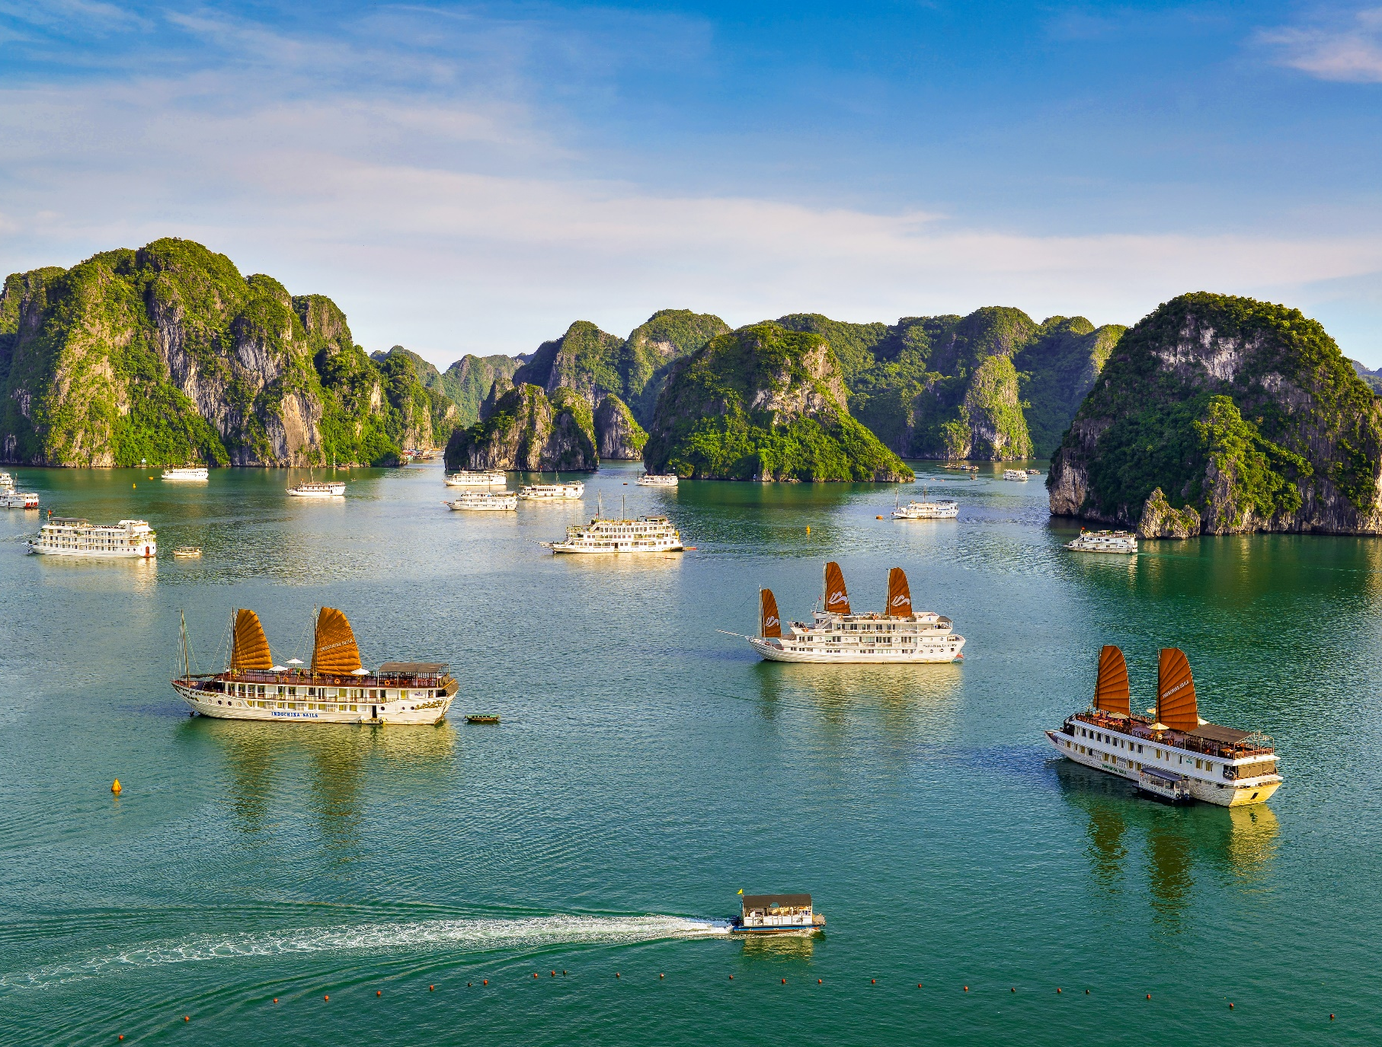


Vietnam
Ethnical Diversity
Diverse nature sights, history, & culture
Long coastlines with numerous magnificent seascapes & beaches
Big hubs: Hanoi, Ho Chi Minh City, Ha Long, Hue, Da Nang – Hoi An, Nha Trang, Phu Quoc
1

Slide 2
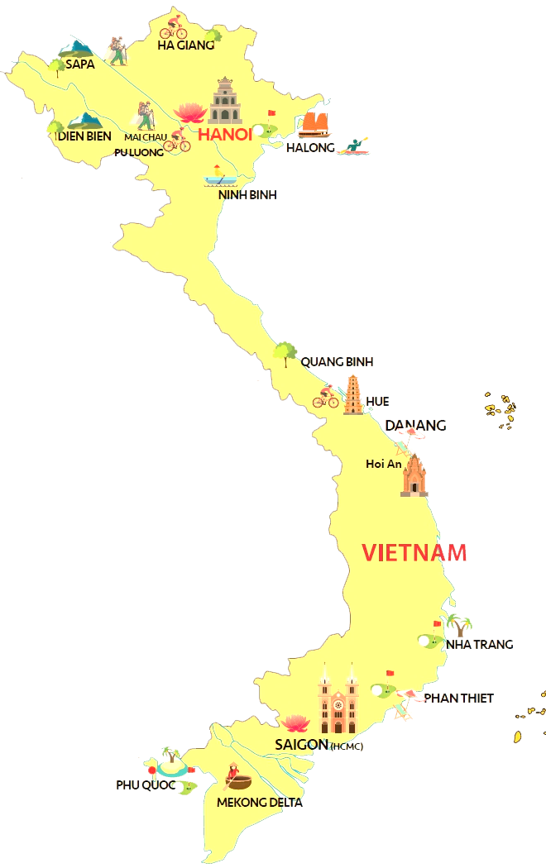











HEADLINES
1
2
Why Vietnam
Key cities
Myanmar
Vietnam
Laos
3
4
Activities
Culture shows
5
6
Cambodia
Dining experiences
Accommodation
7
8
Tour sample
Travel service
7/25/2025

Slide 3
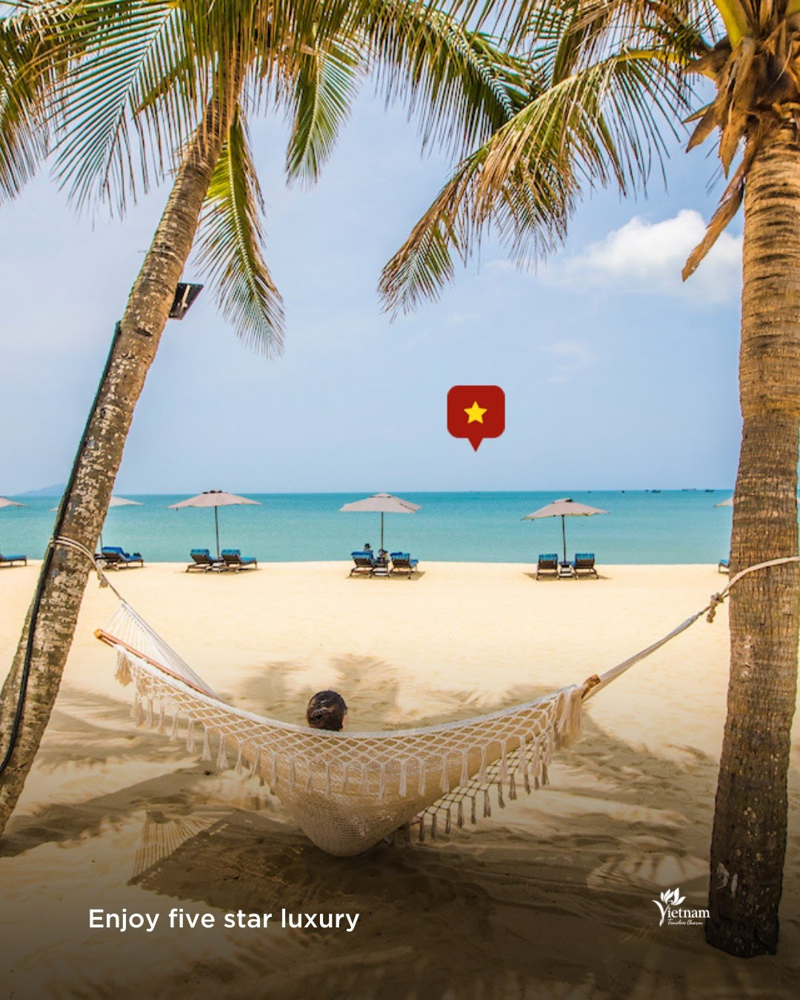
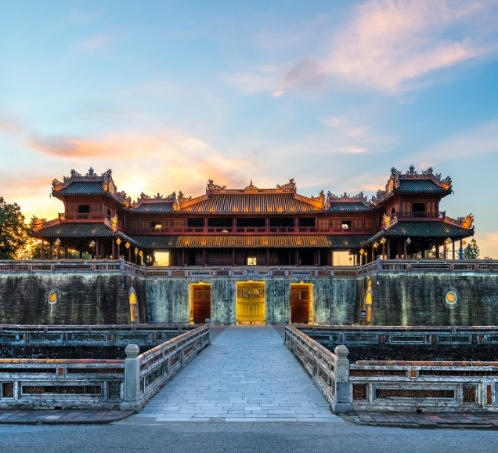

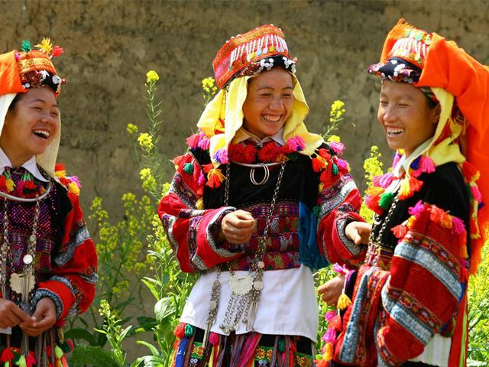
Why travel to Vietnam
Epic history & culture
Nature & wildlife
Best beaches & long coastline
Prominent Architecture
7/25/2025
Simply your best local friend

Slide 4

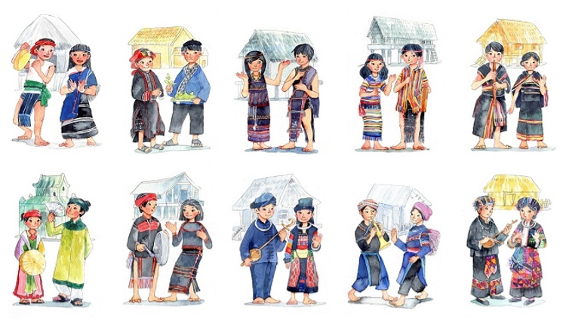
History & Culture
54 ethnic groups with diverse customs and culture, long-held traditions in which Viet is the majority group
Life differs between cities, countryside and mountainous areas yet people are all friendly, helpful and hospitable
Back
7/25/2025
Simply your best local friend

Slide 5
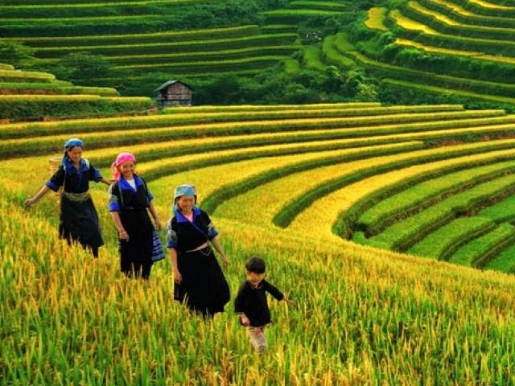
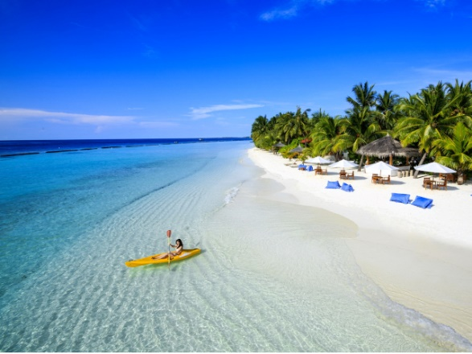
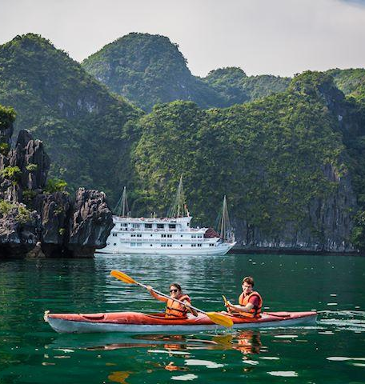
Nature
Over 3000km coastline under the tropical weather
Numerous all year-round sunny white sand beaches
Diversified natures with mountains, national parks, nature reserves, bays, caves
Back
7/25/2025
Simply your best local friend

Slide 6
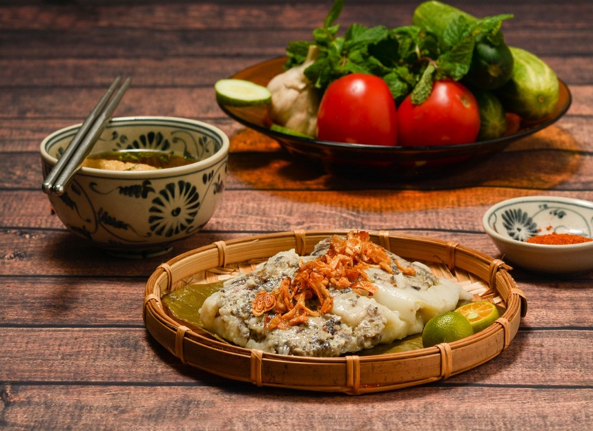
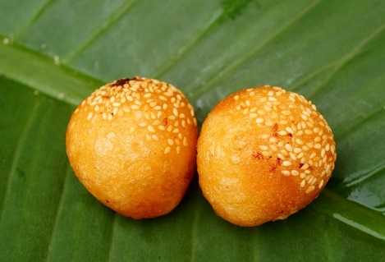
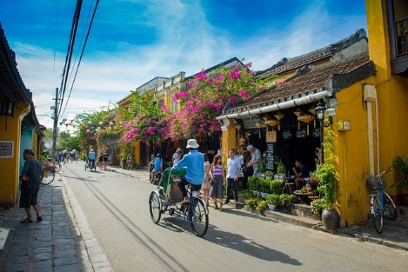
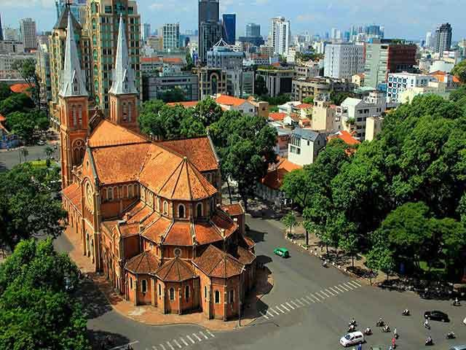
Food
Various choices of food from local cuisine to Asian cuisine (Japanese, Korean, Chinese, Malaysian, Indian), Middle East’s (Lebanese, Turkish) and Western cuisine (Spanish, Italian, French) together with multiple fast food brands such as KFC, Mc Donald’s, Lotteria,…
French colonial architecture remains: the government buildings, mansions and villas, city opera houses, bridge, churches and cathedrals, post office, or tree-lined boulevards in Hanoi and Ho Chi Minh City together with blocked buildings and skyscrapers.
Traditional architecture in Hue, Hoian, and many local villages while house-on-stilts are home to mountainous people.
Architecture
Back
7/25/2025
Simply your best local friend

Slide 7







Weather – Best time to travel
Vietnam – A tropical climate country with the weather varying dramatically across regions
North: 4 seasons per year: Winter from Nov to Jan; Summer from May to Aug with the hottest weather and maximum rainfall in a year; Spring with drizzly weather from Feb to April; Autumn with cool atmosphere in Sep and Oct.
Central: Hot and humid weather from March to August; Rainy seasons with possible storms and typhoons from September to February.
South: Summer all year round, rainy season from early May to late Sep; temperature ranges between 21 and 35 °C (69.8 and 95.0 °F).
Jan | Feb | Mar | Apr | May | Jun | Jul | Aug | Sep | Oct | Nov | Dec
North
Central
South
Back
7/25/2025
Simply your best local friend
Notes:
Vietnam’s weather varies in regions, it would not be the one-size-fits-all answer.

Slide 8

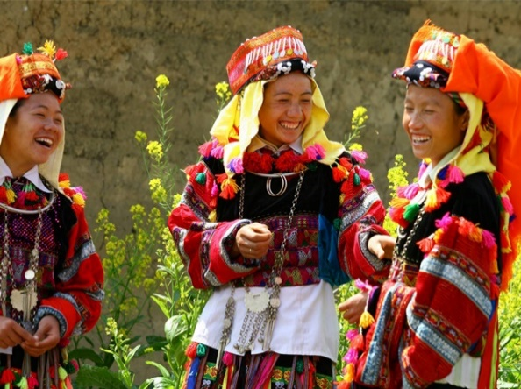
Safety
Stable politic, safe to go, no terrorism or
demonstration, peaceful & friendly people
02
Back

Slide 9
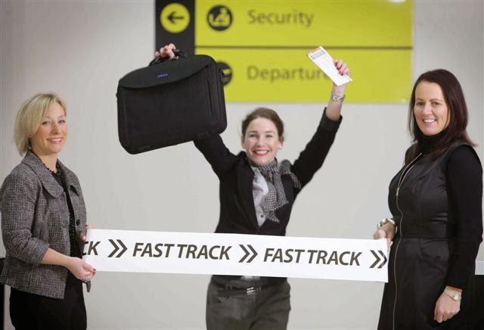
IMMIGRATION
Immigration service
Fast track service, VIP services
Welcoming at the aircraft gate
Get visa stamp at visa counter without waiting in line
Be assisted and escorted throughout immigration procedure
Baggage porters available on request
Back
7/25/2025

Slide 10


VISA
Visa approval letter
Documents required: passport copies, air tickets in/out Vietnam and travel insurance
With this Visa letter, guests can obtain Visa on arrival at the airport
The process may take around 10 working days
E-Visa can be done on your own or assisted by Threeland Travel
Link to apply e-visa: https://evisa.xuatnhapcanh.gov.vn
Documents required: Passport copies, flight details and 1 passport-sized photo (clear, without glasses on)
The process may take around 4 – 5 working days
E -Visa
Back
7/25/2025
7/25/2025
Notes:
Visa approval letter to Vietnam can be arranged by Threeland Travel

Slide 11
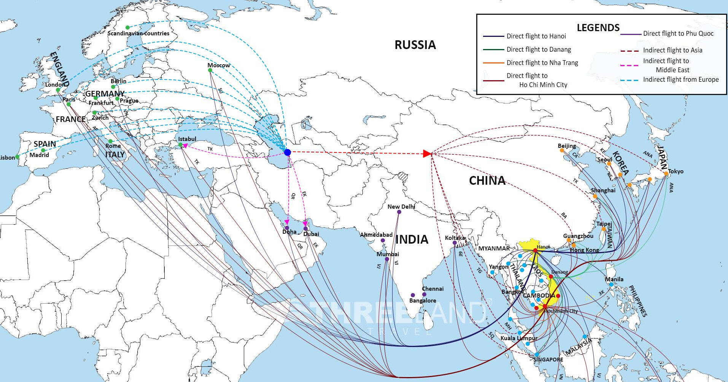
International Flight connection
Back
7/25/2025
Notes:
- Great connection with big hubs. Thanks to the globalization and convenience of traffic flow, connection within Vietnam as well as between Vietnam and the world becomes easier than ever. Numerous direct & indirect flights from Europe, Middle East, North Asia, North America, Australia and many Asian countries

Slide 12
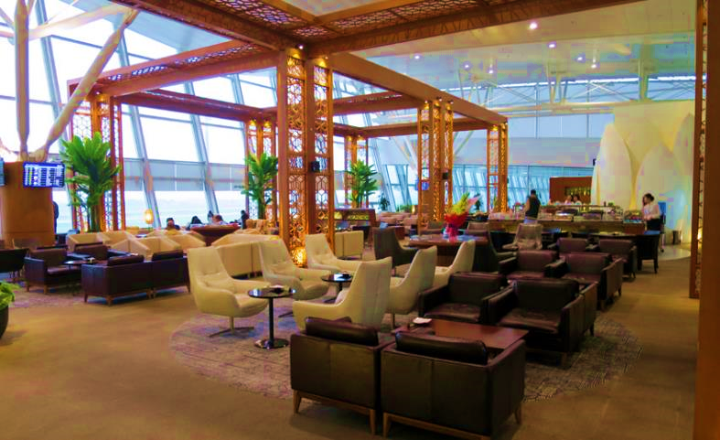
International Airports
Service available
Business class lounges
Banking
Currency exchange counters
Free Wi-Fi
Post and telegraph offices
Tourism information counters
Airport information counter
Duty free shops
Restaurants & cafes
Free water
Car rental service
Medical service
Baggage wrapping service
Back
7/25/2025

Slide 13

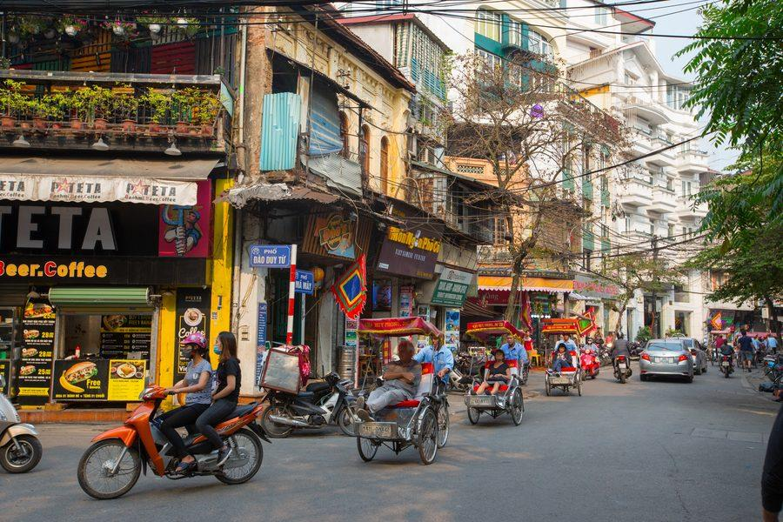
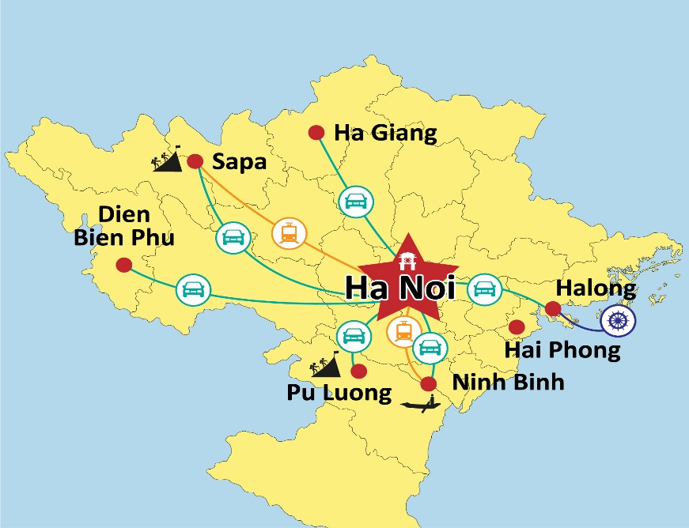
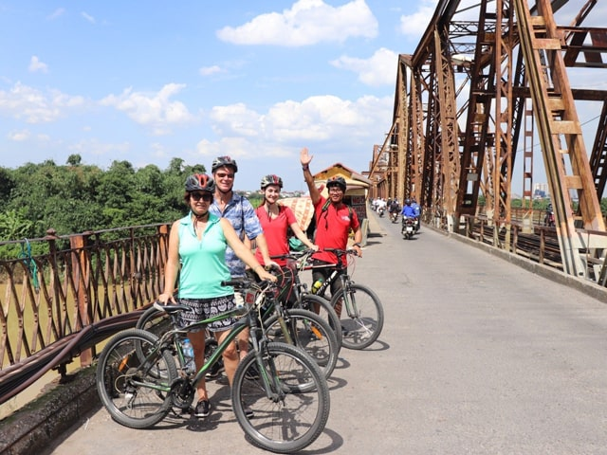
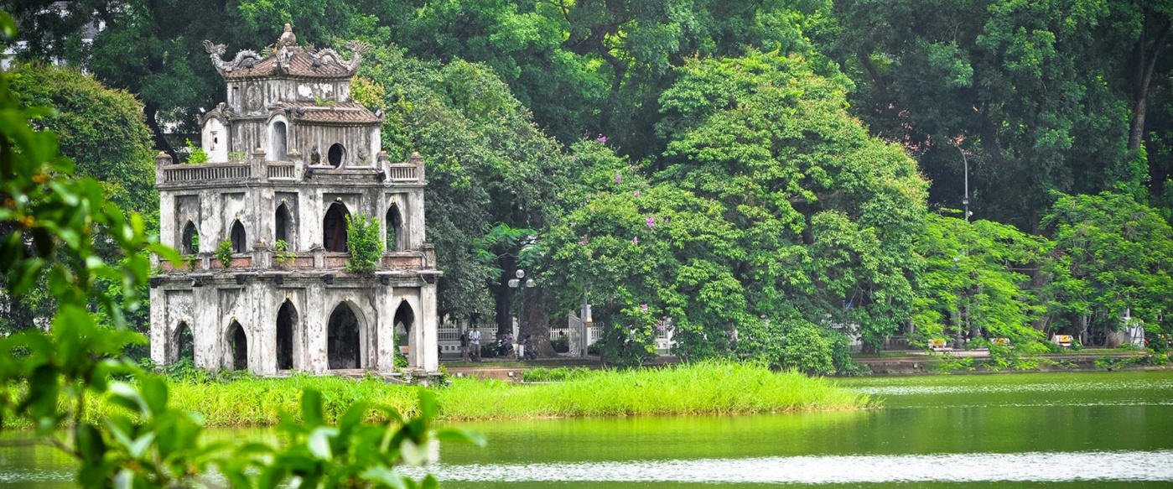
Hanoi
Rich in history & culture, it is the political & economic centre of the country
Despite the growth of modernization, the old charm of a thousand-year town is still well-maintained
Back
Notes:
Chèn 1 đoạn video về Hanoi

Slide 14

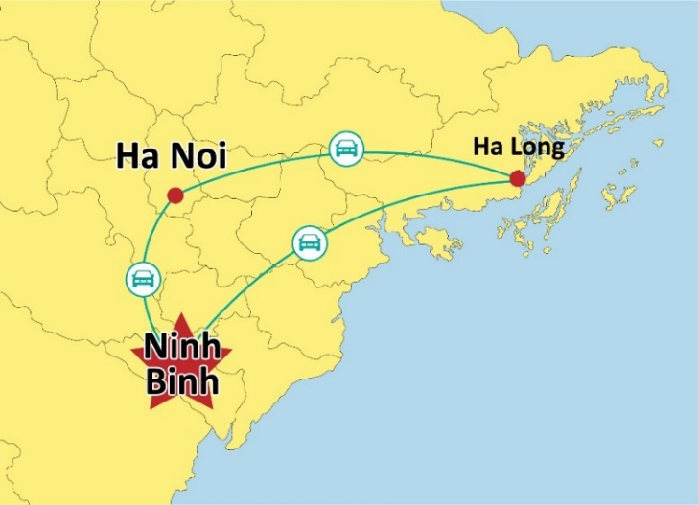
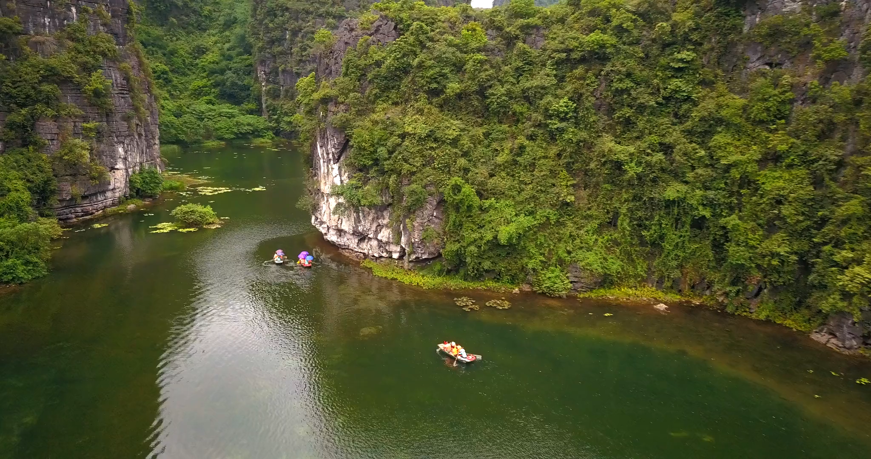
Ninh Binh
A magnificent natural landscape destination - located approximately 90km south of Hanoi
Rich in culture, history, and diverse ecological resources.
Back

Slide 15
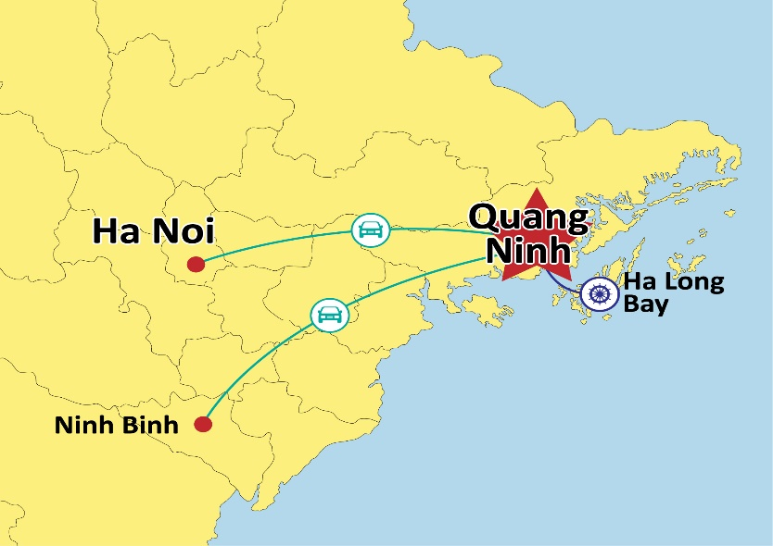
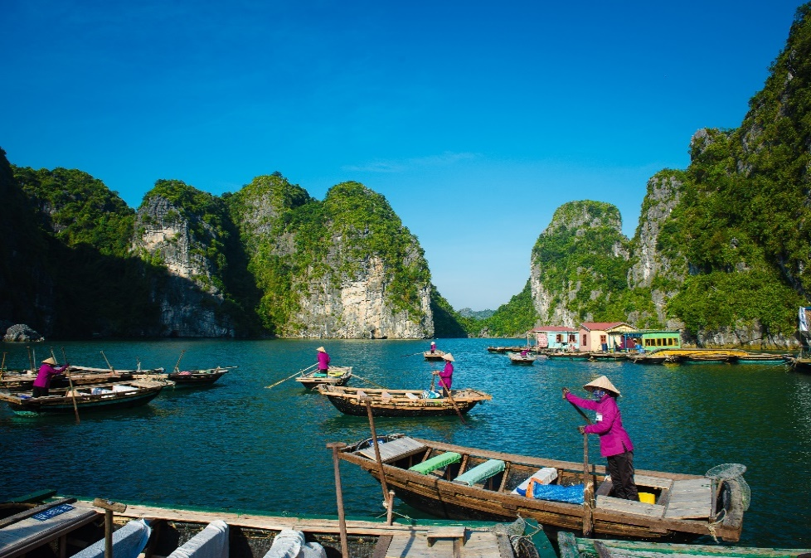
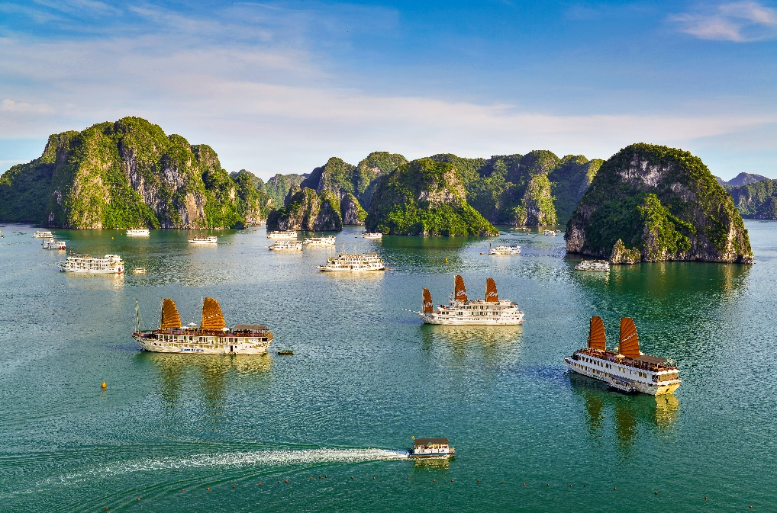
Halong
Magniﬁcent landscapes with millions-old formations of breathtaking grottos, thousands of limestone islands and small islets.
Day cruise, 1-night or 2-night cruise itineraries with varieties of activities like kayaking, visiting caves, swimming, sunset party,…
Back

Slide 16
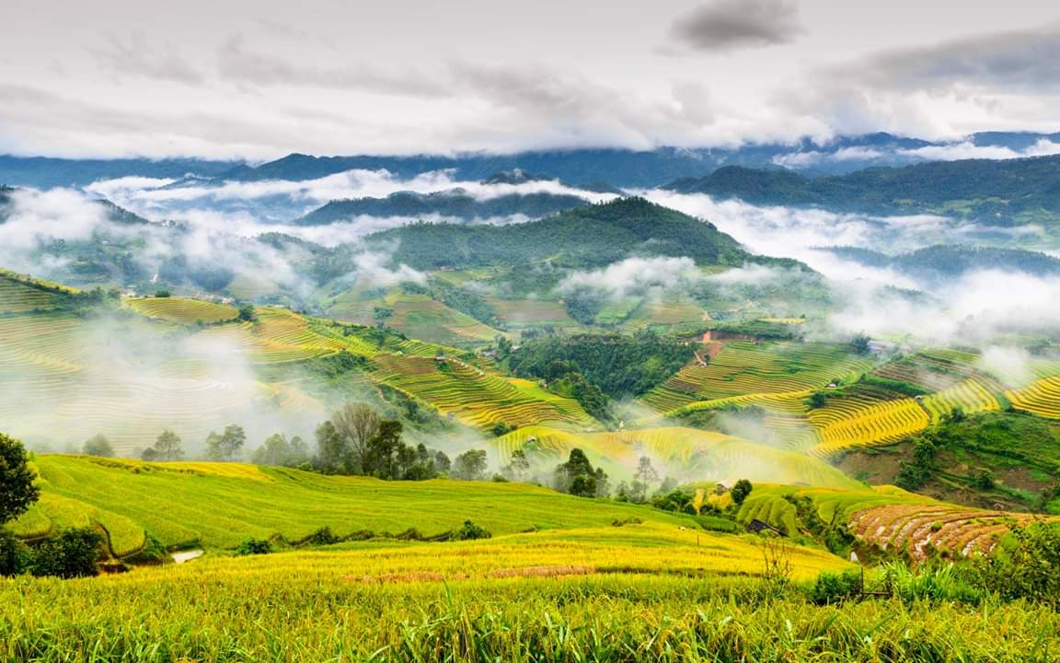
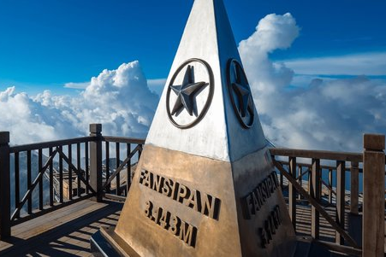
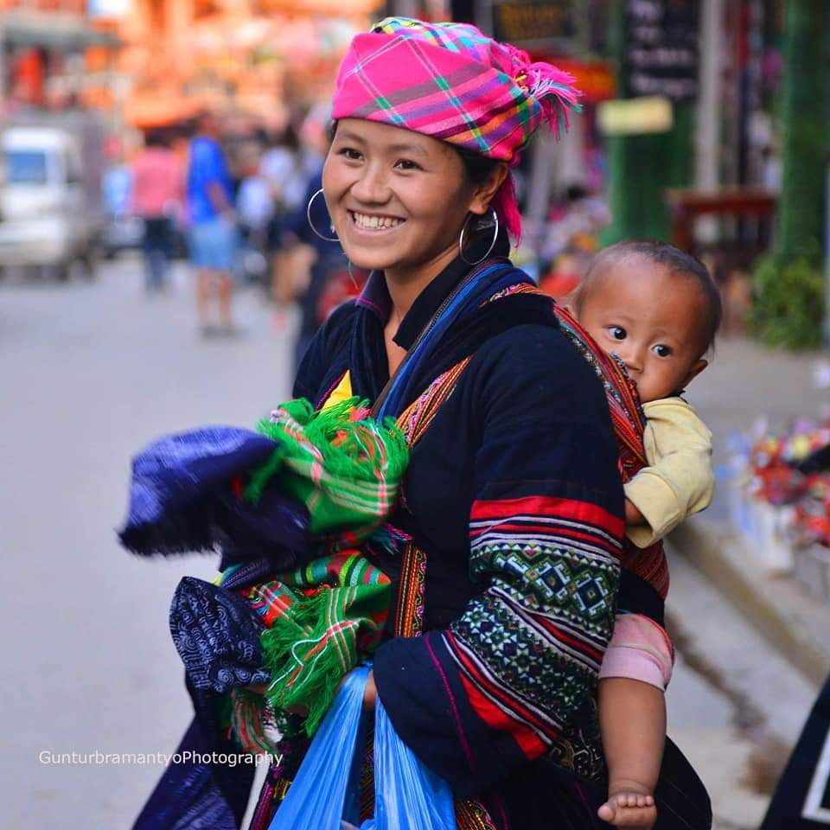
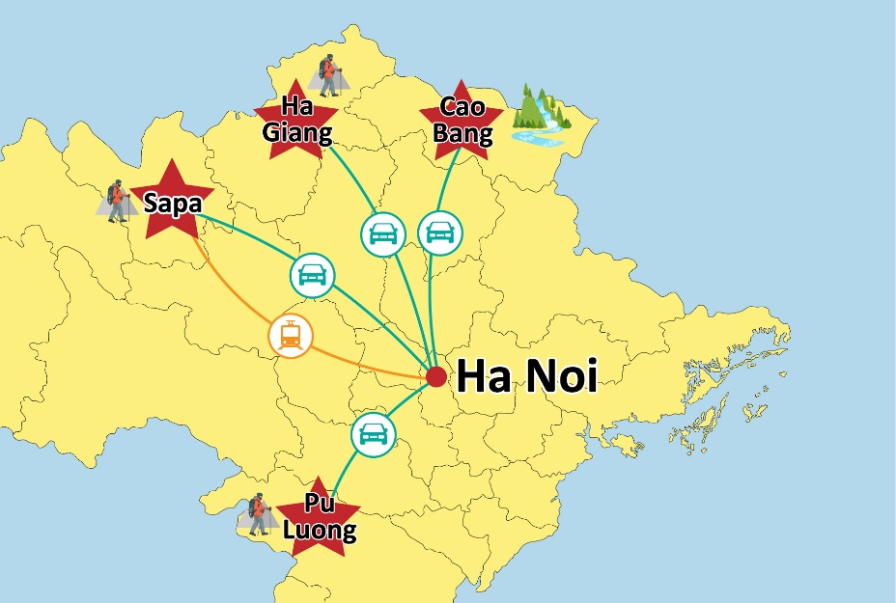
Sapa
Feature hill-tribal villages, breathtaking landscape with mountain ranges, terraced paddy fields, beautiful valleys and waterfalls.
Home to the highest peak of Indochina – Fansipan
Back

Slide 17
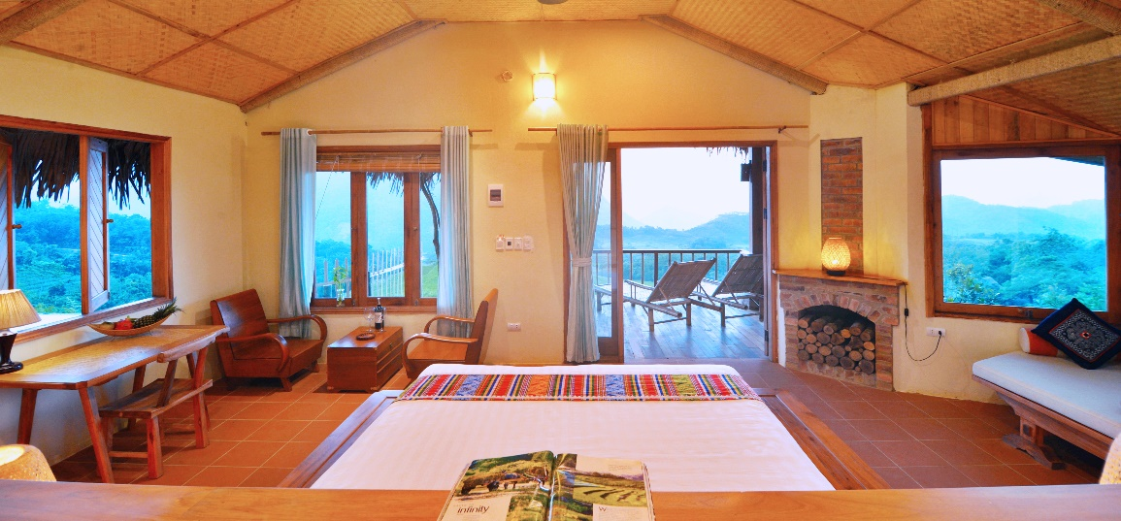
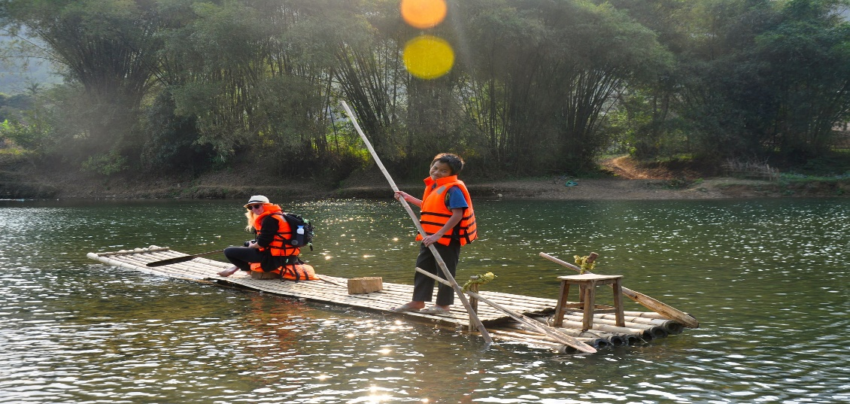
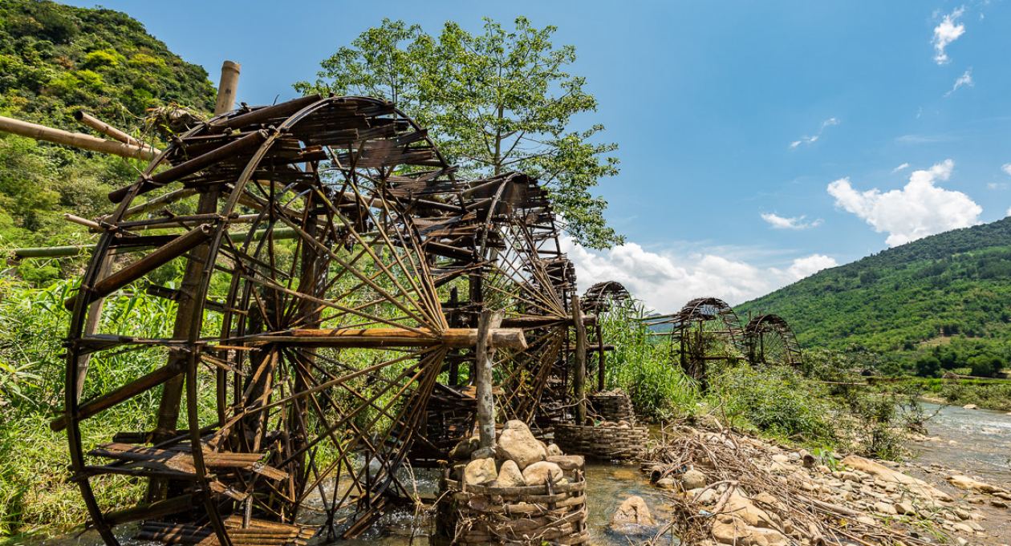
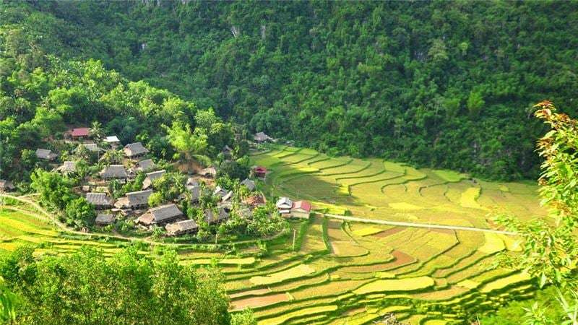
Puluong
A more peaceful and little-known place for a perfect nature retreat
Trekking and cycling are popular activities to see the waterfalls, water wheels and rice terraces
Back

Slide 18
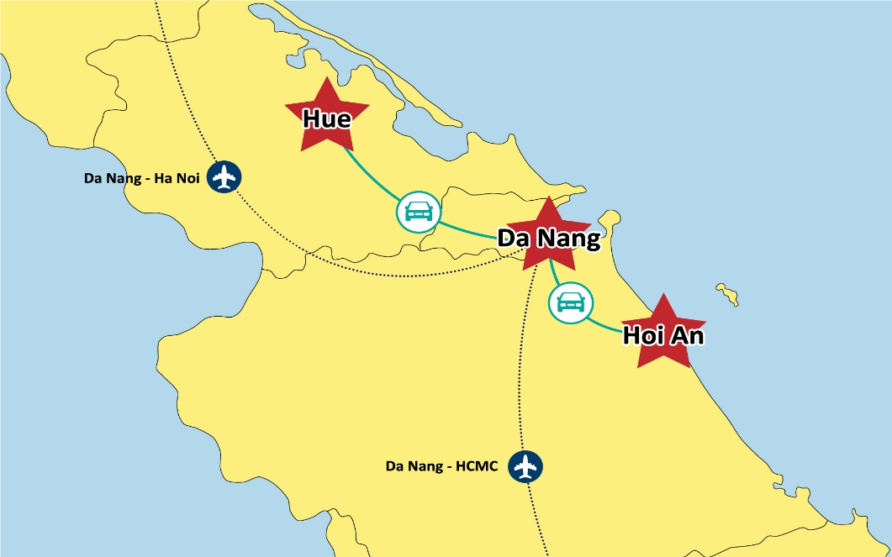

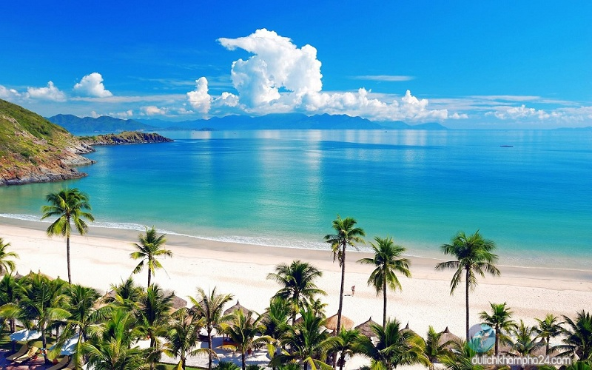
Danang
A family friendly destination oﬀering luxury resorts, beautiful beaches, amusement parks, world-class casinos, golf courses and entertainment centres.
The famous Golden Bridge on Ba Na Hills.
Back

Slide 19
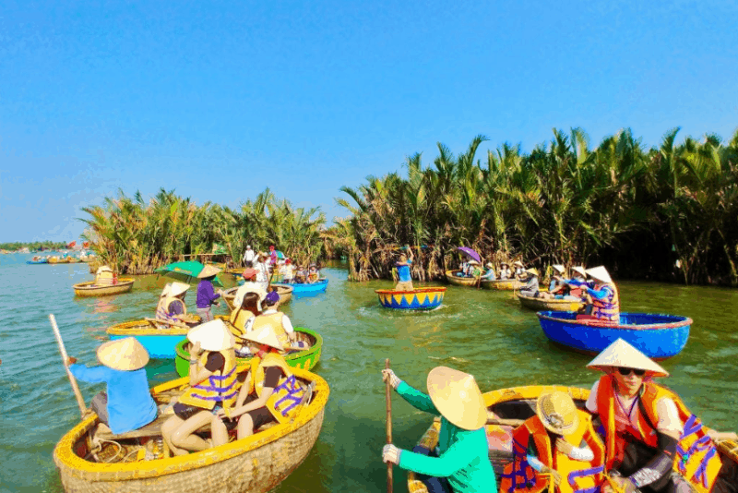
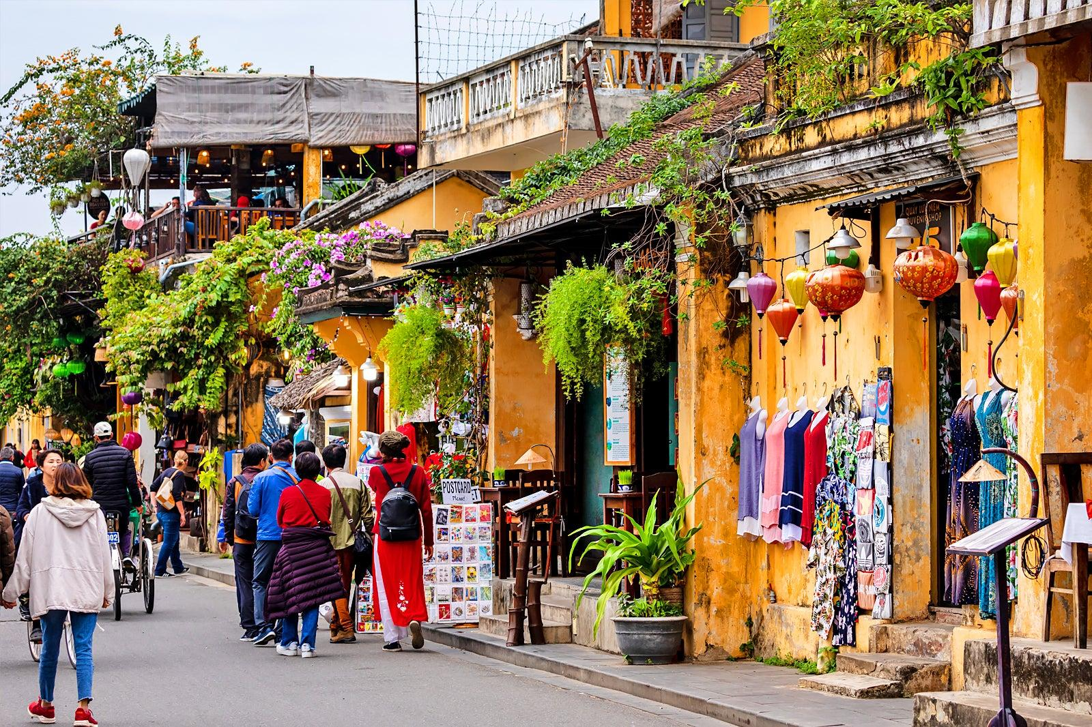
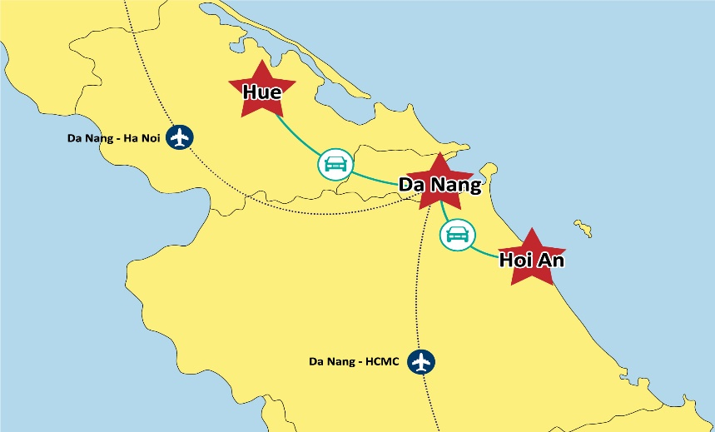
Hoian
Hoian Ancient Town is an UNESCO World Heritage Site
Monthly lantern festival, lantern-lit nights, traditional silk-making products & one-day tailor-made clothing.
Back

Slide 20
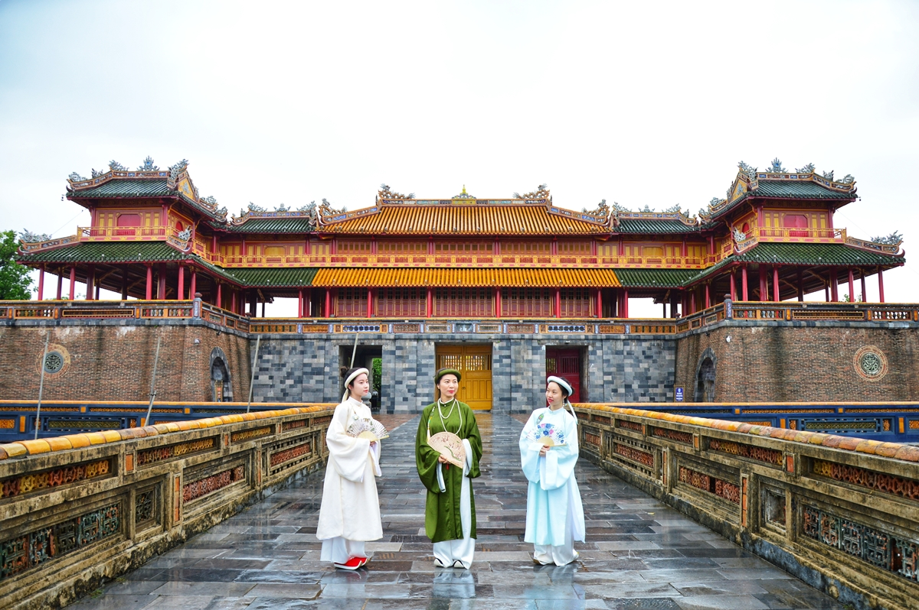

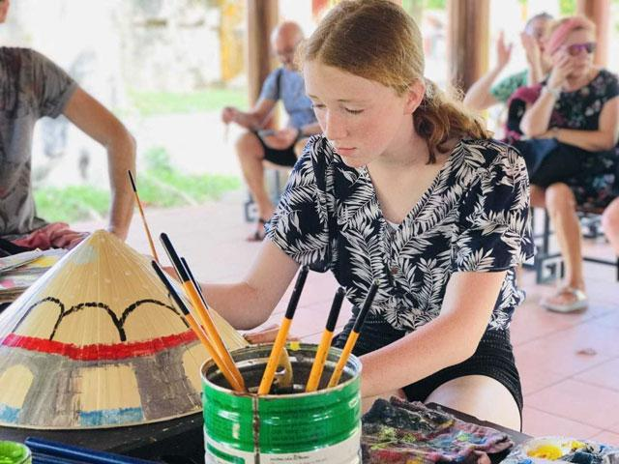
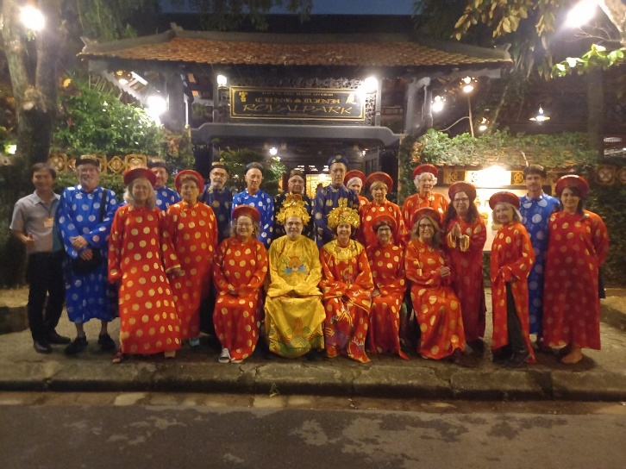
Hue
Featured by imperial legacies, peaceful ambience and art deco mansions
UNESCO list: The Royal Citadel complex (UNESCO heritage) and Hue Royal Court music (UNESCO intangible heritage)
Back

Slide 21
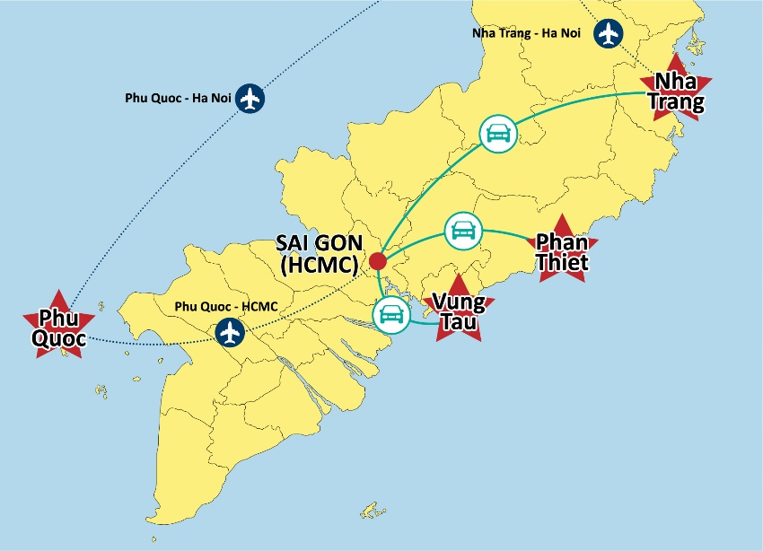
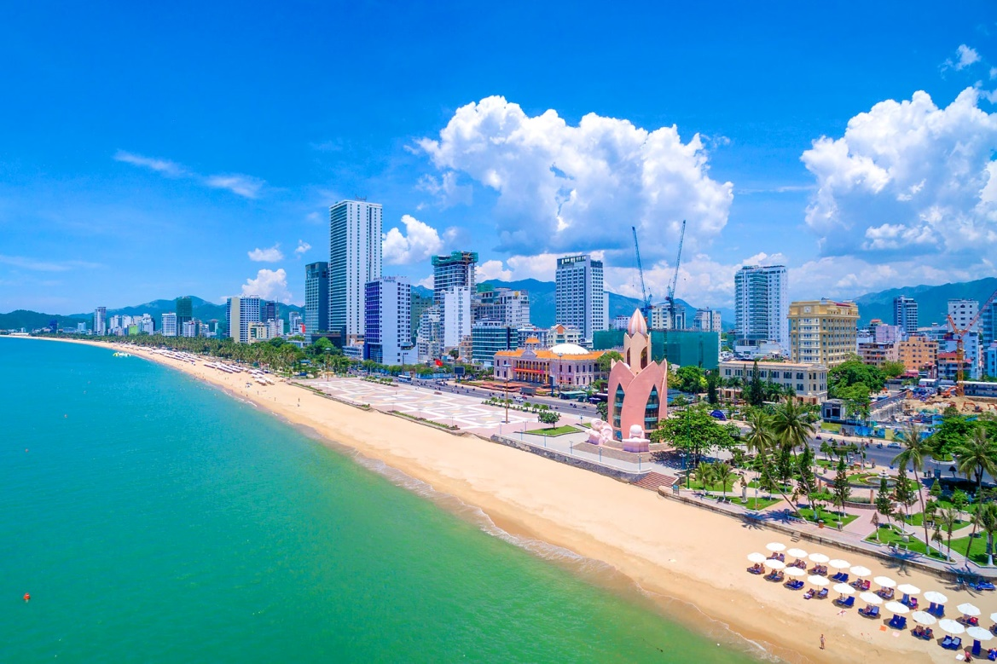
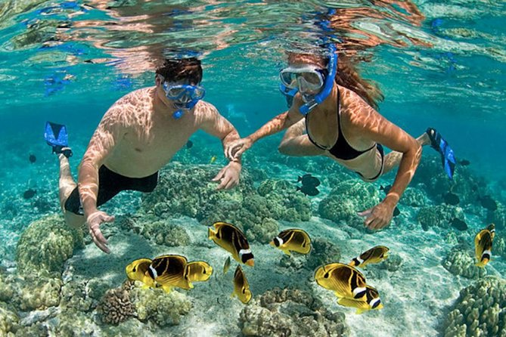
Nha Trang
A playground for sun seekers.
Days here are spent dining on delicious seafood, snorkeling around stunning islands, and partying on the sand after dark.
Home to some of the country’s finest luxury resorts and thrilling watersports.
Back

Slide 22
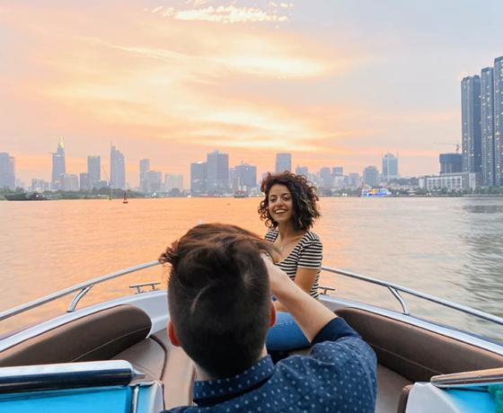


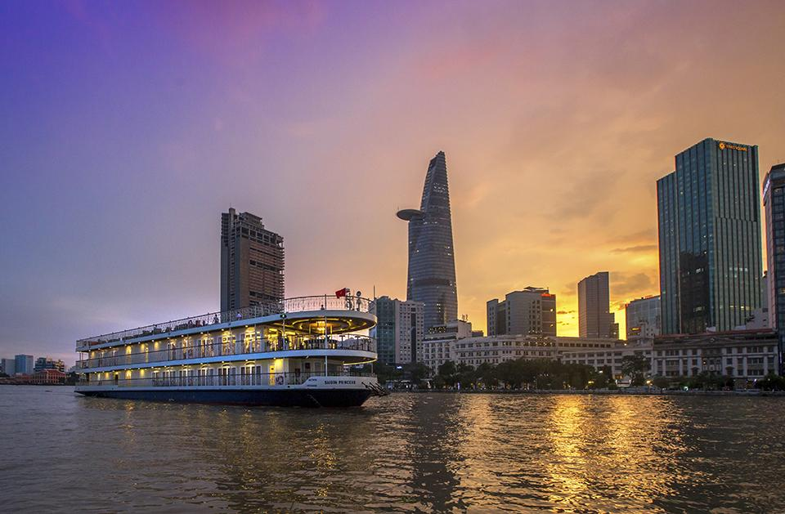
Ho Chi Minh
The largest metropolis in Vietnam, harmony of French buildings and churches, historical sites, shadowy streets, enthralling local-style markets, and modern skyscrapers
Vibrant nightlife and is a shopping paradise
Back

Slide 23
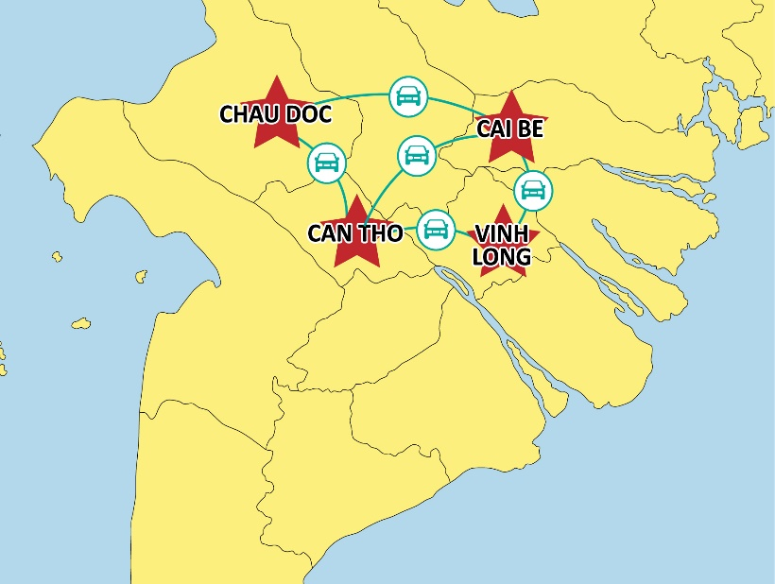
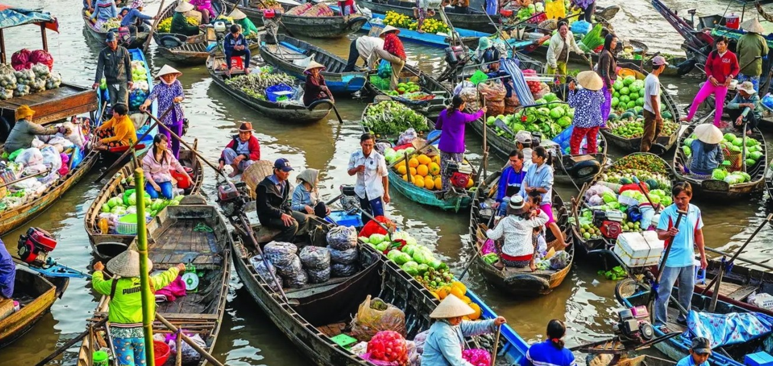
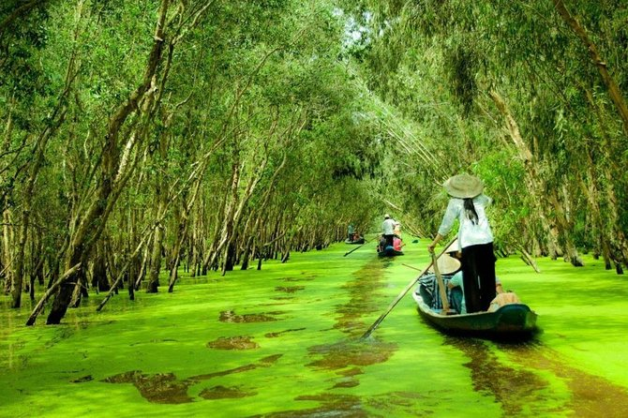
Mekong Delta
An enormous area where Mekong River runs through before reaching the sea creating fertilized deltas with vast fields, lush tropical orchards and density of rivers and canals
Features: floating markets, boat trip in My Tho & Ben Tre | bike tour through villages in Vinh Long, Can Tho or Chau Doc
Luxury cruise crossing Vietnam - Cambodia border | Tra Su Mangrove Forest, Tram Chim National Park | visit local family-run factories & orchards.
Back

Slide 24


3 nights & 4 nights Mekong cruise between Saigon & Phnom Penh
Day 1: Saigon
Day 2: Cai Be
Day 3: Chau Doc
Day 4: Phnom Penh
Back
7/25/2025
Notes:
Easy to connect to: Rach Gia – Phu Quoc
Chau Doc – Phnom Penh

Slide 25


4 days & 3 nights cruise between Phnom Penh & Siem Reap
(only run in high water season: Jul - Apr)
Day 1 Phnom Penh
Day 2 Tonle River
Day 3 Kampong Cham
Day 4 Wat Hanchey
Day 5 Siem Reap
Back
7/25/2025
Notes:
Easy to connect to: Rach Gia – Phu Quoc
Chau Doc – Phnom Penh

Slide 26

8 days & 7 nights cruise between Phnom Penh & Siem Reap
(only run in high water season: Jul - Apr)
Day 1: Ho Chi Minh City
Day 2: Cai Be–Sa Dec
Day 3: Chau Doc–Cambodian Border Crossing
Day 4: Phnom Penh
Day 5: Phnom Penh–Prek Bang Kong
Day 6: Wat Hanchey–Angkor Ban
Day 7: Konpong Louang–Kampong Tralach
Day 8: Siem Reap
Back
7/25/2025
Notes:
Easy to connect to: Rach Gia – Phu Quoc
Chau Doc – Phnom Penh

Slide 27





Southern beaches
Nha Trang - City of sunny white sandy beaches, water sports, islands and seabed activities, home of luxurious resorts, amusement park, golf courses, world-class restaurants & bars.
Mui Ne: Known as Vietnam’s Sahara Desert with white and red sand dunes, home to funny games including jeep drive, sand sledding, squad bike, water sports and beach relaxation.
Dozens of beautiful sunny beaches along the coastline with less travel, emerald waters, great fresh sea foods and boutique resort, with few names: Ninh Chu, Con Dao island, Phu Yen....
Back

Slide 28



Phu Quoc
The only Visa-free destination in Vietnam
The largest island in Vietnam
Features: crystal clear water, colorful coral reefs, various water activities, Hon Thom Nature Park with the longest sea cable car in the world, Vinpearl Safari - the first semi-wildlife park in Vietnam and United Center – the so-called Vietnam’s first-ever ‘sleepless city’
Back

Slide 29








Various Travel Styles
Two to three-week tours including culture, beach relaxation & hiking in the rural areas.
Theme tour, including educational tour, charity tour, M.I.C.E.
Photography tours, Honeymoons, LGBT tours, spa treatment.
Light adventures: cycling, hiking, motor-biking, caving in the North..
Hard adventures: trekking, rafting, mountain biking, rock climbing, caving in the Central.
Sea cruise in Halong Bay with rowing boat trip, sightseeing of karst scenery and ancient temples in Ninh Binh, eco-stay in Northern mountain: Puluong
Excursions from Hanoi, Hoian and Saigon to the rural suburb for sightseeing & agricultural tours, golf tour.
Vespa tour and food tours in Hanoi, Hoian and Saigon.
Beach relax at Halong, Danang, Hoian, Quy Nhon, Nha Trang and isolated islands of Cat Ba, Con Dao and Phu Quoc.
Mekong river cruise from Saigon to Siem Reap via Phnom Penh, Cambodia.
Back
7/25/2025
Simply your best local friend

Slide 30


Highlight activities
Cyclo
Vespa or Motorbike Tour
Exploring the busting streets on "Cyclo" - a simple bicycle taxi of the Vietnamese people in Hanoi & Saigon.
Getting a ride on the most popular means of transport in Vietnam, Vespa motorbike tour can take you to the hidden corners of Saigon & Hanoi
Back
7/25/2025
Simply your best local friend

Slide 31


Highlight activities
Boarding a sampan
Cruising among 3000 islets
Drift down the river among villages, mountains and lush rice fields.
A leisure cruise among one of the world’s new seven wonders where its’ 1,600 islands and islets form spectacular seascape of limestone pillars.
Back
7/25/2025
Simply your best local friend

Slide 32


Highlight activities
Making incense sticks in Hue
Scenic boat trip on Thu Bon River & visit Organic Village with lunch in Hoian
Visit a traditional village and learn how to make the incense sticks – a religious item in Vietnam.
Become a farmer and learn about local life at a traditional vegetable village in a day
Back
7/25/2025
Simply your best local friend

Slide 33


Highlight activites
Basket Boat ride in Hoian
Cycling to Tra Que Village in Hoian
Back
7/25/2025
Simply your best local friend

Slide 34


Highlight activites
Lantern boat ride in Hoian
Lantern making in Hoian
Back
7/25/2025
Simply your best local friend

Slide 35


Highlight activites
Cooking class
Floating market
Hone your cooking skills among tranquil setting at one of Vietnam's top-rated cooking class
Discover the local lives in Mekong Delta that moves along with the rhythms of the mighty Mekong
Back
7/25/2025
Simply your best local friend

Slide 36


Highlight activites
Herbal foot soak in Mai Chau or Puluong
Traditional dance performance
Back
7/25/2025
Simply your best local friend

Slide 37




Nightlife activities
Night tours: Thang Long Citadel, Hoa Lo Prison in Hanoi, Bai Dinh in Ninh Binh…
Sightseeing by hop on hop off bus seeing the city at night
Walking streets: all over Vietnam
Night market: in major hubs
Back

Slide 38






Water activities
Snorkeling
Surfing
Sea walking
Kayaking
Diving
SUP
Back

Slide 39





Adventurous activities
Paragliding
Gun shooting
Ziplining
Canyoning
Quad Biking
Back

Slide 40


Off-the-beaten track activities
Back

Slide 41





Culture show - Water Puppet Show
  Combination of traditional Vietnamese puppetry and music.
  The performance starts with a troupe of wooden water puppets being skillfully moved across the stage on a pool of water.
  Puppets perform a variety of scenes, accompanied by a live orchestra playing traditional Vietnamese music.
Thang Long Theatre
Bong Sen Theatre
Address: 57B Dinh Tien Hoang street, Hoan Kiem District, Hanoi
Address: 16 Le Thai To street, Hoan Kiem, Hanoi
Duration: 50 minutes
Duration: 50 minutes
Trailer: https://youtu.be/-bezb1tRCZM
Show Schedule:
4 Shows Daily : 16:10 ; 17:20 ; 18:30 ; 20:00
Show Schedule:
  Monday: 17:15 ;
  Tuesday: 17:15
  Wednesday: 16:00 ; 17:15
  Thursday: 17:15 ; 18:30
  Friday: 17:15
  Saturday: 16:00 ; 17:15
  Sunday: 17:15
Ticket price:
Second class ticket: USD 9 per person First Class ticket: USD 11 per person
Ticket price:
Second class ticket: USD 9 per person First Class ticket: USD 11 per person
Back

Slide 42





The Quintessence of Tonkin Show
  Known as Tonkin Show or “Tinh Hoa Bac Bo” in Vietnamese
  Authentic Vietnamese history and culture from a contemporary perspective.
  Hundreds of performers, an interactive water stage, and state-of-the-art technology combine to create an unforgettable show that captures the essence of the Vietnamese people.
Trailer: https://youtu.be/ZMQBWPsFUFo
Ticket price: USD per person, including return transfer from Grand Plaza Hanoi hotel
  Silver ticket: USD 21 per person
  Gold ticket: USD 26 per person
  Platinum ticket: USD 34 per person
  Child ticket: Children under 1.3 meters tall equal 50% of an adult ticket.
Show time: Every Saturday 19:30-20:45
Address: Da Phuc Village, Sai Son Commune, Quoc Oai District, Hanoi
Back
Duration: 75 minutes

Slide 43

Hoian Memories Show
Opening hours:
  Mini show: 17:30 – 19:00
  Main Show: 20:00 – 21:00
https://kyuchoian.com/
  The Hoian Memories Show features Vietnam's traditional ao dai using modern staging techniques, lighting technology, and audio effects.
  The Memories Show is an interactive production that offers an immersive experience of Old Hoi An.
  It opens at 5pm and features historical architecture, miniature themed villages, mini-shows and creative workshops.
Trailer: https://youtu.be/fBLF-kFihPs
Ticket price:
Adult: ECO ticket: USD 20
Child : ECO ticket: USD 9
HIGH ticket: USD 26
HIGH ticket: USD 14
VIP ticket: USD 45
VIP ticket: USD 25
Add: Hoi An Lune Center, 1a Nguyen Phuc Chu , Minh An, Hoian
( Child ticket applied for children from 6- under 12 years old and under 1.4 meter tall.
If children over 1.4 meter all, adult ticket price is applied. )
Duration: 60 minutes
Back
Fr Monday to Sunday, except Tuesday

Slide 44


Additional values
Hotels
Restaurants
Numerous choices from fine dinning to local restaurants for various guests from different regions
Numerous of international brand hotels with well-equipped conference facilities
.
Shopping
Night life
Various local markets, shopping centers and malls from resonable cost items to skillful handicraft products.
Various kinds of day & night activities available: art shows, bars, pubs, discotheques, shopping...
Back
7/25/2025
Simply your best local friend

Slide 45




Restaurants
Vietnamese Cuisine
Vietnamese food uses a lot of spices and fresh herbs
Uses mainly with fresh ingredients, minimal use of oil, sugar
Balances between herbs and meats
Back
7/25/2025
Simply your best local friend

Slide 46




Restaurants
Western Cuisine
Match with variety of demands from visitors of all cultures
Plentiful choices Italian, French, Western food, Middle East, Turkish, fast food
Back
7/25/2025
Simply your best local friend

Slide 47




Restaurants
Vegetarian Cuisine
New philosophy of a well-balanced and healthy life.
Easily find a quality vegetarian restaurants throughout the countries
Back
7/25/2025
Simply your best local friend

Slide 48




Unique dining experiences
Dinner on cruise
Dining on bamboo raft
Dining on a rice field
Dining in the dark
Back

Slide 49

TOUR SAMPLE
HIGHLIGHTS IN VIETNAM & CAMBODIA
The Best of Vietnam - 11D10N
Day 1: Saigon Arrival
Day 2: Saigon City Tour – Cu Chi Tunnels
Day 3: Saigon – Mekong Delta – Saigon
Day 4: Saigon – Danang – Hoi An Ancient Town
Day 5: Hoian – Tra Que village – Cooking demonstration – Hoian
Day 6: Hoian – Myson – Hoian – Hue
Day 7: Hue city tour – Street food - Flight to Hanoi
Day 8: Hanoi City Tour
Day 9: Hanoi – Halong Bay – Overnight cruise
Day 10: Halong Bay – Hanoi
Day 11: Hanoi Departure
Back
7/25/2025
Simply your best local friend

Slide 50

TOUR SAMPLE
HIGHLIGHTS IN VIETNAM & CAMBODIA
The Best of Vietnam and Cambodia - 12D11N
Day 1: Saigon arrival
Day 2: Saigon – City Tour
Day 3: Saigon – Mekong Delta – Saigon
Day 4: Saigon – Cu Chi tunnel – Siem Reap
Day 5: Siem Reap – Angkor Tours
Day 6: Siem Reap – Kampong Pluk – Da Nang – Hoi An
Day 7: Hoian – Tra Que Village – Cooking Demonstration –
Hoian ancient town
Day 8: Hoian – Golden Bridge – Hue
Day 9: Hue City Tour – Street Food – Flight to Hanoi
Day 10: Hanoi City Tour
Day 11: Hanoi – Halong Bay Overnight Cruise
Day 12: Halong Bay – Hanoi – Departure
Back
7/25/2025

Slide 51

TOUR SAMPLE
HIGHLIGHTS IN VIETNAM & CAMBODIA
Vietnam Daily Departure with Pu Luong - 12D11N
Day 1: Hanoi Arrival – City Tour
Day 2: Hanoi – Tam Coc – Hoa Lu - Hanoi
Day 3: Hanoi – Pu Luong – Water wheels walk and rafting
Day 4: Enthralling Trekking Routes
Day 5: Village Life and The Community – Pu Luong – Hanoi
Day 6: Hanoi – Halong Bay
Day 7: Hanoi – Halong – Hoi An by Night Flight
Day 8: Hoi An – Half Day City
Day 9: Hoi An – Hue – Half Day City Tour
Day 10: Hue – Saigon – City Tour
Day 11: Saigon – Cu Chi Tunnels – Saigon
Day 12: Saigon Departure
Back
7/25/2025
Simply your best local friend

Slide 52

TOUR SAMPLE
HIGHLIGHTS IN VIETNAM & CAMBODIA
Best of Indochina - 13D12N
Day 1: Saigon arrival
Day 2: Saigon – City Tour
Day 3: Saigon – Mekong Delta – Saigon
Day 4: Saigon – Cu Chi tunnel – Siem Reap
Day 5: Siem Reap – Angkor Tours
Day 6: Siem Reap – Kampong Pluk – Luang Prabang
Day 7: Luang Prabang – City tour – Pak Ou Cave
Day 8: Luang Prabang – Khuang Si waterfall – Hanoi
Day 9: Hanoi City Tour – Overnight train to Sapa
Day 10: Lao Cai – Sapa – Minority ethnic Villages & local life
Day 11: Sapa – Hill tribal market – Overland to Hanoi
Day 12: Hanoi – Halong Bay Overnight Cruise
Day 13: Halong Bay – Hanoi – Departure
Back
7/25/2025

Slide 53

MICE TOUR SAMPLE
HIGHLIGHTS IN VIETNAM & CAMBODIA
SAIGON & SURROUNDING 7 DAYS 6 NIGHTS
1
HANOI & SURROUNDING WITH SAPA 8 DAYS 7 NIGHTS
2
DANANG & SURROUNDING 8 DAYS 7 NIGHTS
3
Back
7/25/2025
Simply your best local friend

Slide 54

TOUR SAMPLE
HIGHLIGHTS IN VIETNAM & CAMBODIA
SAIGON & SURROUNDING 7 DAYS 6 NIGHTS
DAY 1 : SAIGON ARRIVAL – DINNER CRUISE (D)
DAY 2 : SAIGON – CU CHI TUNNELS – CITY TOUR (B/L/D)
DAY 3 : SAIGON – MEKONG DELTA – MY THO – CAN THO (B/L/D)
DAY 4 : CAN THO – CAI RANG FLOATING MARKET – CHAU DOC – SPEEDBOAT TO PHU QUOC (B/L/D)
DAY 5 : PHU QUOC ISLAND HOPPING (B/L/D)
DAY 6 : PHU QUOC AT LEISURE (B)
DAY 7 : PHU QUOC – DEPARTURE (B)
Highlights:
Explore Saigon's dynamic blend of modern skyscrapers & colonial architecture, historical landmarks with an enchanting dinner cruise along the Saigon River.
- Discover Vietnam's wartime history at the Cu Chi Tunnels, navigating underground passages, experience guerrilla warfare tactics & explore hidden trapdoors.
- Cruise through the picturesque Mekong Delta, known as Vietnam's "rice bowl," passing by lush rice paddies & traditional stilted houses. Visit local villages for handicrafts and fresh tropical fruits.
- Immerse yourself in Vietnamese culture at the mesmerizing A O Show, a captivating performance combining acrobatics, dance, and theatrical elements in a contemporary setting.
- Relax on the pristine beaches of Phu Quoc Island, Vietnam's largest island to soak up the sun, swim in turquoise waters & explore secluded coves.
Back
7/25/2025
Simply your best local friend

Slide 55

TOUR SAMPLE
HIGHLIGHTS IN VIETNAM & CAMBODIA
HANOI & SURROUNDING WITH SAPA 8 DAYS 7 NIGHTS
DAY 1 : HANOI ARRIVAL – CYCLO TOUR (D)
DAY 2 : HANOI – NINH BINH – HOA LU – TAM COC (B/L/D)
DAY 3 : HANOI – HALONG – OVERNIGHT ON CRUISE (B/L/D)
DAY 4 : HALONG – HANOI – THE QUINTESSENCE OF TONKIN SHOW (B/BR/D)
DAY 5 : HANOI – SAPA – CAT CAT VILLAGE (B/L/D)
DAY 6 : SAPA – MUONG HOA MOUNTAIN TRAIN – FANSIPAN LEGEND CABLE CAR – SAPA (B/L/D)
DAY 7 : SAPA – TA PHIN VILLAGE – HANOI – FAREWELL DINNER (B/L/D)
DAY 8 : HANOI – DEPARTURE (B)
Highlights:
- Discover the enchanting streets of Hanoi, dive into the vibrant atmosphere of the Old Quarter and savor the flavors of Vietnamese street food.
- Explore the captivating landscapes of Ninh Binh, cruise through scenic caves and ancient temples nestled amid the karst formations.
- Sail through the breathtaking beauty of Halong Bay, renowned for its emerald waters and towering limestone islands and witness stunning sunsets over the bay.
- Immerse yourself in local culture of Sa Pa, trek to remote villages, and soak in panoramic mountain views.
- Experience the spellbinding Quintessence of Tonkin Show, an immersive cultural spectacle that brings Vietnamese folklore to life.
Back
7/25/2025
Simply your best local friend

Slide 56

TOUR SAMPLE
HIGHLIGHTS IN VIETNAM & CAMBODIA
DANANG & SURROUNDING 8 DAYS 7 NIGHTS
DAY 1 : DANANG ARRIVAL – HOIAN TOWN – MEMORIES SHOW (D)
DAY 2 : HOIAN – CAM THANH COCONUT VILLAGE & BASKET BOAT RIDE – HOIAN TOWN VISIT (B/L/D)
DAY 3 : HOIAN – TRA QUE VEGETABLE VILLAGE BICYCLE & COOKING CLASS – LANTERN BOAT RIDE (B/L/D)
DAY 4 : HOIAN – DANANG – HUE (B/L/D)
DAY 5 : HUE CITY TOUR (B/L/D)
DAY 6 : HUE – DANANG – CITY TOUR (B/L/D)
DAY 7 : DANANG – BA NA HILLS AND GOLEN BRIDGE – DANANG (B/L/D)
DAY 8 : DANANG – DEPARTURE (B)
Highlights:
- Explore the vibrant city of Danang, where modernity meets tradition against the backdrop of stunning coastal scenery.
- Ascend to the whimsical realm of Bana Hills, ride the world's longest cable car, explore the Golden Bridge & marvel at the panoramic views.
- Journey back in time to the imperial city of Hue, brimming with historical treasures. Discover the ancient citadel, cruise along the poetry Perfume River, and explore the elaborate tombs of past emperors.
- Step into the charming town of Hoi An, where lantern-lit streets and centuries-old architecture create an enchanting atmosphere.
Glide along tranquil waterways in a basket boat, learn lantern making, and drift on a lantern boat at dusk.
- Immerse yourself in the mesmerizing Memories Show, an epic performance that showcases the rich history and culture of Vietnam through captivating storytelling, vibrant costumes, and dazzling visual effects.
Back
7/25/2025

Slide 57











International hotel chains in Vietnam
INTERNATIONAL HOTEL BRANDS IN VIETNAM
Back

Slide 58


DENSITY OF HOTEL IN VIETNAM
Note:
Most crowded
Most of the 5 star hotels in Vietnam has large ballroom
From 500m2 to 1000m2 for Gala dinner and meeting.
Hotels in Hanoi:
International brands: Intercon Westlake, Sheraton Hanoi, Intercontinental Landmark72 & Melia Hanoi & JW Marriott - all specialize in conferences and seminars, the largest ballroom in Hanoi (1000m2)
Novotel Thai Ha: emerging brand ballroom ~ more than 500 square meters
Pullman Hanoi: ballroom ~ more than 500n2
Hotels/Cruises in Halong:
Indochine Cruise: large ship with super wide sundeck for MICE, small incentive groups have the option to go on a yacht, have lunch on a raft (4 - 9 pax max/yacht)
Ha Long Cruise also offer gala dinner on the beach
Hotels in Saigon:
All 5* international brand hotels have large meeting rooms of approximately 500m2 such as: Intercontinal Saigon, Sofitel Saigon, Pullman Saigon, New World Saigon
Larger meeting rooms: Sheraton (720m2), Vinpearl Landmark81 (1020m2), Holiday Inn (700m2)
Dinner option: dinner on Saigon river boat with Indochina Queen/Junk and Princess cruise (higher), sunset dinner, snacks on yacht Aqua Voyages (upto 20 pax/yacht)
Least crowded
Nha Trang
Back
7/25/2025

Slide 59


A SAMPLE OF 5 STAR INTERNATIONAL HOTEL
Sheraton Hanoi
Idea for poolside party
ballroom ~ 400m2
Situated on the shore of Hanoi's largest lake, Sheraton Hanoi Hotel features the panoramic views of lush greenery around the West Lake and Red River from many of its 299 rooms and suites.
Hotel video: https://youtu.be/L87T2B5jLXM
Back
7/25/2025

Slide 60

A SAMPLE OF 5 STAR INTERNATIONAL HOTEL
Intercontinental Hanoi
Idea for lake and pool side party
Situated on the shore of Hanoi's largest lake
Room Capacity: 318
The hotel offers meetings and events venue consists of a Grand Ballroom and four meeting rooms with superior technical support, including Internet coverage and video conferencing. A grand ballroom that can accommodate up to 364 guests.
Back

Slide 61





A SAMPLE OF 5 STAR RESORT IN DANANG, HOI AN, PHU QUOC
All 5* international brand hotels close to the beach have large meeting rooms: Sheraton Grand, Hyatt Regency,... Furama (next to the beach) and Bay Captial Danang (in the city, overlooking the river).
Dinner option: dinning on the beach at the resort where guests stay, or option to stay at a hotel in town and do an event at another location close to the beach such as: Temple Da Nang.
Dinner on cruise in Danang city: Han River Dragon Cruise Marina or Happy Yatch - DHC Marina; dinner on floating restaurant: Yatch Marina
Back
7/25/2025

Slide 62




A SAMPLE OF 4 STAR HOTEL
Back
7/25/2025

Slide 63



HALONG CRUISES
ON THE BAY
  Visiting caves, islands
  Kayaking & bamboo boat
  Visiting floating villages
  Swimming on islands
  Shopping, visiting Pearl Farm
  Dining in caves, beaches
  Biking, Snorkeling, Rock Climbing
ON CRUISE
  Cooking class
  Tai Chi
  Squid fishing
  Massage and nails
  Watching film
  Karaoke
  Relaxing on sundeck
Back
7/25/2025
Notes:
Easy to connect to: Rach Gia – Phu Quoc
Chau Doc – Phnom Penh

Slide 64

TRAVEL SERVICE – ACCESSIBILITY WITHIN INDOCHINA
From Hanoi to:
Halong: Land transfer (2.5hours); Seaplane (40 minutes; scenic view over halong bay in 15’)
Ninh Binh: land transfer in 2 hours
Pu Luong: land transfer in 4 hours
Sapa: Land transfer (5 hours), overnight train
Danang, Hue: Land transfer by overnight bus (not recommend); train or overnight train; flight (highly recommended, 1.5 hours)
Nha Trang, Phu Quoc, Saigon by Flight
Siem Reap: Flight
Phnom Penh: Flight
From Saigon to:
Cu Chi Tunnels: Land transfer in 1 hour (75km)
Mekong Delta: My Tho (80km): Land transfer in 1 hour, Can Tho ( 130km): 2 hours
Nha Trang: Flight ( recommended)
Danang/Hue/Hoian: Flight
Siem Reap: Bus, Flight, Mekong Cruise
Phnom Penh: Bus, Flight, Mekong Cruise
From Siem Reap to Saigon: Bus, Flight, Cruise
From Siem Reap to Luang Prabang: Flight
From Phnom Penh to Saigon: Bus, Flight, Cruise
From Phnom Penh to Siem Reap: Bus, Cruise
From Luang Prabang to Hanoi: by bus, flight
Back

Slide 65

Airports in Vietnam
Three International airports across 3 regions
Near to must-see attractions in the region
Convenient for your immigration process
Back
7/25/2025
Simply your best local friend
Notes:
Vietnam has 10 International airports in 22 airports. 5 main international airports: Noibai (Hanoi), Tan Son Nhat (Ho Chi Minh City), Danang (Danang), Cam Ranh (Khanh Hoa/Nha Trang), Phu Quoc (Phu Quoc Island)

Slide 66






Boeing 777 with more than 300 seats
Modern Airbus 330 with 250 seats
Travel service – regional flights
Airbus 320/321 with 160 ~180 seats
FLEET INFORMATION
Fokker 70
ATR72 with 65 seats
Airbus 321 – 184 seats
Back
7/25/2025
Simply your best local friend

Slide 67


Travel service – regional flights
HIGHLIGHTS IN VIETNAM & CAMBODIA
Meals & Drink
Snack & refreshment for domestic & 60 minute international flights
Hot meals for over 2 hour flights
Back
7/25/2025
Simply your best local friend

Slide 68


Travel ground services
Airport transfer: We’ve served 24/7 at all international airports with onsite staff
Vietnam: Noi Bai, Tan Son Nhat, Danang, Phu Bai, Cam Ranh international airport
Business transfer for corporate, golf or business traveler
Limo services with luxury brands such as Mercedes S class, BMV series 7… for VIP group
Back
7/25/2025
Simply your best local friend

Slide 69







4 seat
7 seat
16 seat
Travel ground services
24 seat – 35 seat
45 seat
Limousine Service
Back
7/25/2025
Simply your best local friend

Slide 70





Travel by trains
Hanoi – Sapa: Departure daily with wide range of accommodation choice from standard local to high-end compartments.
Hanoi – Hue: departs daily with well-furnished with comfortable seats & berths, television, wifi
Da Nang – HCMC: departs daily with both hard & soft seats and soft berths
Back
7/25/2025

Slide 71





